Slide 1
The Good News: Bridging the Gap through Evangelism
One8 Network: 2011 Boot Camp, August 8-9, Hernando, Mississippi

Slide 2
Contact Information:
J. D. Payne
2825 Lexington Road
Louisville, KY 40280
1-800-626-5525 x4498 jpayne@sbts.edu
@jd_payne www.jdpayne.org www.NorthAmericanMissions.org

Slide 3
assumptions

Slide 4

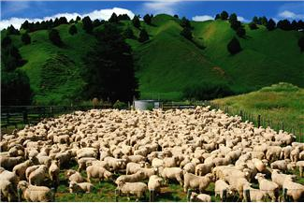
Many Churches are Planted…

Slide 5
Some Passages to Begin
Acts 13-14
Acts 16:11-15
Col 4:12-13 (cf. Acts 19:8-10)

Slide 6
1 Thessalonians 1:1-10
Requirements for Church Planting
SOWER
SPIRIT
SEED
SOIL
Source: Charles Brock, Indigenous Church Planting

Slide 7
Many Churches are Planted…

Slide 8
Why?

Slide 9
Concerns of Today
Poor Definition of Church Planting
Lack of Missionaries in Church Planting
The Down Shift

Slide 10

POOR DEFINITION

Slide 11
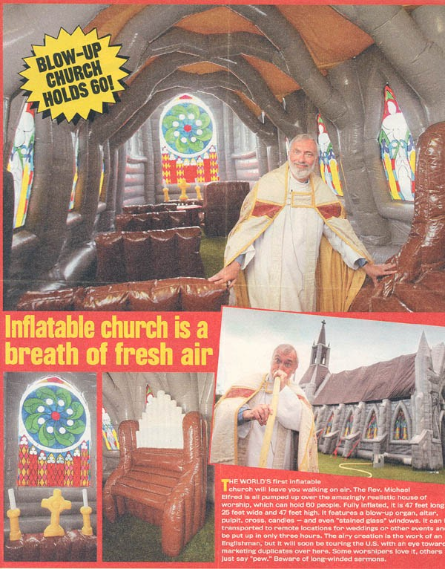
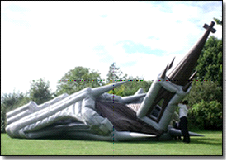



If It Is About Planting Churches…

Slide 12

It Is About Making Disciples
Biblical Church Planting Is Evangelism That Results In New Churches

Slide 13
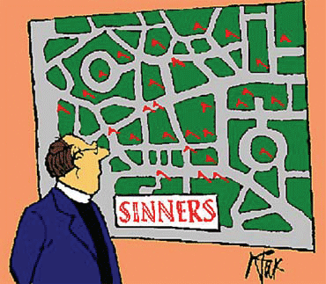
So, If It Is About Making Disciples…
Then What Are We Planting?

Slide 14
What are we planting?
Kingdom Confession
Kingdom Ethic
Kingdom Commission
Matt 18:15-20
Matt 22:37-40
Matt 28:18-20
“one another” passages
Matt 16:13-19
Matt 28:18-20
Kingdom Citizens

Slide 15
What Are We Planting?
Kingdom Communities (i.e., local churches)
Live According to the Kingdom Ethic in Relation to God, other Kingdom Citizens, and the World
Kingdom Citizens

Slide 16

FEW MISSIONARIES FOR THE TASK

Slide 17
Which Would You Desire?
10/100%
Or
100/10%

Slide 18

THE DOWN SHIFT

Slide 19
HOW CAN WE CHANGE REALITY?

Slide 20

What You Want in the End, Put in at the Beginning

Slide 21







Slide 22
GUIDELINES FOR THE JOURNEY
Prayerfully Cast the Seed Broadly (P.A.W.)
Spend More Time with the Most Receptive

Slide 24
GUIDELINES FOR THE JOURNEY
Prayerfully Cast the Seed Broadly (P.A.W.)
Spend More Time with the Most Receptive
Work Through the Social Networks of New Believers

Slide 25
Church Planting Team

Slide 26
Church Planting Team
Person of Peace

Slide 27
Creating a Culture of Evangelism
Evaluate and Adjust the Leadership (intentionality and story-telling)
Learn from Your Past and Train Others
Preach and Teach It
Communicate that the Corporate Gathering is to Compliment not Substitute for Personal Evangelism (I³)

Slide 28
If the core group is not evangelistic before the first public worship gathering, they usually are not going to be evangelistic in the future.
Develop your team with people who have a history of evangelistic lifestyles.
Develop strategies that advocate that the church will be planted from out of the harvest (90-100% new believers).

Slide 29
The Good News: Bridging the Gap through Evangelism
One8 Network: 2011 Boot Camp, August 8-9, Hernando, Mississippi

