Slide 1
“Neighbors to the Nations”
Boone’s Creek Baptist Church
Lexington, Kentucky
September 11, 2011

Slide 2
J. D. Payne
Email: jpayne@sbts.edu
Phone: 502-897-4307
Twitter: @jd_payne
Blog: www.jdpayne.org www.northamericanmissions.org
Contact Information

Slide 3
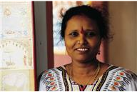
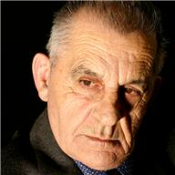
The Strangers Next Door

Slide 4
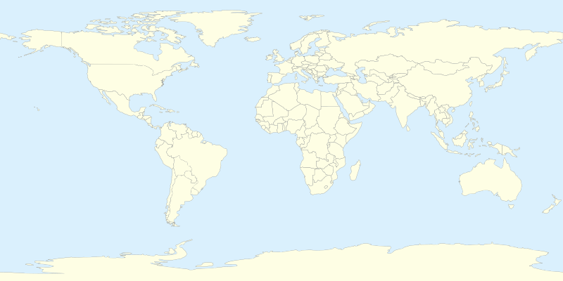
Acts 17: 26-27

Slide 5
7 Million
International Migrants, 2010
Source: United Nations

Slide 6
43 Million
International Migrants, 2010
Source: United Nations

Slide 7
20% of World’s International Migrations

Slide 8
3% of World’s International Migrations

Slide 9
1933
Estimated Numbers of Unreached People Groups
Source: Global Research Department, International Mission Board
448

Slide 10
Countries with Highest Numbers of UPGs (source: Operation World 7th ed.)
Rank | Country | Unreached People Groups
1 | India | 2,223
2 | China, PRC | 427
3 | Pakistan | 374
4 | Bangladesh | 353
5 | Nepal | 325
6 | Indonesia | 200
7 | Sudan | 138
8 | Laos | 134
9 | Iran | 93
10 | Russia | 77
11 | Thailand | 75
12 | Chad | 72
13 | Afghanistan | 71
14 | Nigeria | 67
15 | Sri Lanka | 64
16 | Vietnam | 63
17 | United States | 59
18 | Brazil | 58
19 | Malaysia | 56
20 | Myanmar | 51
Rank | Country | Unreached People Groups
21 | Kazakhstan | 41
22 | Israel | 40
23 | Turkey | 38
24 | Mali | 37
25 | Uzbekistan | 37
26 | Algeria | 35
27 | Kenya | 35
28 | Côte d’Ivoire | 34
29 | Tanzania | 33
30 | France | 33
31 | Bhutan | 32
32 | Cambodia | 30
33 | Guinea | 29
34 | Burkina Faso | 28
35 | Libya | 28
36 | Niger | 28
37 | United Kingdom | 28
38 | Senegal | 27
39 | Kyrgyzstan | 27
40 | Tajikistan | 27

Slide 11
Rank | Country | 2009/10 | Percent of Total
 | World Total | 690,923 | 100
1 | China | 127,628 | 18.5
2 | India | 104,897 | 15.2
3 | South Korea | 72,153 | 10.4
4 | Canada | 28,145 | 4.1
5 | Taiwan | 26,685 | 3.9
6 | Japan | 24,842 | 3.6
7 | Saudi Arabia | 15,810 | 2.3
8 | Mexico | 13,450 | 1.9
9 | Vietnam | 13,112 | 1.9
10 | Turkey | 12,397 | 1.8
Top Places of Origin for International Students in the U. S., 2009-2010

Slide 12
Rank | Country | 2009/10 | Percent of Total
 | World Total | 690,923 | 100
11 | Nepal | 11,233 | 1.6
12 | Germany | 9,548 | 1.4
13 | United Kingdom | 8,861 | 1.3
14 | Brazil | 8,786 | 1.3
15 | Thailand | 8,531 | 1.2
16 | Hong Kong | 8,034 | 1.2
17 | France | 7,716 | 1.1
18 | Indonesia | 6,943 | 1.0
19 | Columbia | 6,920 | 1.0
20 | Nigeria | 6,568 | 1.0
Top Places of Origin for International Students in the U. S., 2009-2010

Slide 13
Country | Refugees | Asylum-Seekers (pending cases)
Canada | 169,434 | 61,170
U. S. | 275,461 | 63,803
Refugee and Asylum Seekers, 2009
Notes:
UNHCR, “2009 Global Trends: Refugees, Asylum-seekers, Returnees, Internally Displaced and Stateless Persons,” (Geneva: United Nations High Commissioner for Refugees, 2010), 24-26. [on-line] http://www.unhcr.org/4c11f0be9.html; accessed 23 January 2011.

Slide 14
Country | Number
Iraq | 18,838
Burma | 18,202
Bhutan | 13,452
Iran | 5,381
Cuba | 4,800
Somalia | 4,189
Eritrea | 1,571
Vietnam | 1,486
Congo, Democratic Republic | 1,135
Burundi | 762
Other | 4,786
Refugee Arrivals in the U.S. by Country of Nationality, 2009
Notes:
UNHCR, “2009 Global Trends: Refugees, Asylum-seekers, Returnees, Internally Displaced and Stateless Persons,” (Geneva: United Nations High Commissioner for Refugees, 2010), 24-26. [on-line] http://www.unhcr.org/4c11f0be9.html; accessed 23 January 2011.

Slide 15
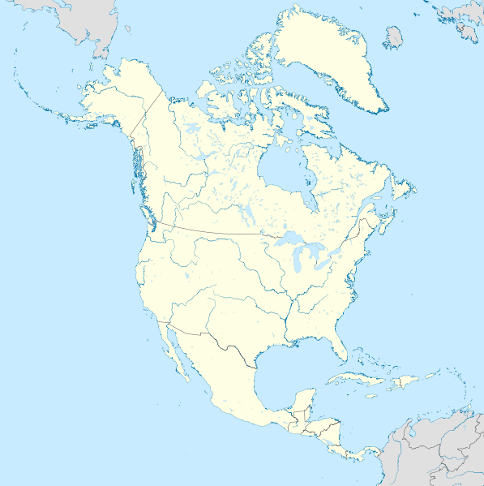

Slide 20
From Baltimore to Nepal—From New York to West Africa

Slide 21
Who Are The Strangers Next Door to You?

Slide 22
Remember the P.A.W.
Pray
Act
Watch

Slide 23
“Neighbors to the Nations”
Boone’s Creek Baptist Church
Lexington, Kentucky
September 11, 2011

