Slide 1
Examining Evangelical Concentrations and International Migrations in the United States and Canada: A Call for More and Better Urban Research
Evangelical Missiological Society
Scottsdale, Arizona
September 29-October 1, 2011

Slide 2
J. D. Payne
Email: jpayne@sbts.edu
Phone: 502-897-4307
Twitter: @jd_payne
Blog: www.jdpayne.org www.northamericanmissions.org
Contact Information

Slide 3
Value
X

Slide 4
Value
X

Slide 5
Value
X

Slide 7
Case Study #1: Evangelical Concentrations in the United States and Canada

Slide 8
What is Our Urban Perspective?

Slide 9
At 35,000 Feet?

Slide 10
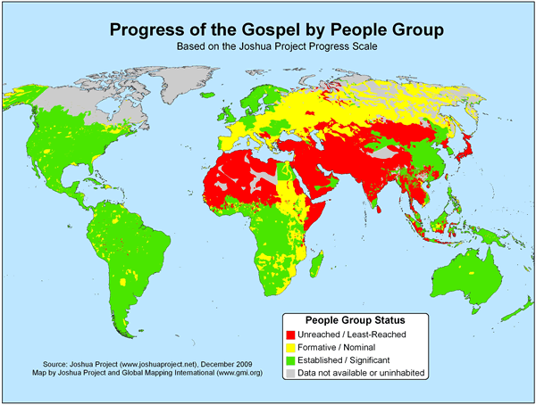

Slide 11
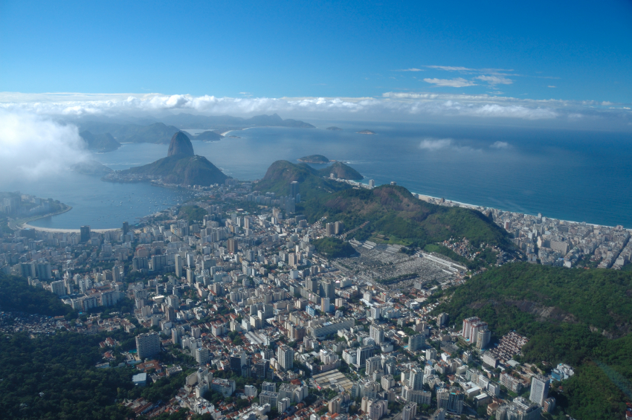
At 15,000 Feet?

Slide 12
Evangelical Percentages
Evangelical Churches to Population Ratios
What We Know

Slide 13
Best Data is 10 Years Old for U. S./5 Years Old for Canada
Questionable Definition of “Evangelical” and inclusion of “Adherents”
Limitations Affecting What We Know

Slide 14
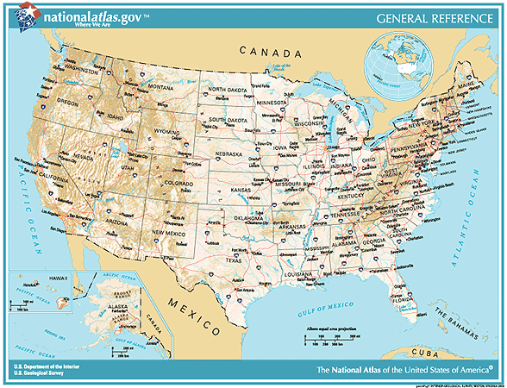
United States Metro Areas 5% or less evangelical

Slide 15
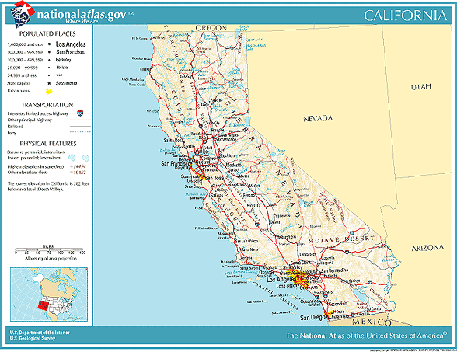
California
Salinas, CA
4.7% evangelical 109 evangelical churches total population: 401,762
people per church: 3,686
Statistic Source: The Association of Religion Data Archives

Slide 16
Connecticut
Hartford, CT
2.7% evangelical 152 evangelical churches total population: 1,148,618
people per church: 7,557
New London-Norwich, CT
2.5% evangelical 40 evangelical churches total population: 259,088
people per church: 6,477
Statistic Source: The Association of Religion Data Archives

Slide 17
Iowa
Dubuque, IA
3.1% evangelical 13 evangelical churches total population: 89,143
people per church: 6,857
Statistic Source: The Association of Religion Data Archives

Slide 18
Maine
Bangor, ME
3.8% evangelical 41 evangelical churches total population: 144,919
people per church: 3,535
Lewiston-Auburn, ME
5% evangelical 25 evangelical churches total population: 103,793
people per church: 4,152
Portland, ME
3.8% evangelical 58 evangelical churches total population: 265,612
people per church: 4,580
Statistic Source: The Association of Religion Data Archives

Slide 19
Massachusetts
Boston-Worcester-Lawrence-Lowell-Brockton, MA
2.5% evangelical 778 evangelical churches total population: 6,057,826
people per church:7,786
Pittsfield, MA
1.5% evangelical 14 evangelical churches total population: 134,953
people per church: 9,640
Springfield, MA
1.9% evangelical 62 evangelical churches total population: 608,479
people per church: 9,814
Barnstable-Yarmouth, MA
1.5% evangelical 25 evangelical churches total population: 222,230
people per church: 8,889
Statistic Source: The Association of Religion Data Archives

Slide 20
Nevada
Reno, NV
4.6% evangelical 72 evangelical churches total population: 339,486
people per church: 4,715
Statistic Source: The Association of Religion Data Archives

Slide 21
New Jersey
Philadelphia-Wilmington-Atlantic City, PA-NJ-DE
3.6% evangelical 1,085 evangelical churches total population 6,188,463
people per church: 5,704
Reno, NV
4.6% evangelical 72 evangelical churches total population: 339,486
people per church: 4,715
Statistic Source: The Association of Religion Data Archives

Slide 22
New York
Utica-Rome, NY
3.4% evangelical 62 evangelical churches total population: 299,896
people per church: 4,837
Glens Falls, NY
3.1% evangelical 29 evangelical churches total population: 124,345
people per church: 4,288
Syracuse, NY
3.7% evangelical 145 evangelical churches total population: 732,117
people per church: 5,049
Albany-Schenectady-Troy, NY
2.7% evangelical 150 evangelical churches total population: 875,583
people per church: 5,837
Rochester, NY
4.1% evangelical 216 evangelical churches total population: 1,098,201
people per church: 5,084
New York – Northern New Jersey – Long Island, NY-NJ-CT-PA
2.3% evangelical 2478 evangelical churches total population: 21,104,292
people per church: 8,517
Binghamton, NY
4.4% evangelical 72 evangelical churches total population 252,320
people per church: 3,504
Statistic Source: The Association of Religion Data Archives

Slide 23
Rhode Island
Providence-Warwick-Pawtucket, RI
1.7% evangelical 117 evangelical churches total population: 962,886
people per church: 8,230
Statistic Source: The Association of Religion Data Archives

Slide 24
Pennsylvania
Scranton--Wilkes-Barre—Hazelton, PA
3.1% evangelical 132 evangelical churches total population: 624,776
people per church: 4,733
Allentown-Bethlehem-Easton, PA
2.8% evangelical 97 evangelical churches total population: 637,985
people per church: 6,577
Pittsburgh, PA
5% evangelical 593 evangelical churches total population: 2,358,695
people per church: 3,978
Reading, PA
4% evangelical 93 evangelical churches total population: 373,638
people per church: 4,018
Statistic Source: The Association of Religion Data Archives

Slide 25
Texas
Laredo, TX
3.9% evangelical 42 evangelical churches total population 193,117
people per church: 4,598
Statistic Source: The Association of Religion Data Archives

Slide 26
Utah
Salt Lake City-Ogden, Utah
2.3% evangelical 136 evangelical churches total population: 1,333,914
people per church: 9,808
Provo-Orem, Utah
0.6% evangelical 20 evangelical churches total population: 368,536
people per church: 18,427
Statistic Source: The Association of Religion Data Archives

Slide 27
Vermont
Burlington, VT
2.9% evangelical 30 evangelical churches total population: 198,889
people per church: 6,630
Statistic Source: The Association of Religion Data Archives

Slide 28
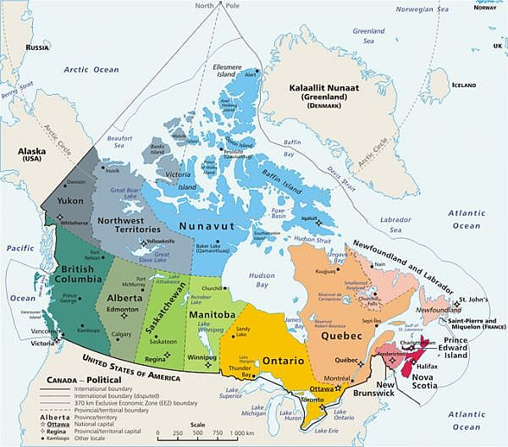
Evangelicals in Selected Canadian Metropolitan Areas
Source: Lorne Hunter, Outreach Canada
Map: Natural Resources Canada

Slide 29
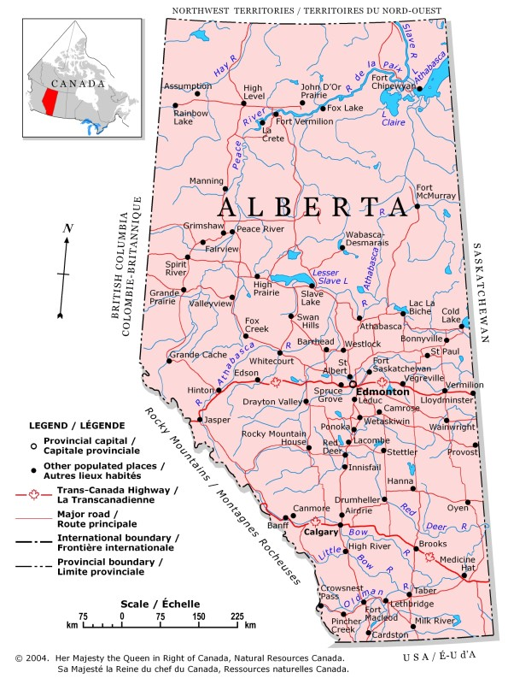
Alberta
Edmonton
Total Population: 1,050,046
evangelical churches: 307
People per Church: 3,420
Calgary
Total Population: 1,107,242
evangelical churches: 290
People per Church: 3,818
Source: Lorne Hunter, Outreach Canada
Map: Natural Resources Canada

Slide 30
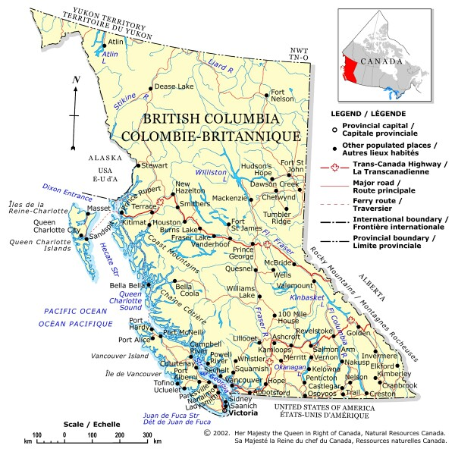
British Columbia
Vancouver
Total Population: 2,236,068
evangelical churches: 684
People per Church: 3,269
Victoria
Total Population: 334,332
evangelical churches: 91
People per Church: 3,674
Source: Lorne Hunter, Outreach Canada
Map: Natural Resources Canada

Slide 31
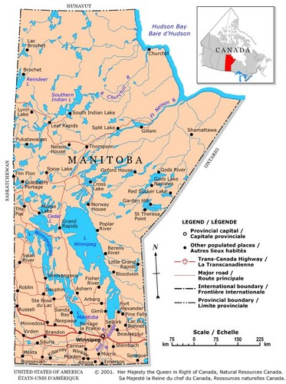
Manitoba
Winnipeg
Total Population: 706,749
evangelical churches: 223
People per Church: 3,169
Source: Lorne Hunter, Outreach Canada
Map: Natural Resources Canada

Slide 32
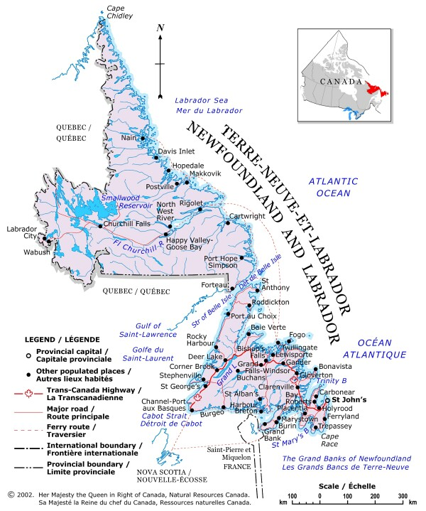
Newfoundland
St. John’s
Total Population: 181, 394
evangelical churches: 27
People per Church: 6,718
Source: Lorne Hunter, Outreach Canada
Map: Natural Resources Canada

Slide 33
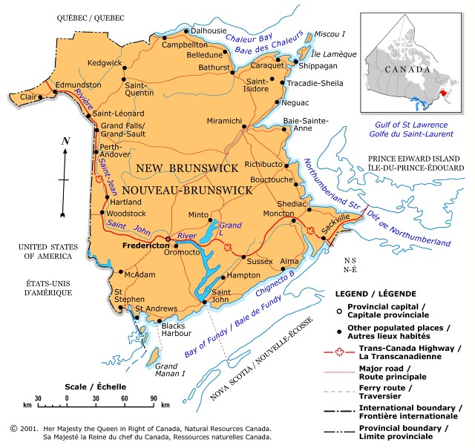
New Brunswick
Saint John
Total Population: 125,944
evangelical churches: 60
People per Church: 2,099
Source: Lorne Hunter, Outreach Canada
Map: Natural Resources Canada

Slide 34
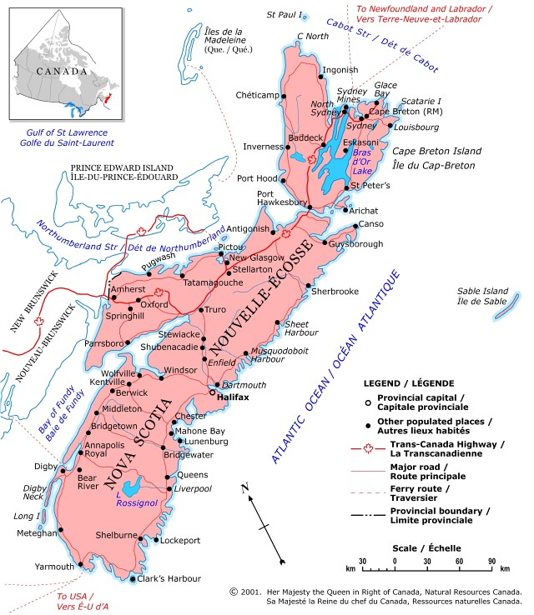
Nova Scotia
Halifax
Total Population: 382,203
evangelical churches: 108
People per Church: 3,539
Source: Lorne Hunter, Outreach Canada
Map: Natural Resources Canada

Slide 35
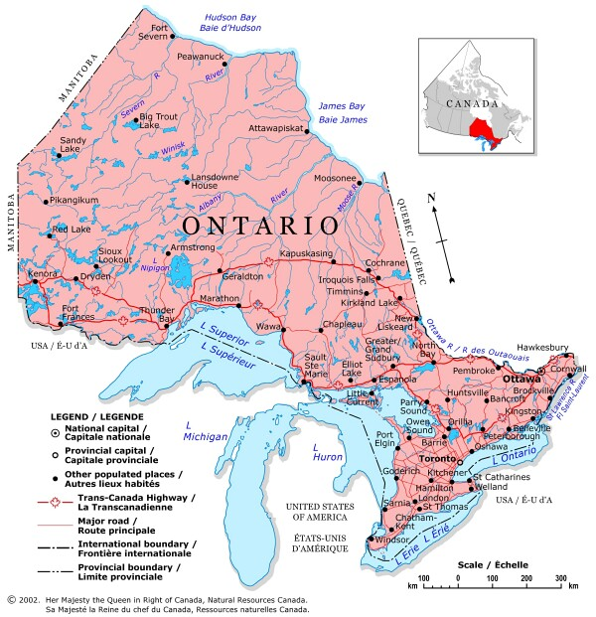
Ontario
Thunder Bay
Total Population: 125,359
evangelical churches: 39
People per Church: 3,214
Greater Sudbury
Total Population: 161,983
evangelical churches: 34
People per Church: 4,764
Ottawa-Gatineau
Total Population: 1,158,314
evangelical churches: 189
People per Church: 6,129
Kingston
Total Population: 154,971
evangelical churches: 43
People per Church: 3,604
Hamilton
Total Population: 716, 230
evangelical churches: 196
People per Church: 3,654
Oshawa
Total Population: 344,374
evangelical churches: 64
People per Church: 5,381
London
Total Population: 465,720
evangelical churches: 139
People per Church: 3,351
Toronto
Total Population: 5,406,324
evangelical churches: 1,034
People per Church: 5,229
Windsor
Total Population: 332,066
evangelical churches: 88
People per Church: 3,773
St. Catherine’s-Niagara
Total Population: 396,754
evangelical churches: 166
People per Church: 2,390
Source: Lorne Hunter, Outreach Canada
Map: Natural Resources Canada

Slide 36
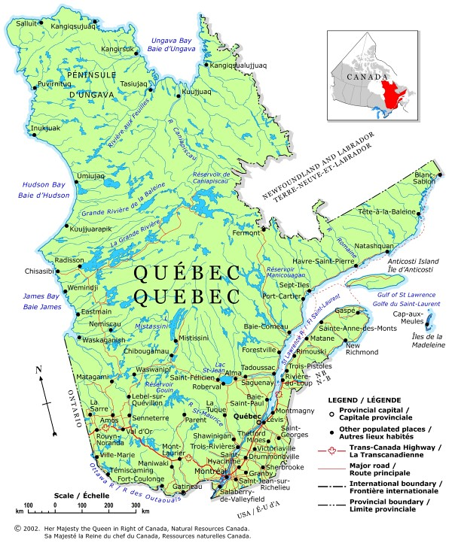
Quebec
Saguenay
Total Population: 152,132
evangelical churches: 7
People per Church: 21,733
Trois-Rivieres
Total Population: 142,614
evangelical churches: 15
People per Church: 9,508
Quebec
Total Population: 723,263
evangelical churches: 31
People per Church: 23,331
Montreal
Total Population: 3,666,280
evangelical churches: 422
People per Church: 8,688
Sherbrooke
Total Population: 164,685
evangelical churches: 19
People per Church: 8,668
Source: Lorne Hunter, Outreach Canada
Map: Natural Resources Canada

Slide 37
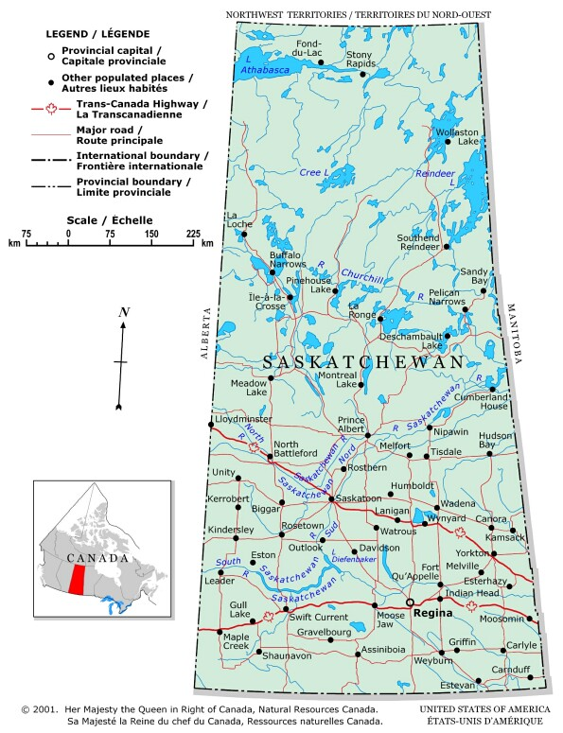
Saskatchewan
Saskatoon
Total Population: 235,464
evangelical churches: 101
People per Church: 2,331
Regina
Total Population: 198,316
evangelical churches: 63
People per Church: 3,148
Source: Lorne Hunter, Outreach Canada
Map: Natural Resources Canada

Slide 38
Case Study #2: International Migrations to the United States and Canada

Slide 39
Country of Birth
Populations by Country of Birth
Enclaves (to some degree)
What We Know

Slide 40
Unknown Ethno-linguistic Characteristics
Unknown Evangelical Percentages by People Group
Unknown Receptivity Levels
Unknown Generational Matters
Unknown Global Social Networks
Unknown Harvest Force
Limitations Affecting What We Know

Slide 41
Country | Estimated number of international migrants at mid-year, 2010 | As Percentage of Global Total
United States | 42,813,281 | 20
Canada | 7,202,340 | 3.4
Notes:
Source: United Nations, “The International Migrant Stock—2008 Revision,” [on-line] http://esa.un.org/migration/index.asp?panel=1; accessed 15 February, 2011.

Slide 42
Country | UPGs, Joshua Project | UPGs, Joshua Project using 2% Definition (and including groups with unknown Evangelical %) | UPGs, Global Research
Canada | 16 | 42 | 193
U. S. | 60 | 326 | 448
Totals | 76 | 368 | 641
ASSUMPTIONS

Slide 43
Top Places of Origin for International Students in the U. S., 2009-2010
Notes:
Taken from http://www.iie.org/en/Research-and-Publications/~/media/Files/Corporate/Open-Doors/Fast-Facts/Fast%20Facts%202010.ashx; accessed 28 February, 2011.

Slide 44
Rank | Country | 2009/10 | Percent of Total
 | World Total | 690,923 | 100
1 | China | 127,628 | 18.5
2 | India | 104,897 | 15.2
3 | South Korea | 72,153 | 10.4
4 | Canada | 28,145 | 4.1
5 | Taiwan | 26,685 | 3.9
6 | Japan | 24,842 | 3.6
7 | Saudi Arabia | 15,810 | 2.3
8 | Mexico | 13,450 | 1.9
9 | Vietnam | 13,112 | 1.9
10 | Turkey | 12,397 | 1.8

Slide 45
Rank | Country | 2009/10 | Percent of Total
 | World Total | 690,923 | 100
11 | Nepal | 11,233 | 1.6
12 | Germany | 9,548 | 1.4
13 | United Kingdom | 8,861 | 1.3
14 | Brazil | 8,786 | 1.3
15 | Thailand | 8,531 | 1.2
16 | Hong Kong | 8,034 | 1.2
17 | France | 7,716 | 1.1
18 | Indonesia | 6,943 | 1.0
19 | Columbia | 6,920 | 1.0
20 | Nigeria | 6,568 | 1.0

Slide 46
Refugee and Asylum Seekers, 2009
Notes:
UNHCR, “2009 Global Trends: Refugees, Asylum-seekers, Returnees, Internally Displaced and Stateless Persons,” (Geneva: United Nations High Commissioner for Refugees, 2010), 24-26. [on-line] http://www.unhcr.org/4c11f0be9.html; accessed 23 January 2011.

Slide 47
Country | Refugees | Asylum-Seekers (pending cases)
Canada | 169,434 | 61,170
U. S. | 275,461 | 63,803
Notes:
UNHCR, “2009 Global Trends: Refugees, Asylum-seekers, Returnees, Internally Displaced and Stateless Persons,” (Geneva: United Nations High Commissioner for Refugees, 2010), 24-26. [on-line] http://www.unhcr.org/4c11f0be9.html; accessed 23 January 2011.

Slide 48
Refugee Arrivals in the U.S. by Country of Nationality, 2009
Notes:
Daniel C. Martin, “Refugees and Asylees: 2009,” Annual Flow Report, Office of Immigration Statistics, 3 [on-line] http://www.dhs.gov/xlibrary/assets/statistics/publications/ois_rfa_fr_2009.pdf; accessed 24 January, 2011.

Slide 49
Country | Number
Iraq | 18,838
Burma | 18,202
Bhutan | 13,452
Iran | 5,381
Cuba | 4,800
Somalia | 4,189
Eritrea | 1,571
Vietnam | 1,486
Congo, Democratic Republic | 1,135
Burundi | 762
Other | 4,786
Notes:
UNHCR, “2009 Global Trends: Refugees, Asylum-seekers, Returnees, Internally Displaced and Stateless Persons,” (Geneva: United Nations High Commissioner for Refugees, 2010), 24-26. [on-line] http://www.unhcr.org/4c11f0be9.html; accessed 23 January 2011.

Slide 50
The North American and International Significance for Urban Research

Slide 51
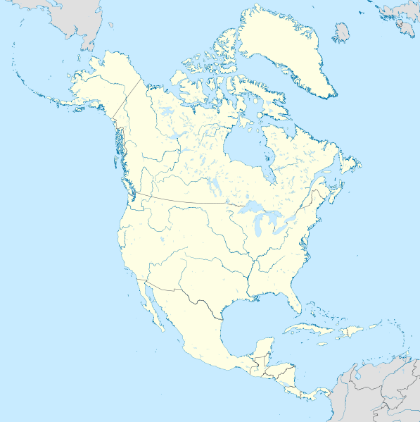

Slide 54
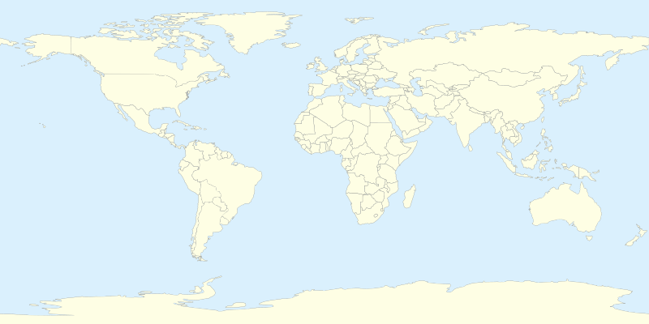

Slide 57
What is Needed?

Slide 58
A missiology that embraces urban research for North America
A recognition that better urban research at home has significant implications for labors abroad

Slide 59
The development of support networks for a cadre of urban researchers at both the professional and volunteer levels.
The collaborative efforts across Evangelical lines to conduct, share, and disseminate findings as quickly as possible

