Slide 1
2012 National Missions Symposium
Baptist Missionary Association of America
January 17-18, Conway, Arkansas

Slide 2
Contact Information
J.D. Payne
(502) 897-4307
Twitter: @jd_payne
jpayne@sbts.edu
Blog: www.jdpayne.org
Web site: www.northamericanmissions.org

Slide 3
Issues Affecting Church Multiplication
Sovereignty of God
Context
Church (Institutional) Factors
Notes:
Introductory notes.

Slide 4
“Church Multiplication and the Plans of Man, and the Purpose of God”
Prov 19:21; Acts 16:1-15

Slide 5
What is the Biblical Paradigm for Church Planting?

Slide 6
Evangelism that Results in New Churches
Ex. Acts 13-14

Slide 7
Considering the Evidence
Biblical Evidence
Evangelistic Evidence
Demographic Evidence
Cultural Evidence
Historical Evidence
Economic Evidence
Denominational Evidence

Slide 8
What are we planting?
Kingdom Confession
Kingdom Ethic
Kingdom Commission
Matt 18:15-20
Matt 22:37-40
Matt 28:18-20
“one another” passages
Matt 16:13-19
Matt 28:18-20
Kingdom Citizens

Slide 9
What are we planting?
Kingdom Communities (i.e., local churches)
Live according to the Kingdom Ethic in relation to God, other Kingdom Citizens, and the World
Kingdom Citizens

Slide 10
Complexity
Reproducibility

Slide 11
The 4 Requirements

Slide 12
A Glimpse of Church Multiplication:
In the Majority World

Slide 13
Issues Affecting Church Multiplication
Sovereignty of God
Context
Church (Institutional) Factors
Notes:
Introductory notes.

Slide 14
Present Realities

Slide 15
Arkansas: 43% evangelical, 586 people per church
Statistic Source: The Association of Religion Data Archives
Presentation by: The Church Planting Center, The Southern Baptist Theological Seminary, 2009

Slide 16
Alabama: 41% evangelical, 717 people per church
Statistic Source: The Association of Religion Data Archives
Presentation by: The Church Planting Center, The Southern Baptist Theological Seminary, 2009

Slide 17
Kentucky: 34% evangelical, 788 people per church
Statistic Source: The Association of Religion Data Archives
Presentation by: The Church Planting Center, The Southern Baptist Theological Seminary, 2009

Slide 18
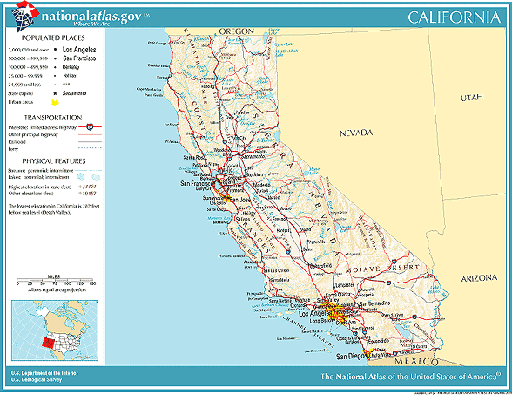
California: 7% evangelical; 3,760 people per church
Statistic Source: The Association of Religion Data Archives
Presentation by: The Church Planting Center, The Southern Baptist Theological Seminary, 2009

Slide 19
Maine: 3% evangelical, 3,783 people per church
Statistic Source: The Association of Religion Data Archives
Presentation by: The Church Planting Center, The Southern Baptist Theological Seminary, 2009

Slide 20
Nevada: 5% evangelical, 5,124 people per church
Statistic Source: The Association of Religion Data Archives
Presentation by: The Church Planting Center, The Southern Baptist Theological Seminary, 2009

Slide 21
Pennsylvania: 6% evangelical, 3,014 people per church
Statistic Source: The Association of Religion Data Archives
Presentation by: The Church Planting Center, The Southern Baptist Theological Seminary, 2009

Slide 22
OhIo: 10% evangelical, 2,254 people per church
Statistic Source: The Association of Religion Data Archives
Presentation by: The Church Planting Center, The Southern Baptist Theological Seminary, 2009

Slide 23
Utah: 2% evangelical, 8,589 people per church
Statistic Source: The Association of Religion Data Archives
Presentation by: The Church Planting Center, The Southern Baptist Theological Seminary, 2009

Slide 24
Vermont: 2% evangelical, 4,349 people per church
Statistic Source: The Association of Religion Data Archives
Presentation by: The Church Planting Center, The Southern Baptist Theological Seminary, 2009

Slide 25
Massachusetts: 2% evangelical, 8,078 people per church
Barnstable and Yarmouth
Statistic Source: The Association of Religion Data Archives
Presentation by: The Church Planting Center, The Southern Baptist Theological Seminary, 2009

Slide 26
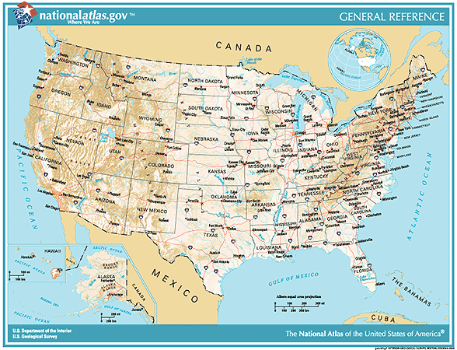
Evangelicals in Selected Counties

Slide 27
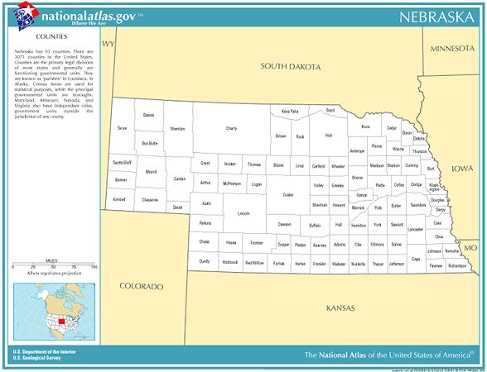
Nebraska
Logan
0 % evangelical
0 evangelicals
Total population:774
0 evangelical churches
0 people per church
Arthur
0 % evangelical
0 evangelicals
Total population: 444
0 evangelical churches
0 people per church
Statistic Source: The Association of Religion Data Archives
Presentation by: The Church Planting Center, The Southern Baptist Theological Seminary, 2009

Slide 28
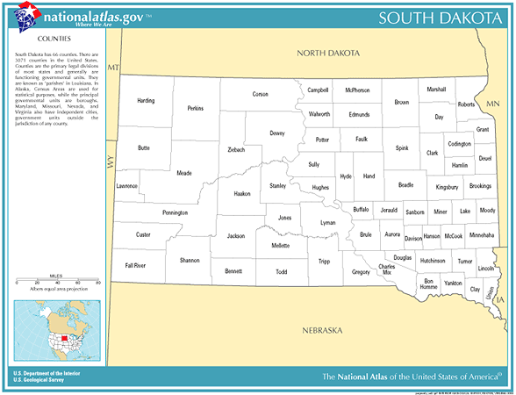
South Dakota
Buffalo
0 % evangelical
0 evangelicals
Total population:2,032
0 evangelical churches
0 people per church
Statistic Source: The Association of Religion Data Archives
Presentation by: The Church Planting Center, The Southern Baptist Theological Seminary, 2009

Slide 29
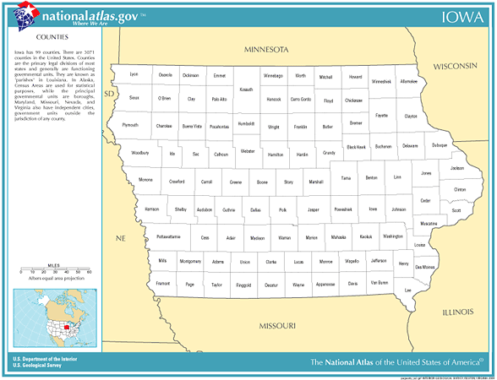
Iowa
Winneshiek
1.7% evangelical
372 evangelicals
Total population: 21,310
4 evangelical churches
5,328 people per church
Dubuque
3.1% evangelical
2,780 evangelicals
Total population: 89,143
13 evangelical churches
6,857 people per church
Jackson
0.6% evangelical
128 evangelicals
Total population: 20,296
3 evangelical churches
6,765 people per church
Johnson
5.4% evangelical
6,014 evangelicals
Total population: 111,006
29 evangelical churches
3,828 people per church
Statistic Source: The Association of Religion Data Archives
Presentation by: The Church Planting Center, The Southern Baptist Theological Seminary, 2009

Slide 30
United States Metro Areas less than 3% evangelical

Slide 31
Utah
Salt Lake City-Ogden, Utah
2.3% evangelical 136 evangelical churches total population: 1,333,914
people per church: 9,808
Provo-Orem, Utah
0.6% evangelical 20 evangelical churches total population: 368,536
people per church: 18,427
Statistic Source: The Association of Religion Data Archives
Presentation by: The Church Planting Center, The Southern Baptist Theological Seminary, 2009

Slide 32
Massachusetts
Boston-Worcester-Lawrence-Lowell-Brockton, MA
2.5% evangelical 778 evangelical churches total population: 6,057,826
people per church:7,786
Pittsfield, MA
1.5% evangelical 14 evangelical churches total population: 134,953
people per church: 9,640
Barnstable-Yarmouth, MA
1.5% evangelical 25 evangelical churches total population: 222,230
people per church: 8,889
Springfield, MA
1.9% evangelical 62 evangelical churches total population: 608,479
people per church: 9,814
Statistic Source: The Association of Religion Data Archives
Presentation by: The Church Planting Center, The Southern Baptist Theological Seminary, 2009

Slide 33
Rhode Island
Providence-Warwick-Pawtucket, RI
1.7% evangelical 117 evangelical churches total population: 962,886
people per church: 8,230
Statistic Source: The Association of Religion Data Archives
Presentation by: The Church Planting Center, The Southern Baptist Theological Seminary, 2009

Slide 34
Connecticut
Hartford, CT
2.7% evangelical 152 evangelical churches total population: 1,148,618
people per church: 7,557
New London-Norwich, CT
2.5% evangelical 40 evangelical churches total population: 259,088
people per church: 6,477
Statistic Source: The Association of Religion Data Archives
Presentation by: The Church Planting Center, The Southern Baptist Theological Seminary, 2009

Slide 35
New York
Albany-Schenectady-Troy, NY
2.7% evangelical 150 evangelical churches total population: 875,583
people per church: 5,837
New York – Northern New Jersey – Long Island, NY-NJ-CT-PA
2.3% evangelical 2478 evangelical churches total population: 21,104,292
people per church: 8,517
Statistic Source: The Association of Religion Data Archives
Presentation by: The Church Planting Center, The Southern Baptist Theological Seminary, 2009

Slide 36
Pennsylvania
Allentown-Bethlehem-Easton, PA
2.8% evangelical 97 evangelical churches total population: 637,958
people per church: 6,577
Statistic Source: The Association of Religion Data Archives
Presentation by: The Church Planting Center, The Southern Baptist Theological Seminary, 2009

Slide 37
Vermont
Burlington, VT
2.9% evangelical 30 evangelical churches total population: 198,889
people per church: 6,630
Statistic Source: The Association of Religion Data Archives
Presentation by: The Church Planting Center, The Southern Baptist Theological Seminary, 2009

Slide 38
Next Steps

Slide 39
Issues Affecting Church Multiplication
Sovereignty of God
Context
Church (Institutional) Factors
Notes:
Introductory notes.

Slide 40
2012 National Missions Symposium
Baptist Missionary Association of America
January 17-18, Conway, Arkansas

Slide 41
Avoid the Nestea Plunge

Slide 42
Calling Out the Missionaries

Slide 43
Prayer Support

Slide 44
Pastoral Mentoring and Accountability

Slide 45
Encouragement
and a Body of Identity

Slide 46
Provide Training

Slide 47
Provide Resources
and Financial Support

Slide 48
Constant Recognition
of the Missionaries

Slide 49
Allow for Much Flexibility-Understand that Missionaries
Do Things Differently

Slide 50
Work with the Missionaries to Establish Clear Expectations

Slide 51
Recognize the Legitimate Nature of the Team and the Newly Planted Church

