Slide 1
CORE: A Great Commission Conference March 19-20, 2012 Concord Baptist Church, Jefferson City, Missouri “Missional Living” J. D. Payne

Slide 2
Contact Information: J. D. Payne jpayne@sbts.edu @jd_payne www.jdpayne.org www.northamericanmissions.org 502-897-4498

Slide 3
Missional Living Occurs. . .

Slide 4
Missional Living Occurs. . .
When Kingdom Citizens Live According to the Kingdom Ethic in the World.

Slide 5
Kingdom
Confession
Impact of the Ethic
Matt 22:37-40
Matt 18:15-20
Matt 28:18-20
Matt 16:13-19
Kingdom Ethic

Slide 6
Kingdom
Confession
Impact of the Ethic
Matt 22:37-40
Matt 18:15-20
Matt 28:18-20
Matt 16:13-19
Kingdom Ethic

Slide 7
The Relational Integration of the Kingdom Ethic
Kingdom Communities (i.e., local churches)
Live According to the Kingdom Ethic in Relation to God, other Kingdom Citizens, and the World
Kingdom Citizens

Slide 8
Missional Living in the World Requires:
Actions
Words
1 Peter 3 Acts 10
Source: Tim Beougher, Southern Seminary

Slide 9
Barriers to Missional Living
Lack of a Spirit-Filled Life
Fear that Paralyzes
Complex Lifestyles that Isolate
Blind to Reality

Slide 10
26% 12%

Slide 11
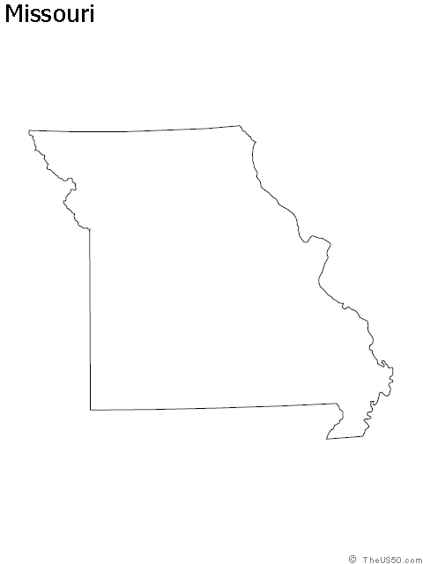
Missouri
25% Evangelical
1,111 People per church

Slide 12
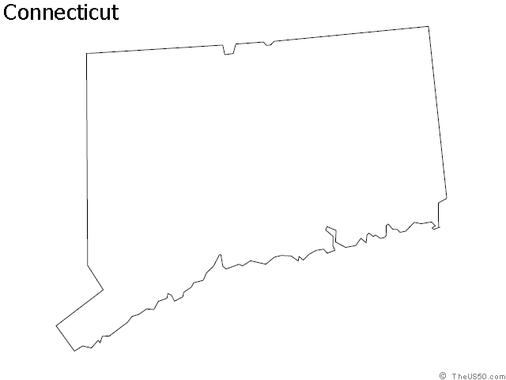
Connecticut
2% evangelical
7,403 people per church
Hartford, CT
2.7% Evangelical
People per church: 7,557
New London-Norwich, CT
2.5% Evangelical
People per church: 6,477

Slide 13
Pennsylvania
6% evangelical
3,014 people per church
Philadelphia-Wilmington-Atlantic City, PA-NJ-DE
3.6% Evangelical
People per church: 5,704
Pittsburgh, PA
5% Evangelical
People per church: 3,978

Slide 14
Utah
2% evangelical
8,589 people per church
Provo-Orem, Utah
0.6% Evangelical
People per church: 18,427

Slide 15
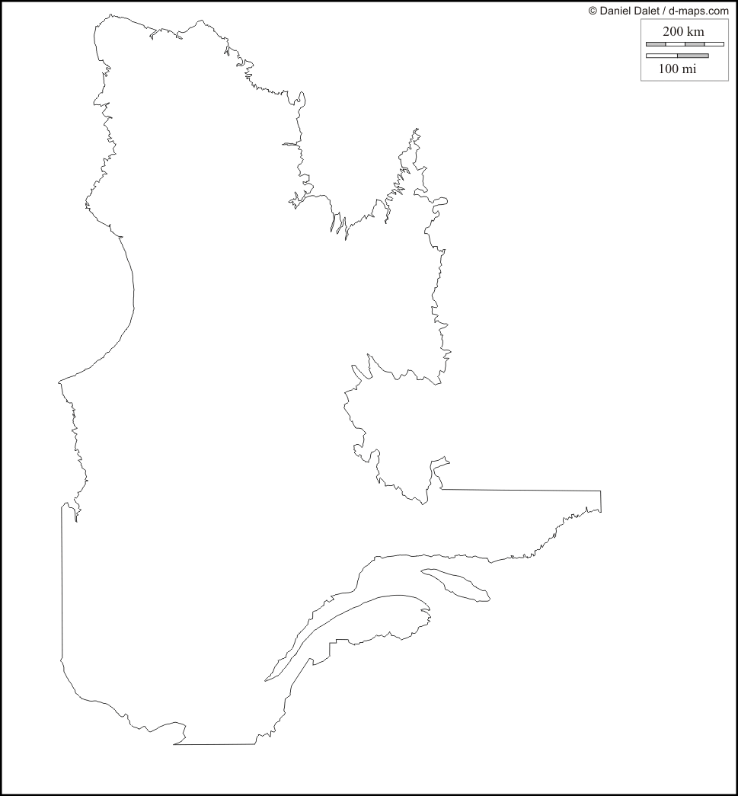
Quebec
Quebec
Total Population: 723,263
Evangelical Churches: 31
People per Church: 23,331
Montreal
Total Population: 3,666,280
Evangelical Churches: 422
People per Church: 8,688

Slide 16
20%

Slide 17
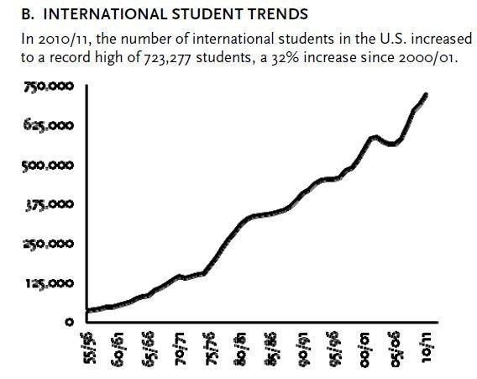
International Student Trends

Slide 18
Missional Living in a Complex World

Slide 19
Six Principles for Missional Living in a Complex World
Colossians 4:2-6

Slide 20
Colossians 4:2-6
Prayerfully
Clarity
Wisely
Intentionally
Graciously
Flexibly

Slide 21
CORE: A Great Commission Conference March 19-20, 2012 Concord Baptist Church, Jefferson City, Missouri “Missional Living” J. D. Payne

