Slide 1
The Legacy of Roland Allen
J. D. Payne
Southeast Region, Evangelical Missiological Society
Wake Forest, North Carolina, March 23-24, 2012

Slide 2
Contact Information: J. D. Payne jpayne@sbts.edu @jd_payne www.jdpayne.org www.northamericanmissions.org 502-897-4498

Slide 3
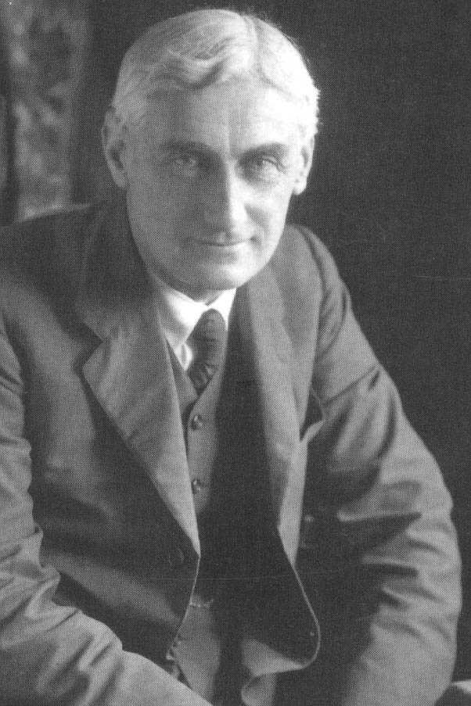
ROLAND ALLEN 1868-1947

Slide 4
“Roland Allen was, in his time, a lonely prophet. His ideas seemed to most of his contemporaries eccentric and unrealistic. I retain vivid memories of my own reading of Allen’s work, when I was beginning missionary service in India. I fought against his ideas—but it was a losing battle. His writing had a kind of bulldog grip, and you could not shake them off. Today many of the things for which he argued are generally accepted: that ordination to the priesthood is not identical with induction into a salaried profession; that Christian disunity is a scandal and an absurdity; that the Eucharist is the essential centre of the life of the Church; and (of course) that the churches of the former ‘mission fields’ ought to be entirely free of dependence on missionary agencies which officiated at their birth. These ideas, radical when Allen canvassed them, are now commonplace. Do we still have anything to learn from this pioneer and prophet? I think so.” -- Lesslie Newbigin, Foreword, in Roland Allen: Pioneer, Priest, and Prophet, by Hubert J. B. Allen, xiii.

Slide 5
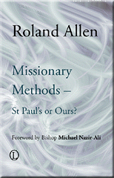

Slide 6
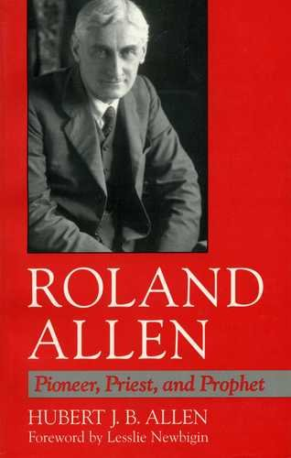

Slide 8
Biographical Sketch
Born to Charles Fletcher (1835-1873) and Priscilla Allen (1839-1935) in England, December 29, 1868
6th of 7 children (2 girls, 5 boys)
Baptized at 4 weeks
Charles died in 1873 while away from family ministering in Central America

Slide 9
Biographical Sketch
Roland won a scholarship to St. John’s College (Oxford)
Won university’s Lothian Prize for essay on Pope Silvester II which was published in The English Historical Review

Slide 10
Biographical Sketch
While an undergraduate at St. John's College he was greatly influenced by the Anglo-Catholic faculty members of Pusey House
Following college, faculty of Pusey House influenced him to attend the High Anglican training school in Leeds

Slide 11
Biographical Sketch
Motive for attending clergy school:
“When I was ordained, I was a child. My idea was to serve God in His Temple. Chiefly that, with a conviction that to be ignorant of God’s Love revealed in Christ was to be in a most miserable state.”

Slide 12
Biographical Sketch
“Moreover, he was always to combine with his High Church emphasis on the Church and the Sacraments an Evangelical concern with a biblical foundation for any arguments and, above all, with the central importance of the Holy Spirit.”
-- Hubert J. B. Allen (19).

Slide 13
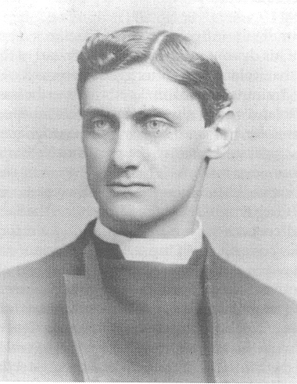
“a refined intellectual man, small not vigorous, in no way burly or muscular… academic and fastidious rather…learning and civilization are more to him than most men”
-- Allen’s Principal

Slide 14
Biographical Sketch
Ordained in 1892 as a deacon in the Anglican Church
1893 became a priest
Served in the Durham diocese in the parish of St. John the Evangelist, Darlington.
Later applied to the Society for the Propagation of the Gospel

Slide 15
Biographical Sketch
“’When I was about four years old and heard that there were men who had never been told the Gospel,’ recounted Roland in his old age, he had cried out: ‘Then I shall go and tell them’.”
-- Hubert J. B. Allen, 21.

Slide 16
Biographical Sketch
Was rejected by the Society due to a “Heart Condition”
Applied to the independent Church of England to North China to be a missionary
1894 accepted by Mission
1895 completed his curacy

Slide 17
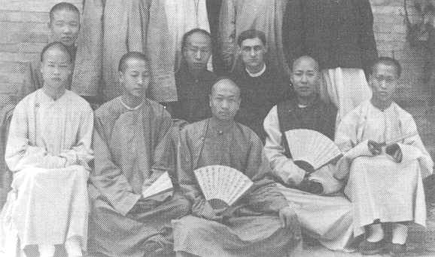
Went to China and quickly learned the language
Oversaw non-Christian day school

Slide 18
Biographical Sketch
Opened a clergy school in the northern part of China
While in China he also oversaw a printing press, became a chaplain at a Legation

Slide 19
Biographical Sketch
Started writing for the Mission’s quarterly journal, The Land of Sinim

Slide 20
Biographical Sketch
1900 was in the Boxer Rebellion
Kept a detailed journal of the uprising, published in 1901, The Siege of the Peking Legations

Slide 21
“In his view now, English-style theological colleges, such as the clergy school that he had himself been in charge of in Peking, were inappropriate: they do not turn out apostles or evangelists, but deacons. . . As he was later to remark: I saw that if the Church in North China was to have no clergy at all except such as could pass through my little theological school and then be financially supported, Churches could not multiply rapidly” (quoted from “The Establishment of Indigenous Churches,” 1927)
-- Hubert J. B. Allen, 59.

Slide 22
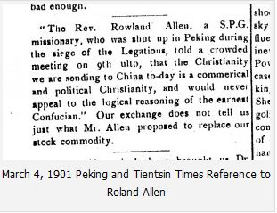

Slide 23
Biographical Sketch
During furlough in England, married Mary Beatrice Tarleton (1863-1960)
Two children: Priscilla Mary (1903-1987) and Iohn Willoughby Tarleton (1904-1979)
1902 Allen and wife departed for China
Started serving at a mission station at Yung Ch’ing
Started to apply missionary principles that were contra paternalism.

Slide 24
As early as 1903, Allen was publicly advocating:
First work of the missionary was training converts in independence
Teach converts to recognize their responsibilities as members of the Church
Never do anything for the converts they can do themselves
Missionaries were to avoid introducing foreign elements unless absolutely essential
Missionaries were always to be retiring from the people
-- Hubert J. B. Allen, 61

Slide 25
Biographical Sketch
Soon had to return to England due to poor health
Mission agency never allowed him to return to China
1904 Allen began serving as a vicar in a rural Buckinghamshire parish of Chalfont St. Peter

Slide 26
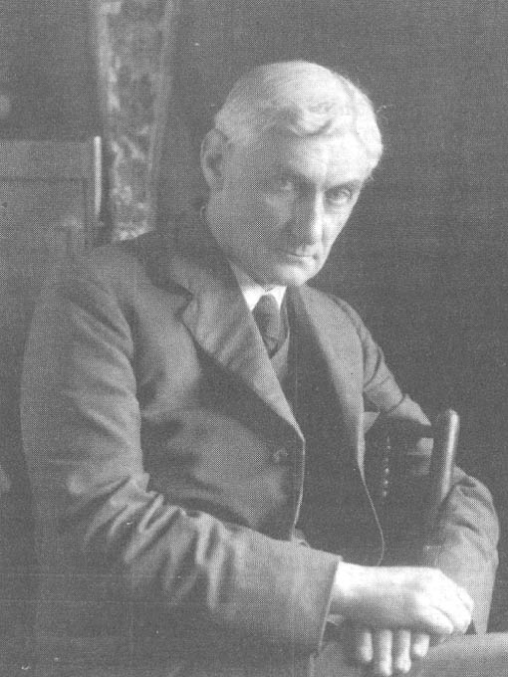
“I was ill, and came home for two years, and began to study the methods of the Apostle St. Paul. From that day forward I began to see light.”

Slide 27
Biographical Sketch
1907 resigned from position as vicar due to theological reasons

Slide 28
Biographical Sketch
Started doing deputation work for a mission organization, assisted ill clergy, and spent much time thinking and writing
1912 published Missionary Methods: St. Paul’s or Ours
1913 published Missionary Principles

Slide 29
Biographical Sketch
1914 developed relationship with Sidney James Wells Clark, wealthy Congregationalist layman and Thomas Cochran, Presbyterian Scotsman missionary-physician
1914 Allen served as a Naval chaplain
1914-1918 he taught Classics in Worcester

Slide 30
Biographical Sketch
1917 partnered together with Clark and Cochran to begin World Dominion Movement, to conduct surveys, research, and publish writings
1917 published booklet, Pentecost and the World
1918 Clark, Cochran, and Allen became involved in the Survey Application Trust and its publishing arm, the World Dominion Press

Slide 31
Biographical Sketch
1919 published Educational Principles and Missionary Methods
Later, Allen’s missiology conflicted with other members of the World Dominion Mvt. yet he continued to be the principal contributor to the journal World Dominion in the 1920s
1923 publishedVoluntary Clergy

Slide 32
Biographical Sketch
1924 extensive survey work in Canada
the Canadian experience and several extended visits in the latter 1920s to southern Africa and India also influenced his missiology and confirmed for him many of his controversial thoughts

Slide 33
Biographical Sketch
1927 published The Spontaneous Expansion of the Church and the Causes Which Hinder It
1928 published Voluntary Clergy—Overseas
1929 published Nonprofessional Missionaries
1930 published The Case for Voluntary Clergy

Slide 34
Biographical Sketch
1930s Allen and wife moved to Nairobi, to be near children
Assisted with St. Mark’s Church in Nairobi
Soon left St. Mark’s, believing he was hindering the church

Slide 35
Biographical Sketch
1937 wrote S.J.W. Clark: A Vision of Missions
Learned Swahili and translated and published several Swahili writings into English; all translations were of Muslim texts

Slide 36
Biographical Sketch
June 9, 1947 Allen died
Gravestone is in Nairobi’s City Park. Simple stone cross with the inscription:
ROLAND ALLEN
Clerk in Holy Orders
1868-1947
I AM the Resurrection and the Life Saith the Lord

Slide 37
Missiology of Roland Allen

Slide 38
Missiology
Issue of Theology
Issue of Devolution
Role of the Missionary
Concept of Spontaneous Expansion

Slide 39
The Issue of Theology
His methods become meaningless when separated from his theology
Apostolic Church learned from Jesus’ examples
Two vital areas: ecclesiology and pneumatology

Slide 40
Two Vital Areas
Ecclesiology
Eucharist
Indigenous Churches

Slide 41
Two Vital Areas
Pneumatology
Baptism of Holy Spirit
Missionary Faith

Slide 42
Issue of Devolution

Slide 43
St. Paul, for instance, established a Church when he organized converts with their own proper officers, but he did not organize a Church and then later, and piece by piece, devolve an authority which at first the Church did not possess. He devolved all necessary power and authority upon the Church when he established it. . . . When St. Paul had once established a Church there was nothing left to devolve. We read nowhere of his going back to a Church and adding to its powers by devolving upon it some responsibility or authority which he had before kept in his own hands. Roland Allen, "Devolution: The Question of the Hour," World Dominion 5 (1927): 278.

Slide 44
In the New Testament the idea of a Church is simple. It is an organized body of Christians in a place with its officers. The Christians with their officers are the Church in the place, and they are addressed as such. That is simple and intelligible. That Church is the visible Body of Christ in the place, and it has all the rights and privileges and duties of the Body of Christ. Above it is the Universal Church, composed of all the Churches in the world, and of all the redeemed in heaven and on earth. The Apostolic idea of the Church is wonderfully intelligible to men everywhere. . . . The Apostolic system is so simple, that it can be apprehended by men in every stage of education, and civilization. Roland Allen, "Devolution: The Question of the Hour," World Dominion 5 (1927): 283-84.

Slide 45
The Role of the Missionary
Priority on Evangelism
Practice an Apostolic Approach
Maintain the Ministration of the Spirit
Manifest Missionary Faith

Slide 46
Apostolic Approach
FAITH
Priority of Evangelism
Ministration of the Spirit
FAITH

Slide 47
Priority on Evangelism

Slide 48
Of the reasons for supporting evangelistic missions I need not speak at length. I believe that they are in themselves supreme, and that without them no educational or medical missions would ever have come into existence. . . . Christ, the beginning, the end; the need for Christ; the hope in Christ; the desire for His glory; the conviction of His sovereignty; the impulse of His Spirit--these are some of the reasons for evangelistic missions, and, however we may express them, they are, as I said, in their nature supreme.
-Roland Allen, "The Relation Between Medical, Educational and Evangelistic Work in Foreign Missions," Church Missionary Society (March 1920): 57.

Slide 49
Practice an Apostolic Approach
Allen believed the more distant a society was from the Christian worldview, the more urgent it was to practice an apostolic approach

Slide 50
This is truly an astonishing fact. That churches should be founded as rapidly, so securely, seems to us today, accustomed to the difficulties, the uncertainties, the failures, the disastrous relapses of our own missionary work, almost incredible. Many missionaries in later days have received a larger number of converts than St. Paul; many have preached over a wider area than he; but none have so established churches. We have forgotten that such things could be. We have long accustomed ourselves to accept it as an axiom of missionary work that converts in a new country must be submitted to a very long probation and training, extending over generations before they can be expected to be able to stand alone. Today if a man ventures to suggest that there may be something in the methods by which St. Paul attained such wonderful results worthy of our careful attention, and perhaps of our imitation, he is in danger of being accused of revolutionary tendencies. Allen, Missionary Methods, 3-4.

Slide 51
Practice an Apostolic Approach
Give the people
The Creed
The Sacraments
The Orders
The Scriptures

Slide 52
Ministration of the Spirit
“goal” for the missionaries
“sole work of the missionary of the Gospel”
Way to avoid devolution
“But the ministration of the Sprit speaks not to what we can do, but of what they can do in the power of the Spirit.” Allen, Mission Activities Considered in Relation to the Manifestation of the Spirit , 29.

Slide 53
Manifest Missionary Faith
Must encompass the other three elements:
1) Priority on Evangelism
2) Practice an Apostolic Approach
3) Maintain the Ministration of the Spirit

Slide 54
Concept of Spontaneous Expansion
Spirit
Missionary
Faith
Church
SPONTANEOUS
EXPANSION

Slide 55
The Legacy of Roland Allen
J. D. Payne
Southeast Region, Evangelical Missiological Society
Wake Forest, North Carolina, March 23-24, 2012

