Slide 1
The Strangers Next Door
J. D. Payne
University Educators for Global Engagement
April 13-14, 2012

Slide 2
Contact Information: J. D. Payne jpayne@sbts.edu @jd_payne www.jdpayne.org www.northamericanmissions.org 502-897-4498

Slide 4
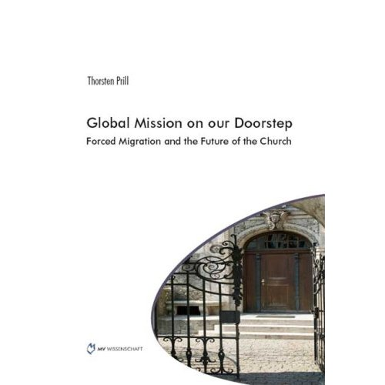

Slide 8
Samuel and Young Cho

Slide 9
3%
214 Million

Slide 10
Terminology
Migration
Migrant
Immigration
Emigration
Refugee
Asylum Seeker

Slide 12
Migration and Kingdom Perspective

Slide 13
The Divine Maestro and the Push-Pull Factors

Slide 14
Migration and Kingdom Perspective
Theological Assumption
Missiological Assumption
Notes:
Chapter 1 Pg 6-8

Slide 15
What in the World is God Doing?

Slide 16
The largest nationalities granted British citizenship in 2010 were Indian (29,405), Pakistani (22,054), Filipino (9,429), Bangladeshi (7,966), and Chinese (7,581). The proportions of babies born to mothers from outside the UK recently reached a record high of 24.7%. In the Newham community in east London, the area with the highest proportion of such births exceeded 75% with Pakistan, Poland, and India topping the list for the mothers’ countries of origin.

Slide 17
Are Mr. Singh and Auntie the Strangers Next Door to You?
Notes:
Chapter 2 page 2

Slide 18
Global Migration Trends
Between 1990-2010, the more developed countries gained 45 million international migrants, an increase of 55%.
By 2010, Europe hosted almost 70 million international migrants, 1/3 of the global total. Asia hosted 61 million. Northern America hosted 50 million.

Slide 19
Global Migration Trends
The increase of migrant stock between 2000-2010 was the highest in Northern America (24%), Europe (21%), and Oceania (20%).
Between 2000-2010, nine countries gained over a million international migrants: United States (8.0 million), Spain (4.6 million), Italy (2.3 million), Saudi Arabia (2.2 million), the United Kingdom (1.7 million), Canada (1.6 million), the Syrian Arab Republic (1.3 million), Jordan (1 million), and the United Arab Emirates (1 million).

Slide 20
Global Migration Trends
In 2010, Asia hosted 10.9 million refugees, making up 66% of the global number of refugees. Africa with 2.6 million (16% of the global population); Europe with 1.6 million refugees (10%); Northern America with 730,000 refugees, and Latin America and the Caribbean hosting 530,000 refugees.
In 2005, countries with at least 20 million inhabitants where international migrants constituted high proportions of the population included Australia (20%), Canada (19%), France (11%), Germany (12%), Saudi Arabia (26%), Spain (11% ), Ukraine (15%), and the United States (13%).

Slide 21
Global Migration Trends
Between 2000-2007, the number of international students more than doubled to over 2 million. The main destination countries were the United States, the United Kingdom, Germany, France and Australia. The greatest percent increases occurred in New Zealand, Korea, the Netherlands, Greece, Spain, Italy, and Ireland.
In 2010, migrants comprised 14.2% of the total population of North America and 12.4% of Western Europe.

Slide 22
Global Migration Trends
In 2010, migrants comprised 22% of the total population in Australia, 21.3% of Canada, 13.5% of the United States, 10.4% of the United Kingdom
By 2017, 1 Canadian in 5 could be a visible minority person.

Slide 23
The UNHCR noted that in 2010:
There were 10.55 million refugees
There were 14.7 million internally displaced persons
There were 837,500 asylum seekers

Slide 24
The UNHCR noted that in 2010:
Pakistan hosted the largest number of refugees (1.9 million), followed by the Islamic Republic of Iran (1.1 million), the Syrian Arab Republic (1 million), and Germany (594,000)
Developing countries hosted 80% of the global refugee population

Slide 25
The UNHCR noted that in 2010:
Asia had 54% of the global refugee population, followed by Africa (23%), Europe (15%), and North America (4%)
Afghanistan was the largest country of origin of refugees (3 million), followed by Iraq (1.7 million), Somalia (770,000), the Democratic Republic of the Congo (477,000), and Myanmar (416,000)

Slide 26
The UNHCR noted that in 2010:
Among the top Western refugee hosting countries, Germany hosted 594,300 refugees, followed by the United States (264,600) and the United Kingdom (238,100)
The countries resettling the most refugees were the United States (71,400), Canada (12,100), Australia (8,500), Sweden (1,800), and Norway (1,100)

Slide 27
The UNHCR noted that in 2010:
The most sought-after destination for asylum-seekers was South Africa, followed by the United States, France, Germany, and Sweden
Refugee and asylum-seekers were more often established in urban contexts
Among refugees and people in refugee-like situations, children comprised 44% of the population

Slide 28
2010 Refugee Arrivals to the U. S. by Country of Nationality
Iraq | 18,016
Burma | 16,693
Bhutan | 12,363
Somalia | 4,884
Cuba | 4,818
Iran | 3,543
Congo, Democratic Republic | 3,174
Eritrea | 2,570
Vietnam | 873
Ethiopia | 668
All other countries, including unknown | 5,691
Total | 73,293

Slide 29
Countries with the Highest Numbers of International Migrants, 2005
Country | Number of Migrants (millions) | Percentage of Total
United States | 38.4 | 20.2
Russian Federation | 12.1 | 6.4
Germany | 10.1 | 5.3
Ukraine | 6.8 | 3.6
France | 6.5 | 3.4
Saudi Arabia | 6.4 | 3.3
Canada | 6.1 | 3.2
India | 5.7 | 3.0
United Kingdom | 5.4 | 2.8

Slide 30
Countries with the Highest Numbers of International Migrants, 2010
Country | Estimated number of international migrants at mid-year, 2010 | As Percentage of Global Total
United States | 42,813,281 | 20
Russian Federation | 12,270,388 | 5.7
Germany | 10,758,061 | 5
Saudi Arabia | 7,288,900 | 3.4
Canada | 7,202,340 | 3.4
France | 6,684,842 | 3.1
United Kingdom | 6,451,711 | 3
Spain | 6,377,524 | 3
India | 5,436,012 | 2.5
Ukraine | 5,257,527 | 2.5

Slide 31
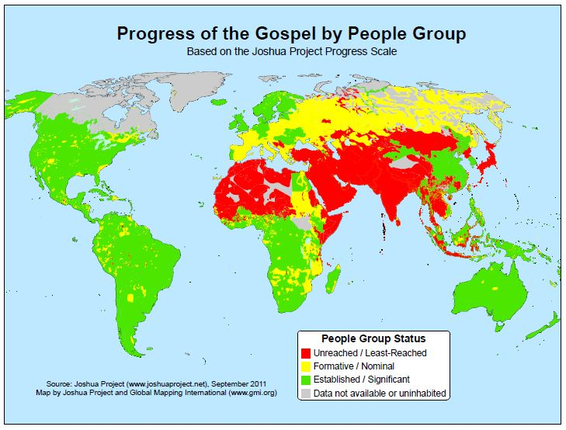
Notes:
Source: Joshua Project

Slide 32
The Strangers Next Door are from Where?

Slide 33
Country of Birth | Legal Perm. U.S. Residents, ’10
Mexico | 139,120
China, People’s Republic | 70,863
India | 69,162
Philippines | 58,173
Dominican Republic | 53,870
Cuba | 33,573
Vietnam | 30,632
Haiti | 22,582
Columbia | 22,406
Korea, South | 22,227
Iraq | 19,855
Jamaica | 19,825
El Salvador | 18,806
Pakistan | 18,258
Bangladesh | 14,819
Ethiopia | 14,266

Slide 34
Top Places of Origin, International Students in the United States
Rank | Country | 2010/11 | Percentage of Total
 | World Total | 723,277 | 100
1 | China | 157,558 | 21.8
2 | India | 103,895 | 14.4
3 | South Korea | 73,351 | 10.1
4 | Canada | 27,546 | 3.8
5 | Taiwan | 24,818 | 3.4
6 | Saudi Arabia | 22,704 | 3.1
7 | Japan | 21,290 | 2.9
8 | Vietnam | 14,888 | 2.1
9 | Mexico | 13,713 | 1.9
10 | Turkey | 12,184 | 1.7

Slide 35
The World’s Unreached in the West

Slide 36
World’s Peoples
Global People Groups: 11,642
Unreached People Groups: 6,734

Slide 37
“Unreached”?

Slide 38
Mejra

Slide 39
Bosnian Locations in West | Est. Number
Canada | 13,178
France | 100
Germany | 286,000
Ireland | 888
Italy | 29,000
United Kingdom | 2,000
United States | 108,924
Source: Global Research, IMB

Slide 40
Jay

Slide 41
How Many UPGs in the West?

Slide 42
Country | UPGs, Joshua Project | UPGs, Joshua Project (with Adherent % Removed) | UPGs, Global Research
Andorra | 3 | 9 | 5
Australia | 11 | 36 | 43
Austria | 6 | 34 | 23
Belgium | 10 | 26 | 34
Canada | 41 | 132 | 180
Denmark | 12 | 22 | 20
Finland | 7 | 18 | 6
France | 34 | 79 | 97
Germany | 19 | 57 | 64
Greenland | -- | 3 | 1
Iceland | 1 | 5 | 4
Ireland | 4 | 13 | 10

Slide 43
Country | UPGs, Joshua Project | UPGs, Joshua Project (with Adherent % Removed) | UPGs, Global Research
Italy | 12 | 50 | 48
Liechtenstein | 2 | 6 | 3
Luxembourg | 2 | 13 | 10
Malta | 3 | 7 | 5
Monaco | 1 | 8 | 6
Netherlands | 13 | 45 | 41
New Zealand | 6 | 23 | 21
Norway | 14 | 41 | 11
Portugal | 5 | 16 | 22
San Marino | -- | 4 | 2
Spain | 7 | 40 | 37
Sweden | 8 | 38 | 28
Switzerland | 6 | 21 | 18
United Kingdom | 29 | 66 | 73
United States | 73 | 242 | 361

Slide 44
Country | UPGs, Joshua Project | UPGs, Joshua Project (with Adherent % Removed) | UPGs, Global Research
TOTAL: | 329 | 1054 | 1173

Slide 45
How Many UPGs in the United States and Canada?

Slide 46
Country | UPGs, Joshua Project | UPGs, Joshua Project (with Adherent % Removed) | UPGs, Global Research
Canada | 41 | 132 | 180
United States | 73 | 242 | 361
TOTAL: | 114 | 374 | 541

Slide 47
Countries with the Largest Numbers of UPGs

Slide 48
Rank | Country | Number of UPGs
1 | India | 941
2 | China | 368
3 | United States | 361
4 | Brazil | 187
5 | Canada | 180
6 | Indonesia | 177
7 | Mexico | 161
8 | Sudan | 153
9 | Congo, D. R. | 153
10 | Nigeria | 121
11 | Chad | 114
12 | Cameroon | 114
13 | Ethiopia | 108
14 | Laos | 101
15 | Tanzania | 100
16 | France | 97
17 | Nepal | 96
18 | Pakistan | 87
19 | South Sudan | 86
20 | Colombia | 79
Notes:
Source: Global Research

Slide 49
The Strangers Next Door
J. D. Payne
University Educators for Global Engagement
April 13-14, 2012

