Slide 1

Strangers Next Door:
Migration, Immigration, and Mission
J. D. Payne

Slide 2
jpayne@brookhills.org
@jd_payne
jdpayne.org

Slide 3






Slide 4
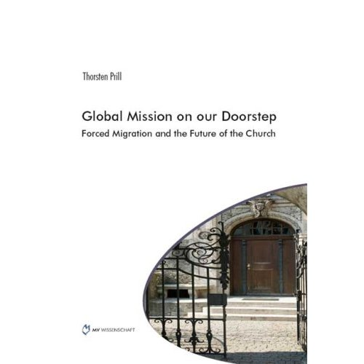





Slide 5



Slide 6


Slide 7
Samuel and Young Cho

Slide 8
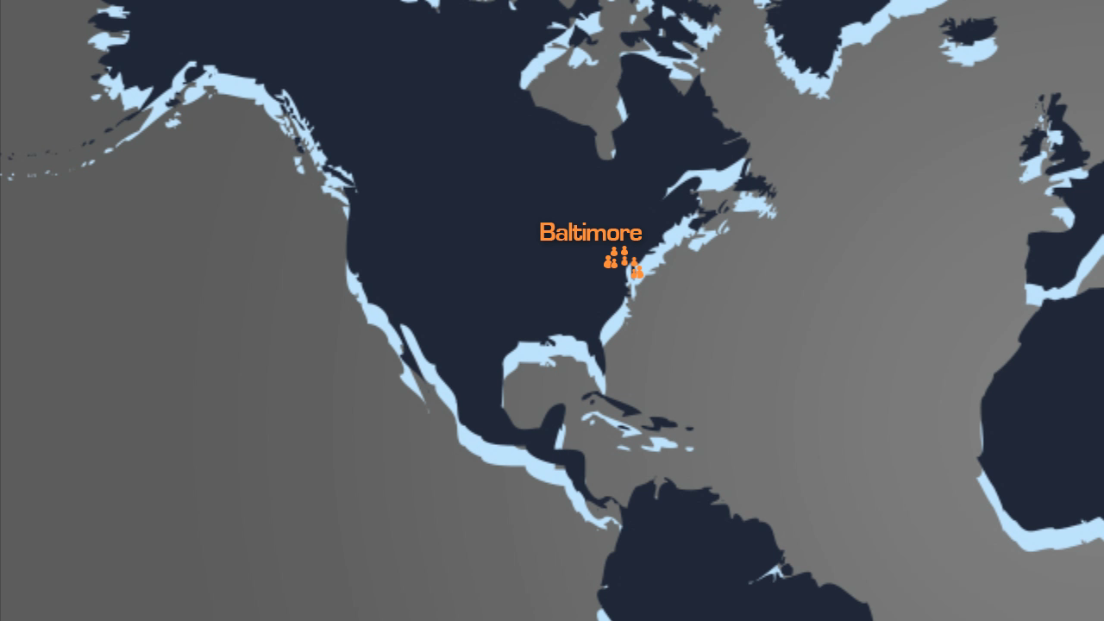

Slide 9
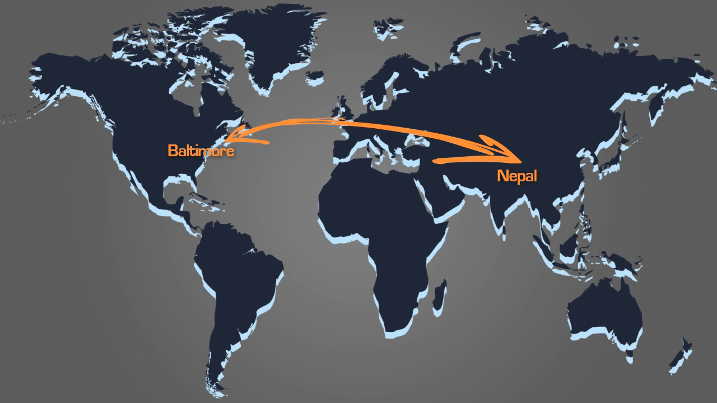

Slide 10
Samuel and Young
Server

Slide 11
David Boyd

Slide 12
3%
232 Million

Slide 13
Migration
Migrant
Immigration
Emigration
Asylum Seeker
Refugee

Slide 14
Acts 17: 26-27

Slide 15
The Divine Maestro and the Push-Pull Factors

Slide 16
What in the World is God Doing?

Slide 17
Yemen

Slide 18
1500-1850: European Colonialism and African Slave Trade Era

Slide 19
1850-1945: Industrial Era

Slide 20
1945-Present: Post-Industrial Global Migrations Era

Slide 21
Countries with the Highest Numbers of International Migrants, 2013
Country | Estimated number of international migrants, 2013
United States | 45,800,000
Russian Federation | 11,000,000
Germany | 9,800,000
Saudi Arabia | 9,100,000
United Arab Emirates | 7,800,000
United Kingdom | 7,800,000
France | 7,400,000
Canada | 7,300,000
Australia | 6,500,000
Spain | 6,500,000

Slide 22
$500 billion
Notes:
2012 global remittances in US dollars

Slide 23
West Africa from New York

Slide 24
Global People Groups: 11,642
Unreached People Groups: 6,734

Slide 25
“Unreached”?

Slide 26
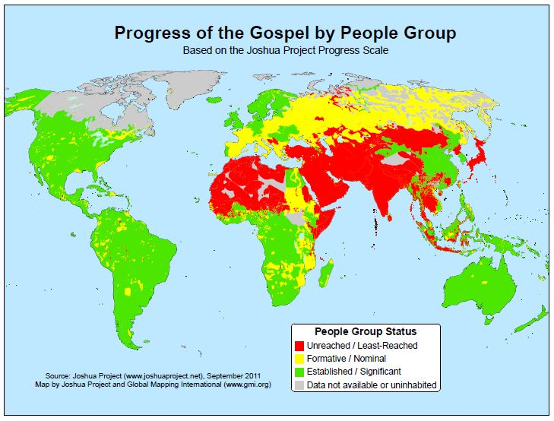
Notes:
Source: Joshua Project

Slide 27
The Strangers Next Door are from Where?

Slide 28
Country of Birth | Perm. Canadian Residents, ’12
China, People’s Republic | 33,018
Philippines | 32,747
India | 28,943
Pakistan | 9,931
United States | 9,414
France | 8,138
Iran | 6,463
United Kingdom | 6,365
Haiti | 5,600
Korea, Republic of | 5,308
Egypt | 4,823
United Arab Emirates | 4,253
Mexico | 4,032
Colombia | 3,678
Morocco | 3,630
Algeria | 3,247

Slide 29
Country of Birth | Perm. Canadian Residents, ’12
Sri Lanka | 3,152
Nigeria | 3,095
Bangladesh | 2,450
Ukraine | 2,203
Israel | 2,183
Afghanistan | 2,155
Jamaica | 2,145
Iraq | 2,125
Cameroon | 2,042
Russia | 1,962
Saudi Arabia | 1,892
Germany | 1,890
Turkey | 1,819
Ethiopia | 1,740
Vietnam, Socialist Republic | 1,702
Total: | 257,887

Slide 30
Top Places of Origin, International Students in Canada
Rank | Country | 2012
 | World Total | 104,810
1 | China | 25,346
2 | India | 13,136
3 | Korea | 7,212
4 | France | 5,762
5 | United States | 4,743
6 | Saudi Arabia | 4,406
7 | Japan | 3,950
8 | Mexico | 3,375
9 | Brazil | 2,295
10 | Germany | 2,046

Slide 31
Starbucks Drinking Saudis

Slide 32
2012 Refugee Arrivals to Canada by Country of Nationality
Mexico | 7,945
China, People’s Republic of | 7,032
Hungary | 6,957
Haiti | 5,617
Colombia | 3,719
India | 3,109
Nigeria | 2,838
Pakistan | 2,801
Sri Lanka | 2,530
Saint Vincent and Grenadines | 1,850
Congo, Democratic Republic of | 1,788
Total | 89,385

Slide 33
Mejra

Slide 34
The World’s Unreached in the West

Slide 35
How Many UPGs in the West?

Slide 36
Country | UPGs, Global Research
Andorra | 5
Australia | 43
Austria | 23
Belgium | 34
Canada | 180
Denmark | 20
Finland | 6
France | 97
Germany | 64
Greenland | 1
Iceland | 4
Ireland | 10
Country | UPGs, Global Research
Italy | 48
Liechtenstein | 3
Luxembourg | 10
Malta | 5
Monaco | 6
Netherlands | 41
New Zealand | 21
Norway | 11
Portugal | 22
San Marino | 2
Spain | 37
Sweden | 28
Switzerland | 18
United Kingdom | 73
United States | 361

Slide 37
1,200

Slide 38
How Many UPGs in the United States and Canada?

Slide 39
Notes:
Source: Joshua Project

Slide 40
35,000 Feet to
15,000 Feet

Slide 41
Country | UPGs, Global Research
Canada | 180
United States | 361
TOTAL: | 541

Slide 42
Countries with the Largest Numbers of UPGs

Slide 43
Rank | Country | UPGs
1 | India | 941
2 | China | 368
3 | United States | 361
4 | Brazil | 187
5 | Canada | 180
6 | Indonesia | 177
7 | Mexico | 161
Notes:
Source: Global Research

Slide 44
Guidelines for Reaching the Strangers Next Door

Slide 45
Be intentional
Learn as you go
Expect to make mistakes
Notes:
Chapter 1 Pg 6-8

Slide 46
Work the bridges of God
Prioritize along receptivity lines
Notes:
Chapter 1 Pg 6-8

Slide 47
Understand cultural and generational differences
Contextualize methods
Practice evangelism that results in new churches
Notes:
Chapter 1 Pg 6-8

Slide 48
Keep things simple and highly reproducible
Avoid paternalism
Notes:
Chapter 1 Pg 6-8

Slide 49
Strategy for Reaching the Strangers Next Door

Slide 50
R. E. P. S.

Slide 51
Your Team
Stranger Next Door

Slide 52
Strangers Next Door:
Migration, Immigration, and Mission
J. D. Payne

