Slide 1

Strangers Next Door:
Migration, Immigration, and Mission
J. D. Payne

Slide 2
jpayne@brookhills.org
@jd_payne
jdpayne.org

Slide 3






Slide 4






Slide 5



Slide 6


Slide 7
Samuel and Young Cho

Slide 8
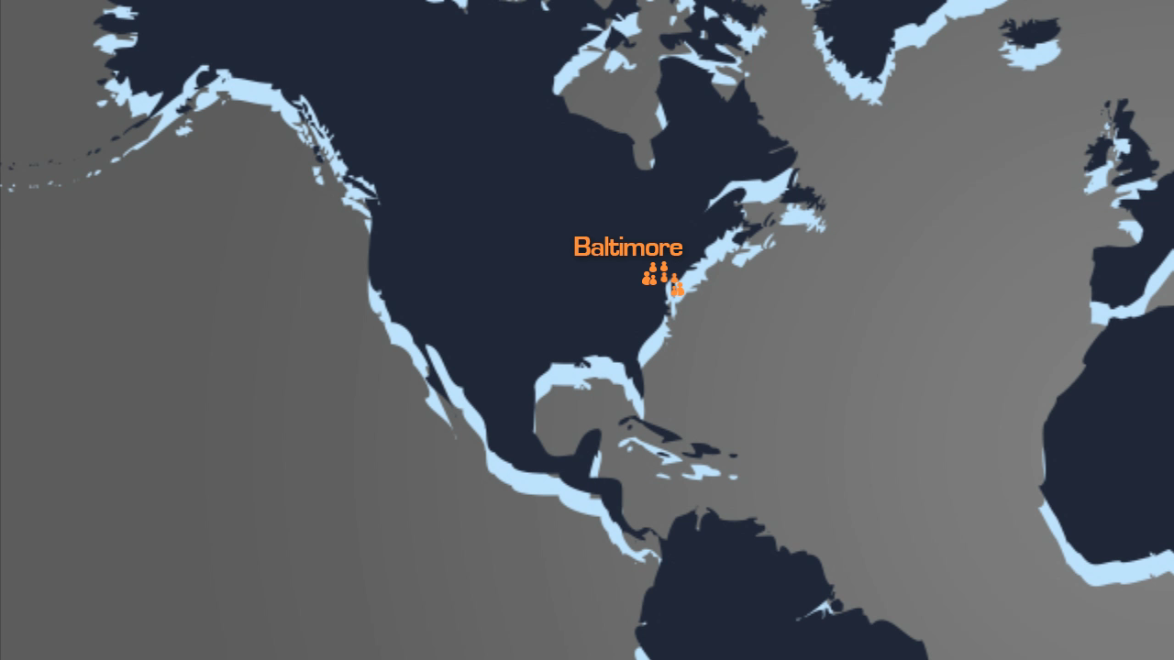

Slide 9
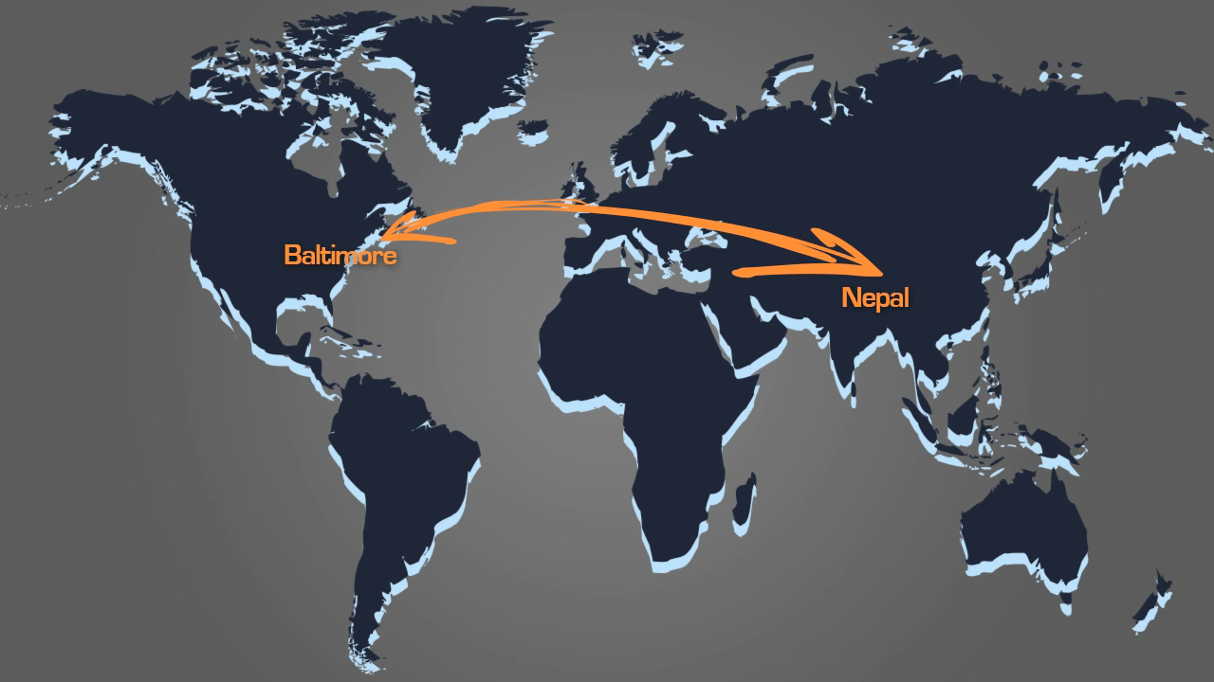

Slide 10
Samuel and Young
Server

Slide 11
David Boyd

Slide 12
3%
232 Million

Slide 13
Acts 17: 26-27

Slide 14
The Divine Maestro and the Push-Pull Factors

Slide 15
What in the World is God Doing?

Slide 16
Yemen

Slide 17
1500-1850: European Colonialism and African Slave Trade Era

Slide 18
1850-1945: Industrial Era

Slide 19
1945-Present: Post-Industrial Global Migrations Era

Slide 20
Countries with the Highest Numbers of International Migrants, 2013
Country | Estimated number of international migrants, 2013
United States | 45,800,000
Russian Federation | 11,000,000
Germany | 9,800,000
Saudi Arabia | 9,100,000
United Arab Emirates | 7,800,000
United Kingdom | 7,800,000
France | 7,400,000
Canada | 7,300,000
Australia | 6,500,000
Spain | 6,500,000

Slide 21
$500 billion
Notes:
2012 global remittances in US dollars

Slide 22
West Africa from New York

Slide 23
Global People Groups: 11,642
Unreached People Groups: 6,734

Slide 24
“Unreached”?

Slide 25
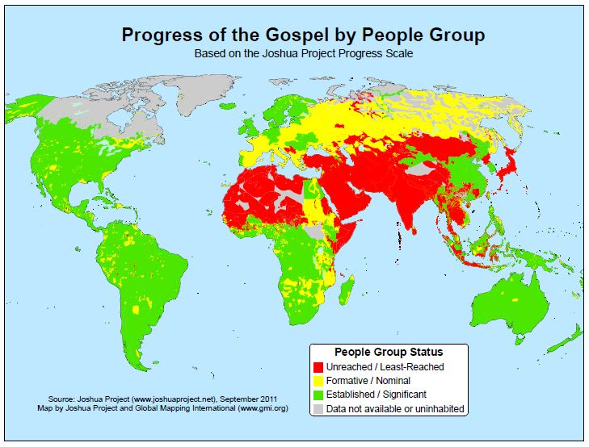
Notes:
Source: Joshua Project

Slide 26
The Strangers Next Door are from Where?

Slide 27
Country of Birth | Legal Perm. U.S. Residents, ’12
Mexico | 146,406
China, People’s Republic | 81,784
India | 66,434
Philippines | 57,327
Dominican Republic | 41,566
Cuba | 32,820
Vietnam | 28,304
Haiti | 22,818
Columbia | 20,931
Korea, South | 20,846
Jamaica | 20,705
Iraq | 20,369
Burma | 17,383
El Salvador | 16,256
Pakistan | 14,740
Bangladesh | 14,705

Slide 28
Top Places of Origin, International Students in the United States
Rank | Country | 2012/13 | Percentage of Total
 | World Total | 819,644 | 100
1 | China | 235,597 | 28.7
2 | India | 96,754 | 11.8
3 | South Korea | 70,627 | 8.6
4 | Saudi Arabia | 44,566 | 5.4
5 | Canada | 27,357 | 3.3
6 | Taiwan | 21,867 | 2.7
7 | Japan | 19,568 | 2.4
8 | Vietnam | 16,098 | 2.0
9 | Mexico | 14,199 | 1.7
10 | Turkey | 11,278 | 1.4

Slide 29
Starbucks Drinking Saudis

Slide 30
2012 Refugee Arrivals to the U. S. by Country of Nationality
Bhutan | 15,070
Burma | 14,160
Iraq | 12,163
Somalia | 4,911
Cuba | 1,948
Congo, Democratic Republic | 1,863
Iran | 1,758
Eritrea | 1,346
Sudan | 1,077
Ethiopia | 620
All other countries, including unknown | 3,263
Total | 58,179

Slide 31
Mejra

Slide 32
The World’s Unreached in the West

Slide 33
How Many UPGs in the West?

Slide 34
Country | UPGs, Global Research
Andorra | 5
Australia | 43
Austria | 23
Belgium | 34
Canada | 180
Denmark | 20
Finland | 6
France | 97
Germany | 64
Greenland | 1
Iceland | 4
Ireland | 10
Country | UPGs, Global Research
Italy | 48
Liechtenstein | 3
Luxembourg | 10
Malta | 5
Monaco | 6
Netherlands | 41
New Zealand | 21
Norway | 11
Portugal | 22
San Marino | 2
Spain | 37
Sweden | 28
Switzerland | 18
United Kingdom | 73
United States | 361

Slide 35
1,200

Slide 36
How Many UPGs in the United States and Canada?

Slide 37
Notes:
Source: Joshua Project

Slide 38
35,000 Feet to
15,000 Feet

Slide 39
Country | UPGs, Global Research
Canada | 180
United States | 361
TOTAL: | 541

Slide 40
Countries with the Largest Numbers of UPGs

Slide 41
Rank | Country | UPGs
1 | India | 941
2 | China | 368
3 | United States | 361
4 | Brazil | 187
5 | Canada | 180
6 | Indonesia | 177
7 | Mexico | 161
Notes:
Source: Global Research

Slide 42
Guidelines for Reaching the Strangers Next Door

Slide 43
Be intentional
Learn as you go
Expect to make mistakes
Notes:
Chapter 1 Pg 6-8

Slide 44
Work the bridges of God
Prioritize along receptivity lines
Notes:
Chapter 1 Pg 6-8

Slide 45
Understand cultural and generational differences
Contextualize methods
Practice evangelism that results in new churches
Notes:
Chapter 1 Pg 6-8

Slide 46
Keep things simple and highly reproducible
Avoid paternalism
Notes:
Chapter 1 Pg 6-8

Slide 47
Strategy for Reaching the Strangers Next Door

Slide 48
R. E. P. S.

Slide 49
Your Team
Stranger Next Door

Slide 50
Strangers Next Door:
Migration, Immigration, and Mission
J. D. Payne

