Slide 1
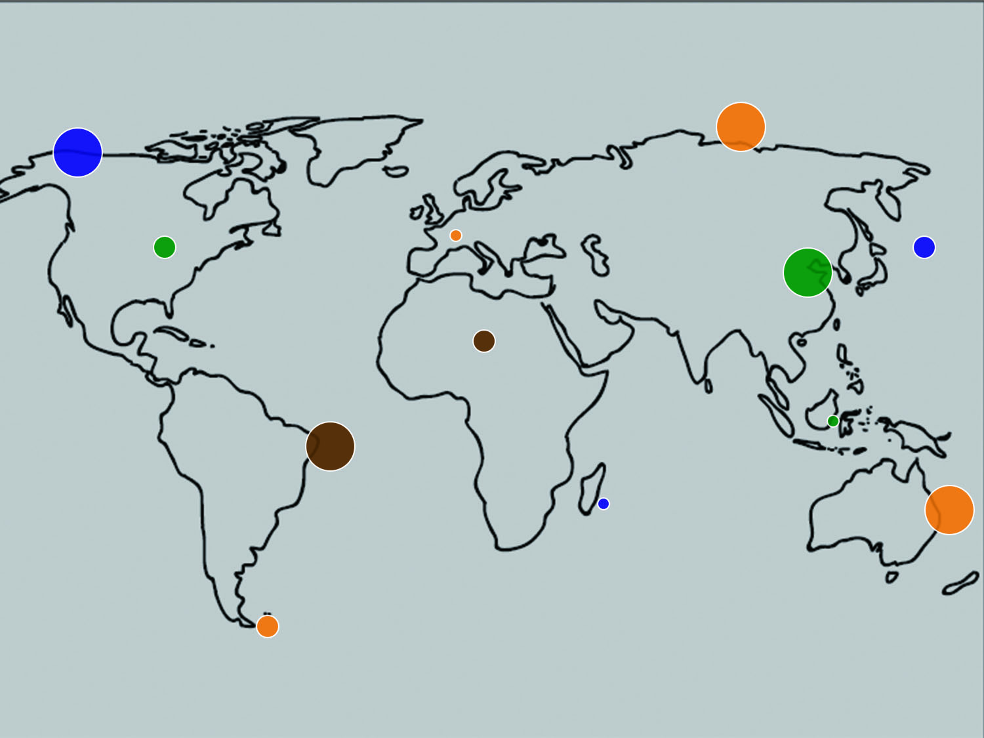
Pressure Points
Twelve Global Issues Shaping the
Face of the Church
J.D. Payne

Slide 2
J. D. Payne jpayne@brookhills.org
@jd_payne jdpayne.org

Slide 3


Slide 4
Introduction
The Church and the Pressures of the Age

Slide 5




Slide 6
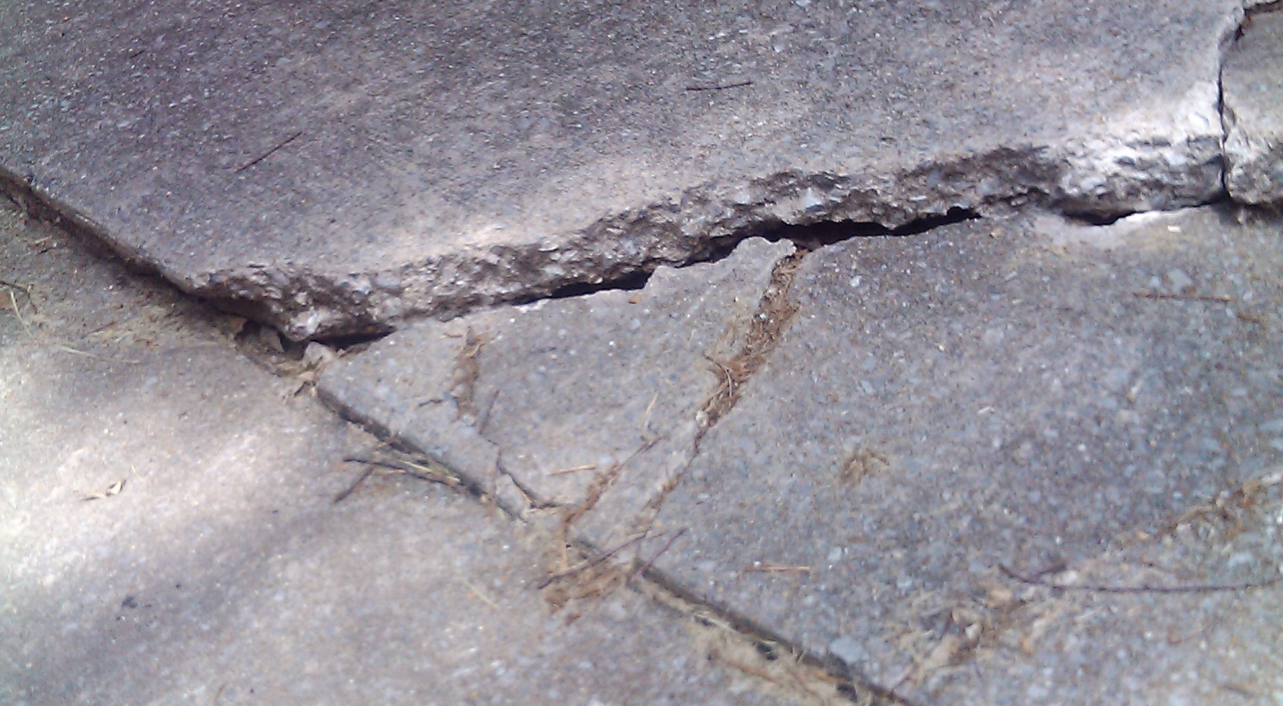

Slide 7
Challenges of the Age

Slide 8
The Stewardship of Innovation

Slide 9
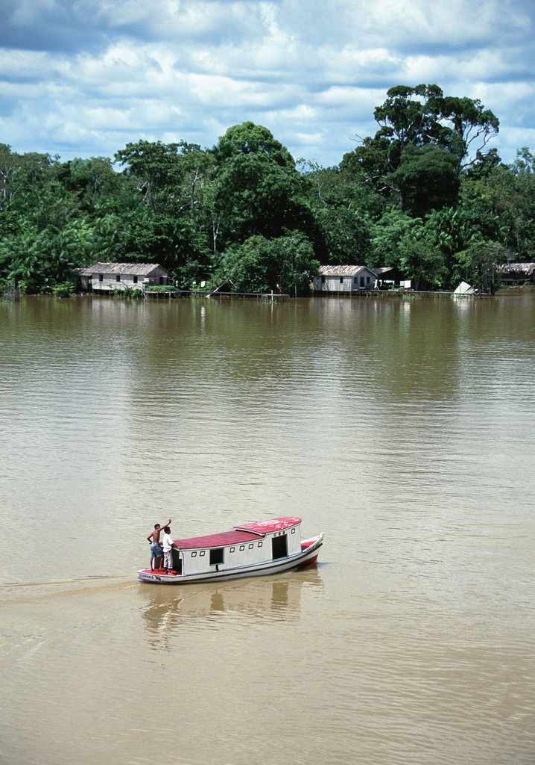




Slide 10
Great Commission

Slide 11
Kingdom Innovation
Spirit-Filled Church

Slide 12
“Desire without knowledge is not good, and whoever makes haste with his feet misses his way” (Proverbs, 19:2, ESV).

Slide 13
Unreached People Groups
“The Bread of Life is simply not available to hundreds and hundreds of millions of people.”
David A. Fraser

Slide 14
Nations: from Countries to Peoples

Slide 15
What is a People Group?

Slide 16
Unengaged and Unreached

Slide 17
11,342 total people groups
6,422 unreached people groups (not including the US and Canada
571 unreached people groups in the US and Canada
3,133 unreached-unengaged people groups

Slide 18
Why Evangelicals?

Slide 19
Where Is Our Priority?

Slide 20
Strangers Next Door

Slide 21
Cross-Cultural
Disciple Making Needed

Slide 22
The West as a
Mission Field
“The west is, once again, a vast mission field.”
George G. Hunter III

Slide 23
Post-Christian Mission Field

Slide 24
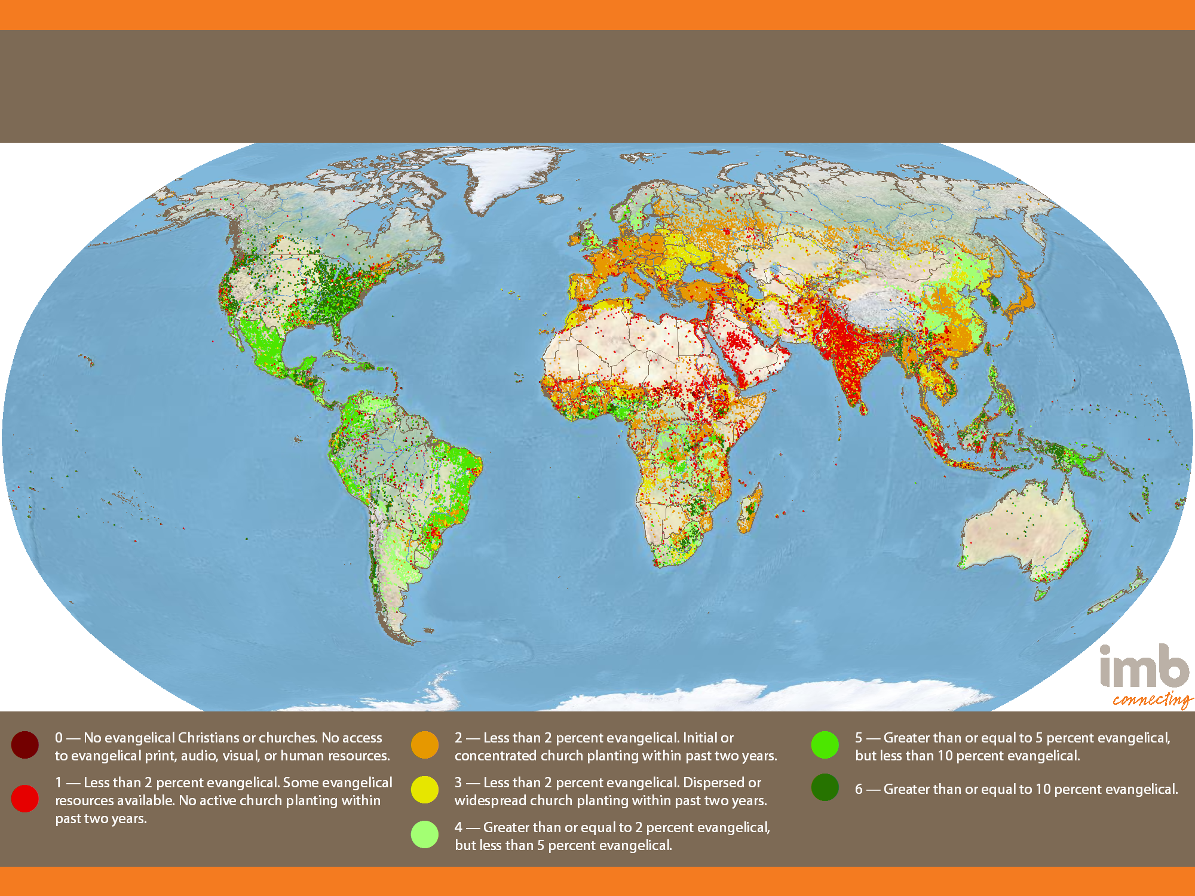
Global Status of Evangelical Christianity
2013 Edition
Notes:
11,332 people groups with a combined population of 6,972,900,714 are detailed in the IMB database as of January 1, 2013. Each people group is represented by one point for every 50,000 people. All data is taken from 2013-01 GSEC Listing of people groups.

Slide 25
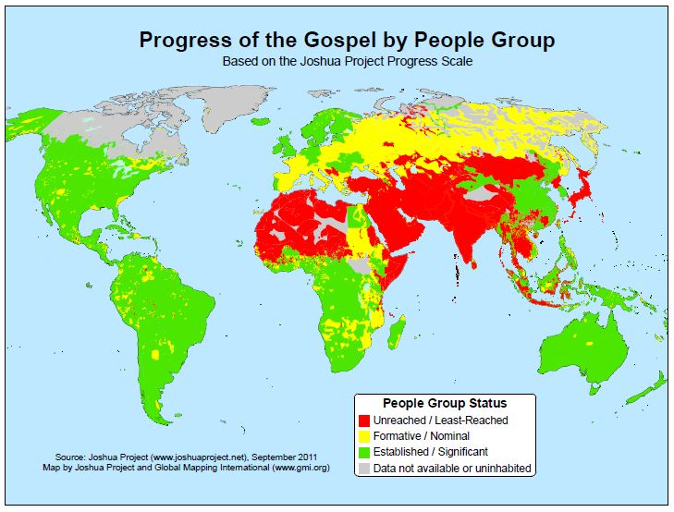
Notes:
Source: Joshua Project

Slide 26
From 35,000 to 15,000 Feet

Slide 27
Least Evangelical US States, 2010
State | Evangelical Percentage
Utah | 2.3
Rhode Island | 2.5
Massachusetts | 3.4
New Hampshire | 3.6
Vermont | 3.6
New Jersey | 4.3
Connecticut | 4.4
Maine | 4.5
New York | 4.5
Delaware | 7.2

Slide 28
Urban Contexts in the US under 5% Evangelical
Metro Area | Evangelical Totals | % of Evangelicals
Provo-Orem, UT | 2,540 | 0.5
Logan, UT-ID | 1,746 | 1
St. George, UT | 2,345 | 2
Pittsfield, MA | 2,817 | 2
Kingston, NY | 4,104 | 2
Barnstable Town, MA | 5,281 | 3

Slide 29
Urban Contexts in the US under 5% Evangelical (cont.)
Metro Area | Evangelical Totals | % of Evangelicals
Salt Lake City, UT | 29,498 | 3
Providence-New Bedford-Fall River, RI-MA | 45,007 | 3
Boston-Cambridge-Quincy, MA-NH | 146,838 | 3
Norwich-New London, CT | 9,320 | 3
Ogden-Clearfield, UT | 18,689 | 3
Glens Falls, NY | 4,502 | 4

Slide 30
Urban Contexts in the US under 5% Evangelical (cont.)
Metro Area | Evangelical Totals | % of Evangelicals
Utica-Rome, NY | 10,580 | 4
Springfield, MA | 24,645 | 4
New Haven-Milford, CT | 33,484 | 4
Portland-South Portland-Biddeford, ME | 20,227 | 4
New York-Northern New Jersey-Long Island, NY-NJ-PA | 750,407 | 4
Poughkeepsie-Newburgh-Middletown, NY | 27,236 | 4

Slide 31
Faiths on the Move

Slide 32
Returning to the Apostolic

Slide 33
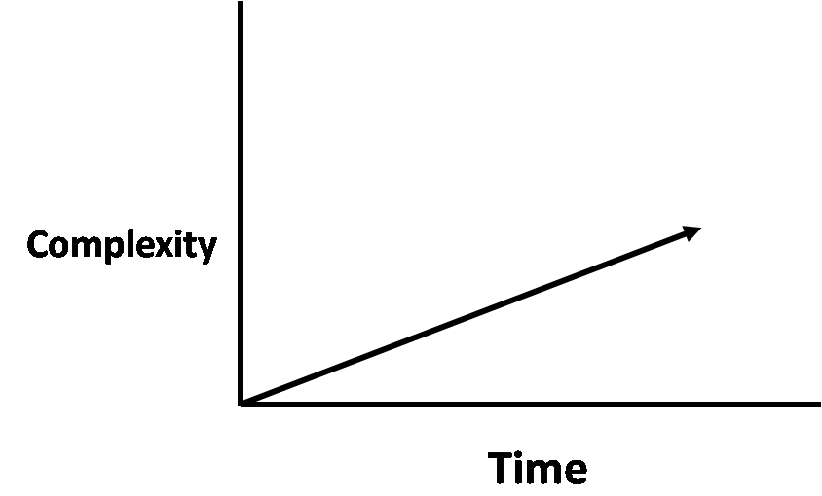
From Simplicity to Complexity

Slide 34
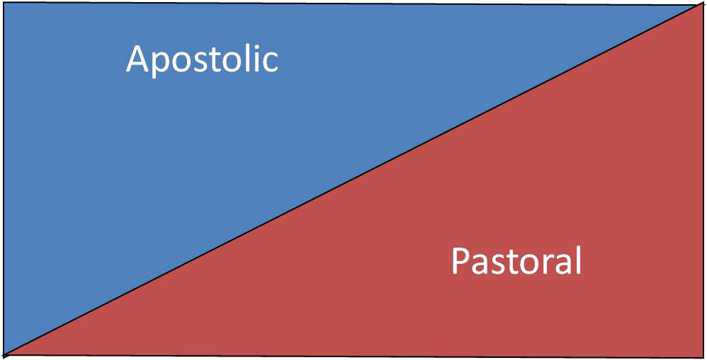
From Apostolic to Pastoral

Slide 35
Need for Scaffolds

Slide 36
Both/And

Slide 37
Growth of the
Majority World Church
“It is like a grain of mustard seed, which, when sown on the ground, is the smallest of all the seeds on earth, yet when it is sown it grows up and becomes larger than all the garden plants and puts out large branches, so that the birds of the air can make nests in its shade”
(Mark 4:31-32, ESV).

Slide 38
An Enquiry into the
Majority World Church

Slide 39
Select Countries with
Evangelical Percentages
Country | Evangelical Percentages
Kenya | 49%
Uganda | 37%
Central African Republic | 32%
El Salvador | 32%
Zimbabwe | 31%
Nigeria | 31%
Nicaragua | 30%
Burundi | 27%

Slide 40
Forgetting About the
Mustard Seed

Slide 41
Select Missionary-Sending Countries
Country | Missionaries
India | 82,950
China, PRC | 20,000
Nigeria | 6,644
Philippines | 4,500
Indonesia | 3,000
Ghana | 2,000
Ukraine | 1,599

Slide 42
Select Missionary-Sending Countries (cont.)
Country | Missionaries
Mexico | 794
Bangladesh | 500
Thailand | 468
Malaysia | 380
Argentina | 350
Japan | 300
Romania | 130

Slide 43
Kingdom Opportunities

Slide 44
Pluralism and the Plurality of Faiths
“I am the Way…No one comes to the
Father except through me”
(John 14:6, ESV).

Slide 45
Pluralism: How the Pressure Is
Felt---Internally

Slide 46
Plurality of Faiths:
How the Pressure is Felt---Externally

Slide 47
World Totals
Folk Religionists 405,120,000
Hindus 1,033,808,000
Buddhists 487,540,000
Jews 13,850,000
Others 58,110,000

Slide 48
Countries with the Largest Number of Religiously Unaffiliated
Country | Estimated Population
China | 700,680,000
Japan | 72,120,000
United States | 50,980,000
Vietnam | 26,040,000
Russia | 23,180,000
South Korea | 22,350,000
Germany | 20,350,000
France | 17,580,000
North Korea | 17,350,000
Brazil | 15,410,000
Total Found in All Countries | 1,126,500,000

Slide 49
Countries with the Largest Muslim Populations 2010, 2030
Country | 2010 Pop. (millions) | Country | Est. 2030 Pop. (millions)
Indonesia | 205 | Pakistan | 256
Pakistan | 178 | Indonesia | 239
India | 177 | India | 236
Bangladesh | 149 | Bangladesh | 188
Egypt | 80 | Nigeria | 117
Nigeria | 76 | Egypt | 105
Iran | 75 | Iran | 90
Turkey | 75 | Turkey | 89
Algeria | 35 | Afghanistan | 51
Morocco | 32 | Iraq | 48

Slide 50
2010, 2030 Comparison of Muslim Proportions by Selected
Countries and Regions
Country/Region | Percent of pop. 2010 | Percent of pop. 2030
Austria | 5.7 | 9.3
Belgium | 6 | 10.2
Canada | 2.8 | 6.6
France | 7.5 | 10.3
Israel | 17.7 | 23.2
Sweden | 4.9 | 9.9
United Kingdom | 4.6 | 8.2
United States | 0.8 | 1.7
Asia-Pacific | 24.8 | 27.3
Sub-Saharan Africa | 29.6 | 31
Europe | 6 | 8

Slide 51
Global Estimates of Muslim Background Believers, 2005
Country | Est. Muslim Background Believers, 2005
Indonesia | 6,000,000
Nigeria | 500,000
Iran | 500,000
Ethiopia | 400,000
United States | 300,000
Burkina Faso | 200,000
Tanzania | 150,000
Bangladesh | 130,000
Algeria | 100,000
Cameroon | 80,000

Slide 52
Global Estimates of Muslim Background Believers, 2005 (cont.)
Country | Est. Muslim Background Believers
Kenya | 70,000
Ghana | 50,000
Saudi Arabia | 50,000
Benin | 40,000
Bulgaria | 40,000
Canada | 40,000
Uganda | 30,000
Kazakhstan | 25,000
Sudan | 25,000
United Kingdom | 20,000
World Total | 8,970,000

Slide 53
Contextualization Matters

Slide 54
International Migration
“And He made from one man every nation of mankind to live on all the face of the earth, having determined allotted periods and the boundaries of their dwelling place”
(Acts 17:26, ESV).

Slide 55
3%
214 Million

Slide 56
The Divine Maestro

Slide 57
God Is Working in the
United States

Slide 58
Countries with the Highest Numbers of International Migrants, 2010
Country | Estimated Number of International Immigrants | As Percentage of Global Total
United States | 42,813,281 | 20
Russian Federation | 12,270,388 | 5.7
Germany | 10,758,061 | 5
Saudi Arabia | 7,288,900 | 3.4
Canada | 7,202,340 | 3.4
France | 6,684,842 | 3.1
United Kingdom | 6,451,711 | 3
Spain | 6,377,524 | 3
India | 5,436,012 | 2.5
Ukraine | 5,257,527 | 2.5

Slide 59
Select Places of Origin of International Students in US, 2011-2012
Country | 2011-12 Academic Year
China | 194,000
India | 100,000
South Korea | 72,000
Saudi Arabia | 34,000
Taiwan | 23,000
Japan | 20,000
Vietnam | 15,500

Slide 60
The Potential of the
Strangers Next Door

Slide 61
Your Team
Stranger Next Door

Slide 62
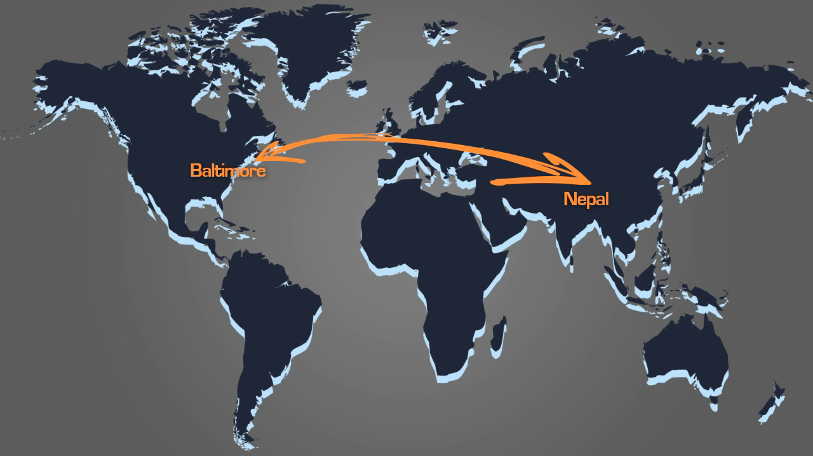

Slide 63
Globalization
“It’s a small, small world.”
-- Richard M. Sherman and
Robert B. Sherman

Slide 64
From Solids to Liquids

Slide 65
From Heavy to Light

Slide 66
Problems of Globalization

Slide 67
Practices Under Pressure

Slide 68
Poverty
“Remember the poor”
(Galatians 2:10, ESV).

Slide 69
As Old As the Garden

Slide 70
The Pressure in the World

Slide 71
Global Undernourishment

Slide 72
Global Undernourishment by Region 2010-2012
Region | Undernourishment in Millions
Developed Regions | 16
Southern Asia | 304
Sub-Saharan Africa | 234
Eastern Asia | 167
South-Eastern Asia | 65
Latin America/Caribbean | 49
Western Asia/Northern Africa | 25
Caucasus/Central Asia | 6
Oceania | 1

Slide 73
Challenges and Opportunities

Slide 74
Growth of the Cities
If current projections are anything to go by, virtually the whole of the world’s demographic growth over the next 30 years will be concentrated in urban areas.
UN Human Settlements Programme

Slide 75
Select Countries with Urban Percentage of Population
Country | Percent Urban
Venezuela | 93
Argentina | 92
Australia | 89
Brazil | 87
France | 85
South Korea | 83
United States | 82

Slide 76
Select Countries with Urban Percentage of Population (cont.)
Country | Percent Urban
Saudi Arabia | 82
Canada | 81
United Kingdom | 80
Mexico | 78
Spain | 77
Russian Federation | 73
Iran | 71

Slide 77
Select Countries with Urban Percentage of Population (cont.)
Country | Percent Urban
Turkey | 70
Ukraine | 69
Japan | 67
Iraq | 66
Algeria | 66
North Korea | 60
Angola | 59

Slide 78
Select Countries with Urban Percentage of Population (cont.)
Country | Percent Urban
Cameroon | 58
Morocco | 58
Nigeria | 50
China | 47
Sudan | 40
Pakistan | 36
India | 30

Slide 79
Global Realities of Our
Urban World

Slide 80
Population

Slide 81
Countries with the Largest Populations (2015 Estimates)
Rank | Country | Est. Population (millions)
1 | China | 1,378
2 | India | 1,247
3 | United States | 323
4 | Indonesia | 248
5 | Brazil | 202
6 | Pakistan | 194
7 | Nigeria | 179
8 | Bangladesh | 176
9 | Russian Federation | 139
10 | Japan | 125

Slide 82
Megacities:
Suns in the Solar System

Slide 83
World’s Megacities, 2011
Megacity | Population (millions)
Tokyo, Japan | 37
Delhi, India | 23
Mexico City, Mexico | 20
New York-Newark, USA | 20
Shanghai, China | 20
São Paulo, Brazil | 20
Mumbai (Bombay), India | 20
Beijing, China | 16
Dhaka, Bangladesh | 15
Kolkata (Calcutta), India | 14
Karachi, Pakistan | 14
Buenos Aires, Argentina | 14

Slide 84
World’s Megacities, 2011 (cont.)
Megacity | Population (millions)
Los Angeles-Long Beach-Santa Ana, USA | 13
Rio de Janeiro, Brazil | 12
Manila, Philippines | 12
Moscow, Russian Federation | 12
Osaka-Kobe, Japan | 12
Istanbul, Turkey | 11
Lagos, Nigeria | 11
Cairo, Egypt | 11
Guangzhou, Guangdong, China | 11
Shenzhen, China | 11
Paris, France | 11

Slide 85
Diversity

Slide 86
Migration

Slide 87
Poverty

Slide 88
Percent of Urban Residents Living in Slums in 2010
Region | Percent of Urban Population in Slums
North Africa | 13
Sub-Sahara Africa | 62
South Asia | 35
Southeast Asia | 31
East Asia | 28
West Asia | 25
Latin America/Caribbean | 24
Oceania | 24

Slide 89
Wealth

Slide 90
Pace of Change

Slide 91
Children and Youth
“But Jesus said, ‘Let the children come to me and do not hinder them, for to such belongs the kingdom of heaven’”
(Matthew 19:14, ESV).

Slide 92
Global Realities

Slide 93
Children and Ethnic Change in the United States

Slide 94
Let Them Come to Me

Slide 95
Health Care
“But a Samaritan…when He saw him,
He had compassion”
(Luke 10:33, ESV).

Slide 96
Present Realities

Slide 97
2010-2015 Countries with
Longest Life Expectancies
Rank | Country/Area | Life Expectancy
1 | Japan | 84
2 | China, Hong Kong SAR | 83
3 | Switzerland | 83
4 | Australia | 82
5 | Iceland | 82
6 | Israel | 82
7 | Italy | 82
8 | Spain | 82
9 | France | 82
10 | Sweden | 81

Slide 98
2010-2015 Countries with the
Lowest Life Expectancies
Rank | Country/Area | Life Expectancy
1 | Sierra Leone | 48
2 | Guinea-Bissau | 49
3 | Dem. Republic of the Congo | 49
4 | Lesotho | 49
5 | Swaziland | 49
6 | Afghanistan | 49
7 | Central Africa Republic | 50
8 | Zambia | 50
9 | Chad | 50
10 | Mozambique | 51

Slide 99
Children

Slide 100
2010-2015 Infant Mortality Rates
Area | Infant Mortality Rate (deaths per 1000 live births)
World | 42
More Developed Regions | 6
Less Developed Regions | 46
Africa | 71
Asia | 37
Europe | 6
Latin America/Caribbean | 19
Northern America | 6
Oceania | 19

Slide 101
2010-2015 Under 5 Mortality Rates
Area | Under 5 Mortality Rate (deaths per 1000 live births)
World | 60
More Developed Regions | 8
Less Developed Regions | 66
Africa | 112
Asia | 49
Europe | 9
Latin America/Caribbean | 24
Northern America | 8
Oceania | 24

Slide 102
Countries with the Highest Under-5 Mortality Rates in 2011
Rank | Country | Deaths per 1,000 Live Births
1 | Sierra Leone | 185
2 | Somalia | 180
3 | Mali | 176
4 | Chad | 169
5 | Dem. Rep. of the Congo | 168
6 | Central African Republic | 164
7 | Guinea-Bissau | 161
8 | Angola | 158
9 | Burkina Faso | 146
10 | Burundi | 139

Slide 103
Maternal Health

Slide 104
HIV/AIDS

Slide 105
Countries Most Affected by
HIV Infections, 2009
Country | HIV estimated percentage in 2009 among those 15-49 years of age
Swaziland | 26
Botswana | 25
Lesotho | 24
South Africa | 18
Zimbabwe | 14
Zambia | 14
Namibia | 13
Mozambique | 12
Malawi | 11
Uganda | 7

Slide 106
Sanitation and Clean Water

Slide 107
Oral Learners
“Faith comes from hearing”
(Romans 10:17, ESV).

Slide 108
Present Global Realities

Slide 109
Orality

Slide 110
Categories of Learning

Slide 111
Faith Comes by Understanding

Slide 112
Pornification of Societies
“Flee from sexual immorality”
(I Corinthians 6:18, ESV).

Slide 113
The Size of the Industry

Slide 114
The Global Reach

Slide 115
The Influence of Pornography

Slide 116
Internal and External Pressure

Slide 117
Conclusion
Global Engagement in a World of Pressure Points

Slide 118
Understand the Pressure Points

Slide 119
Know Your Box in View of the
Pressure Points

Slide 120
Recognize Internal Pressures

Slide 121
Develop a Missionary Strategy

Slide 122
Keep It Simple
Reproducibility
Complexity

Slide 123
Share Today’s Stories
Later Today

Slide 124
Remain Grounded in the
Word of the Ages

Slide 125
Pressure Points
Twelve Global Issues Shaping the
Face of the Church
J.D. Payne

