Slide 1
The Barnabas Factors: Eight Essential Practices of Church Planting Team Members
Multiply Louisiana: Missions and Church Planting Conference

Slide 2
J. D. Payne jpayne@brookhills.org
@jd_payne www.jdpayne.org

Slide 3

Where is this stuff coming from?

Slide 4
Where are the resources for teams?
Dick Scoggins, Building Effective Church Planting Teams (www.dickscoggins.com)
Daniel Sinclair, A Vision of the Possible: Pioneer Church Planting in Teams
Greg Livingstone, Planting Churches in Muslim Cities: A Team Approach

Slide 5
On Selecting Team Members:
Pray/Fast, Guided by the Spirit
Look for people who share:
  Calling
  A Common Theological Position
  A Philosophy of Church Planting
  Chemistry
  The Barnabas Factors
Consider a Team Covenant

Slide 6
Refrain from the AIR-LOVE Test

Slide 7
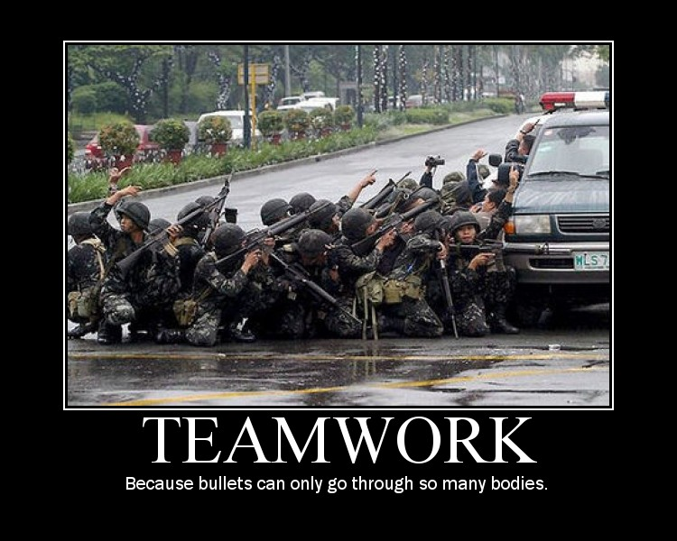
How do you “see” team?

Slide 8

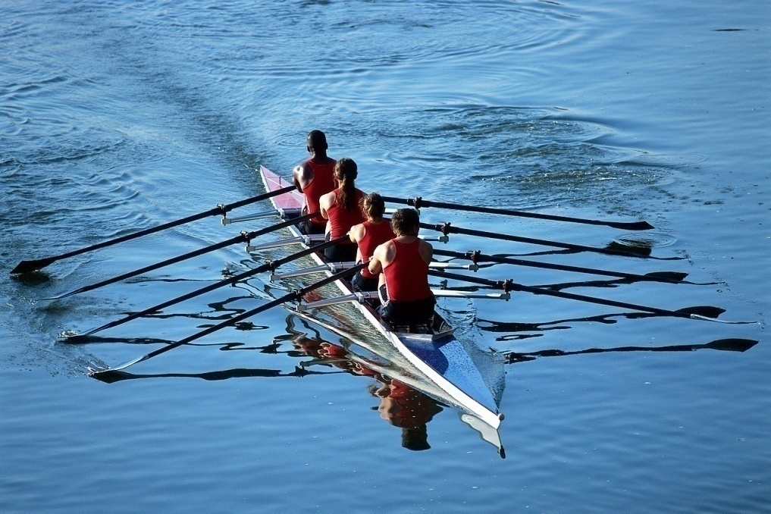
How do you “see” team?

Slide 9
Where are we going?
Definition
Strengths
Limitations
Barnabas Factors

Slide 10
Definition of Team
“A team is a small group of people working together on a common objective, dependent upon one another’s contribution, knowing each other’s strengths and weaknesses, caring about each other’s growth and development, and holding one another mutually accountable.”
    -- Walter C. Wright, Don’t Step on the Rope!: Reflections on Leadership, Relationships, and Teamwork

Slide 11
Strengths of Teams
Shared Leadership
Accountability
Encouragement

Slide 12
Strengths of Teams
Diversity
Strength in Numbers
Serves as a Functional Body of Christ

Slide 13
Strengths of Teams
Provides Pastoral Care
Serves as a Training Ground
Provides a Faster Evangelistic Growth Potential

Slide 14
Strengths of Teams
Wisdom Comes with Numbers
Models Church Before the New Believers

Slide 15
Limitations of Teams
Length of Time to Make Decisions
Conflict is Inevitable
Potential to Become Inwardly Focused

Slide 16
Five Stumbling Blocks
Character Problems
Vision and Values Dissonance
Personality and/or Cultural Differences
Authority Issues
Gifting Fit
--Taken from, Rick Love, “Four Stages of Team Development, Evangelical Missions Quarterly 32 #3 (July 1996): 312-16.

Slide 17
On Selecting Team Members:
Pray/Fast, Guided by the Spirit
Look for people who share:
  Calling
  A Common Theological Position
  A Philosophy of Church Planting
  Chemistry
  The Barnabas Factors
Consider a Team Covenant

Slide 18
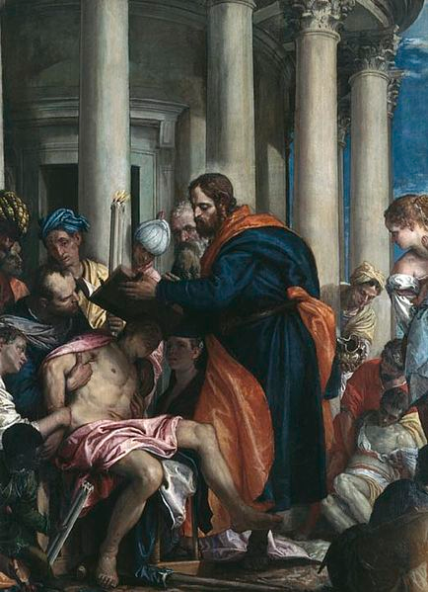
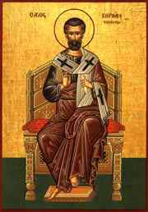
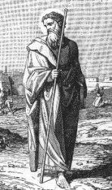
The Barnabas Factors

Slide 19
“The kingdom of God is never so desperate for leaders that biblical standards should be relaxed to accommodate a person of skills and high potential.”
-- George Barna, The Power of Team Leadership, 88.

Slide 20
What are The Barnabas Factors?
Eight healthy practices found in the life of Barnabas that greatly assisted with Kingdom Expansion
These are outward manifestations of an inward character
Identified in community with the person

Slide 21
The Barnabas Factors
Walks with the Lord
Maintains an Outstanding Character
Serves in the Local Church
Remains Faithful to the Call
Shares the Gospel Regularly**
Raises Up Leaders**
Encourages with Speech and Actions
Responds Appropriately to Conflict

Slide 22
Barnabas Factors Standard of Excellence Guide for Team Development

Slide 23

The scale

Slide 24
According to the following statements, please rank the potential team member on the following scale according to how you believe he/she manifests each Barnabas Factor
Low Medium High
1 2 3 4 5 6 7 8 9 10

Slide 25
Overall Ranking
Low: 8-24
Do not select this person for the team.
Medium: 32-56
This person may have some significant struggles at times if
placed on the team. Identify the Barnabas Factors where this
person scored low and provide guidance to improve. Consider
inviting this individual to the team but with strong reservations.
High: 64-80
Though a high ranking is not a guarantee for effectiveness, it
does reveal that this person strongly manifests the Barnabas
Factors that are necessary for a healthy team. Consider
inviting this individual to the team.

Slide 26
The Barnabas Factors
Walks with the Lord
Maintains an Outstanding Character
Serves in the Local Church
Remains Faithful to the Call
Shares the Gospel Regularly**
Raises Up Leaders**
Encourages with Speech and Actions
Responds Appropriately to Conflict

Slide 27
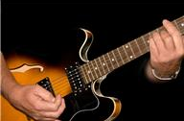
The Barnabas Factors
Remember the E Chord!

Slide 28
Barnabas Factor #1
Foundation for the rest of the factors
Accomplishing great things for the Lord is never to interfere with the team’s walk with the Lord
Enables the team to know how to live in relation to God, to other team members, and to those outside of the Kingdom
Remember Who is the Vine and who is the branch (John 15:5)
Walks with the Lord

Slide 29
According to the following statements, please rank the potential team member on the following scale according to how you believe he/she manifests Barnabas Factor #1
Low Medium High
1 2 3 4 5 6 7 8 9 10

Slide 30
Barnabas Factor #1: Walks with the Lord
This person can give a clear and concise verbal testimony of a conversion experience.
This person is loveable.
This person is trustworthy.
This person is reliable.
This person has a good attitude about God, life, and being part of a church planting team.
This is a wise person.
This person perseveres during difficult times.

Slide 31
Barnabas Factor #2
Character flaws buried in the hearts of team members today will manifest themselves in the actual ministry later.
“For he was a good man, full of the Holy Spirit and of faith” (Acts 11:24, ESV).
“Beloved” (Acts 15:25-26).
Trusted with the offering (Acts 11:27-30)
Trusted to investigate (Acts 11:22)
Receive “right hand of fellowship” (Gal 2:9)
Gave glory to God (Acts 14:10, 15)
Maintains an Outstanding Character

Slide 32
“May we never be priests of God at the altar, and sons of Belial outside the tabernacle door. . . . After all, our truest building must be performed with our hands; our characters must be more persuasive than our speech.”
-- Charles H. Spurgeon, Lectures to My Students, 13.

Slide 33
According to the following statements, please rank the potential team member on the following scale according to how you believe he/she manifests Barnabas Factor #2
Low Medium High
1 2 3 4 5 6 7 8 9 10

Slide 34
Barnabas Factor #2: Maintains an Outstanding Character
This person has a gentle spirit.
This person has good actions.
This person has good speech.
This person is consistently filled with the Holy Spirit.
The fruit of the Spirit is evident in this person’s life.
This person is faith-filled.
This person trusts God for provisions.
This person trusts God with his/her plans.
This person trusts God with the impossible.
This person does not rob God of His fame.

Slide 35
Barnabas Factor #3
With Encouragement:
“Son of Encouragement” (Acts 4:36, ESV)
With Participation and Sacrifice:
Singled-out as a healthy example (Acts 4:32-37)
With Submission:
Willingly traveled to investigate the birth of the Church in Antioch (Acts 11:22-23)
Serves in the Local Church

Slide 36
According to the following statements, please rank the potential team member on the following scale according to how you believe he/she manifests Barnabas Factor #3
Low Medium High
1 2 3 4 5 6 7 8 9 10

Slide 37
Barnabas Factor #3: Serves in the Local Church
This person reflects a positive attitude toward servant leadership.
This person is not a lone-ranger for Jesus, or an island unto him/herself.
This person is a member of _______________________ church (local).
The leaders and other members of this person’s local church speak highly of him/her.
This person is passionate about the local church.
This person encourages the local church.
This person is active in using his/her gifts and talents to serve the local church.
This person makes sacrifices for his/her local church.
This person submits to the pastors of his/her local church.

Slide 38
Barnabas Factor #4
Faithful to the Lord: “full. . . of faith” (Acts 11:24, ESV).
Faithful to the team on the first journey: Paul invited him for a second journey (Acts 15:36)
Faithful to the Great Commission: Stayed a full year in Antioch (Acts 11:26); Continued on during persecution (Acts 13:50; 14:19-20)
Remains Faithful to the Call

Slide 39
According to the following statements, please rank the potential team member on the following scale according to how you believe he/she manifests Barnabas Factor #4
Low Medium High
1 2 3 4 5 6 7 8 9 10

Slide 40
Barnabas Factor #4: Remains Faithful to the Call
This person can give evidence of a call to the same (or similar) task as that of the team.
This person will remain faithful to this call even if he or she does not become part of this team.
This person is faithful to the Lord.
This person will be faithful to the team.
This person is faithful to the Great Commission.

Slide 41
Barnabas Factor #5
He shared with intentionality (Acts 13:51; 14:1-6)
He shared with boldness: “And Paul and Barnabas spoke out boldly, saying, ‘It was necessary that the word of God be spoken first to you” (Acts 13:46, ESV).
He shared with tenacity: In light of fleeing Lystra and Derbe (Acts 14:6), Luke records “and they continued to preach the gospel” (Acts 14: 7, ESV).
He shared with a preference for receptive people: “But they shook off the dust from their feet against them and went to Iconium” (Acts 13:51, ESV).
He shared with an orientation toward follow up (Acts 14:21-23)
Shares the Gospel Regularly**

Slide 42
Remember: Sharing the gospel regularly grew from Barnabas’ character
Biblical church planting is evangelism that results in new churches.
Since evangelism is typically the first thing to depart from the schedules of believers, a team must intentionally make evangelistic work a high priority.

Slide 43
According to the following statements, please rank the potential team member on the following scale according to how you believe he/she manifests Barnabas Factor #5
Low Medium High
1 2 3 4 5 6 7 8 9 10

Slide 44
Barnabas Factor #5: Shares the Gospel Regularly
This person can share a clear and concise verbal presentation of the gospel.
This person has a zeal for sharing the gospel.
This person is intentional and regularly shares the gospel.
This person continues to look for opportunities to share the gospel even when people are not receptive.
This person prefers to work among people who are highly receptive to the gospel.
This person is concerned with making disciples, not simply making converts.

Slide 45
Barnabas Factor #6
He spent time with other significant leaders (in Jerusalem)
He saw the potential in others (Acts 9:26-28;11:25-26; 15:37)
He was willing to take risks guided by wisdom (e.g., Paul and Mark)
Raises Up Leaders**

Slide 46
According to the following statements, please rank the potential team member on the following scale according to how you believe he/she manifests Barnabas Factor #6
Low Medium High
1 2 3 4 5 6 7 8 9 10

Slide 47
Barnabas Factor #6: Raises Up Leaders
The multiplication of disciples, leaders, and churches is a part of this person’s philosophy of ministry.
This person would rather focus on a few potential leaders than spend the majority of his or her time with large numbers of people.
This person is eager to grow as a leader.
This person sees the leadership potential in others.
This person is willing to take wise and calculated risks.
This person’s attitude and lifestyle is a great model for other believers.

Slide 48
Barnabas Factor #7
“Son of Encouragement” (Acts 4:36, ESV)
Words of Trust: “But Barnabas took him and brought him to the apostles and declared to them. . .” (Acts 9:27, ESV)
Words of Exhortation: “He exhorted them all to remain faithful to the Lord. . .” (Acts 11:23, ESV).
Words of Truth: “Taught a great many people” (Acts 11:26, ESV).
Actions that were: Substantial; Sacrificial; Helpful; and Exemplary
Encourages with Speech and Actions

Slide 49
According to the following statements, please rank the potential team member on the following scale according to how you believe he/she manifests Barnabas Factor #7
Low Medium High
1 2 3 4 5 6 7 8 9 10

Slide 50
Barnabas Factor #7: Encourages with Speech and Action
This person is an encourager with both his/her words and actions.
This person speaks words of truth.
This person is not afraid to be vulnerable among other team members.
This person speaks words that reveal a consistent lifestyle.
This is a helpful person.
This is a person who takes on substantial tasks for the Kingdom.
This person’s actions reveal a sacrificial lifestyle for the spread of the gospel.
This is a person who will set a healthy example to the other team members.

Slide 51
Barnabas Factor #8
Conflict is inevitable
Not all conflict is bad
Sometimes teams have to separate for the sake of the Kingdom (Acts 15:36-40)
Even the most godly team members will let you down (Gal 2:11-13)
RESPONSE: Let everything be done– 1)Out of Love, Rom 12:10; 2) For the Sake of the Kingdom; 3) As a Witness for the Lord; 4) Out of a Spirit of Humility and Servanthood; and 4) In Seeking the Best for the Other Member, Gal 6:10)
Responds Appropriately to Conflict

Slide 52
According to the following statements, please rank the potential team member on the following scale according to how you believe he/she manifests Barnabas Factor #8
Low Medium High
1 2 3 4 5 6 7 8 9 10

Slide 53
Barnabas Factor #8: Response Appropriately to Conflict
This person understands that all teams experience conflict.
This person can clearly articulate general biblical principles for how to handle team conflict.
This person has unresolved conflict in his or her life.
Even when wronged, this person responds with love.
This person understands that sometimes teams will have to separate for the sake of the Kingdom.
This person manifests a genuine sense of humility and servanthood even during times of conflict.
This person does not hold grudges against others.
This person truly desires to see the best for others.

Slide 54
Overall Ranking
Low: 8-24
Do not select this person for the team.
Medium: 32-56
This person may have some significant struggles at times if
placed on the team. Identify the Barnabas Factors where this
person scored low and provide guidance to improve. Consider
inviting this individual to the team but with strong reservations.
High: 64-80
Though a high ranking is not a guarantee for effectiveness, it
does reveal that this person strongly manifests the Barnabas
Factors that are necessary for a healthy team. Consider
inviting this individual to the team.

Slide 55
The Barnabas Factors: Eight Essential Practices of Church Planting Team Members
Multiply Louisiana: Missions and Church Planting Conference

