Slide 1
Globalization and the Pressure Points of Our Age J.D. Payne

Slide 2
J. D. Payne jpayne@brookhills.org @jd_payne jdpayne.org

Slide 5
Globalization “It’s a small, small world.” -- Richard M. Sherman and Robert B. Sherman

Slide 6
“not a single process” “simultaneously and unevenly”
Notes:
Manfred B. Steger, Globalization, 36. Steger is professor of global studies and director of the globalism research center at RMIT University.

Slide 7
From Solids to Liquids
Notes:
Image credit: Microsoft Office

Slide 8
From Heavy to Light
Notes:
Image credit: Microsoft Office

Slide 9
Problems of Globalization

Slide 10
Kingdom Opportunities

Slide 11
Church and the Pressure Points of the Age

Slide 12
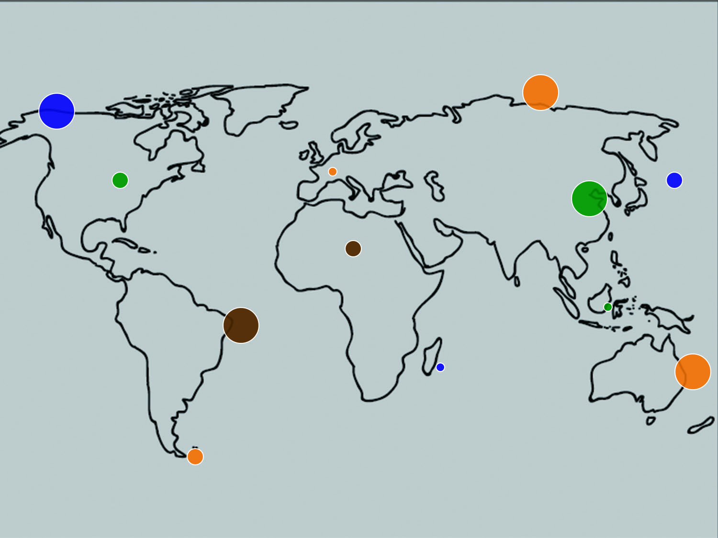
Notes:
Image credit: Microsoft Office

Slide 13
Certainty of Change Matt 16:13-19; Acts 1-16

Slide 14
The Stewardship of Innovation

Slide 15
Great Commission

Slide 16
Spirit-Filled Church
Kingdom Innovation

Slide 17
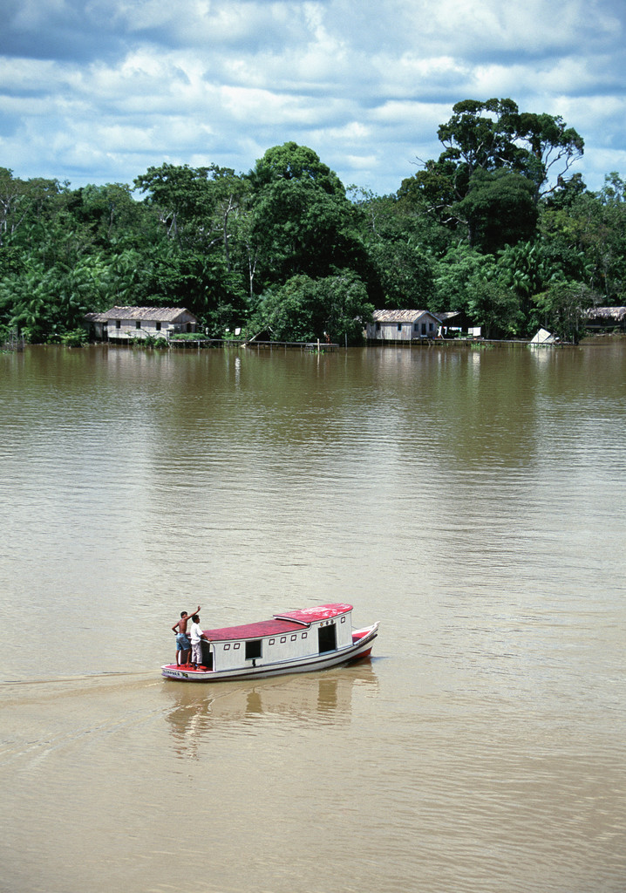
Notes:
Image credit: Microsoft Office

Slide 18
Notes:
Image credit: Microsoft Office

Slide 19
“Desire without knowledge is not good, and whoever makes haste with his feet misses his way” (Proverbs, 19:2, ESV).

Slide 20
Pressure Points of the Age

Slide 21
Unreached People Groups “The Bread of Life is simply not available to hundreds and hundreds of millions of people.” David A. Fraser

Slide 22
Unengaged and Unreached

Slide 23
11,000 people groups
6,000 unreached people groups (not including the US and Canada

Slide 24
3,000 unengaged-unreached people groups

Slide 25
360 unreached people groups in the United States
180 unreached people groups in Canada

Slide 26
Priority?

Slide 27
E2 E3

Slide 28
The West as a Mission Field “The west is, once again, a vast mission field.” George G. Hunter III

Slide 29
Post-Christian Mission Field

Slide 30
Notes:
Image credit: Microsoft Office

Slide 31
Strangers Next Door

Slide 32
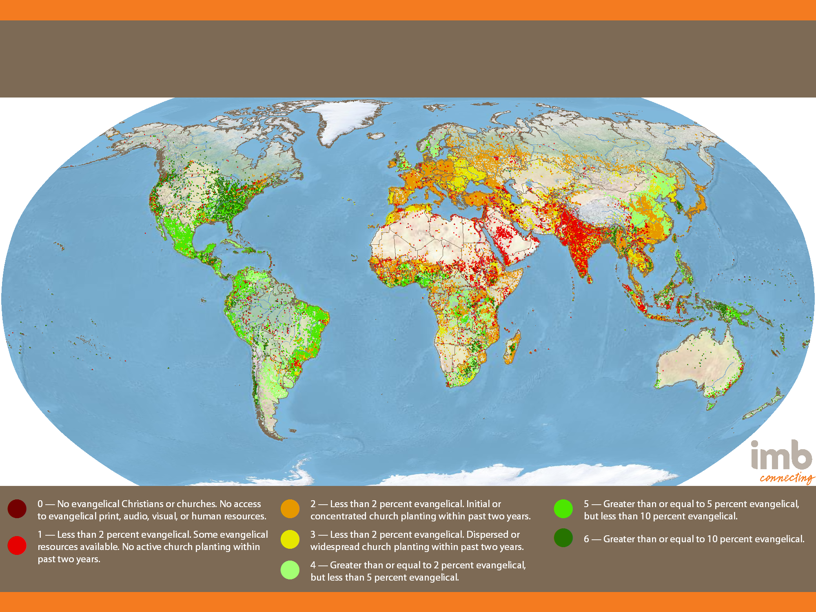
Global Status of Evangelical Christianity
2013 Edition
Notes:
11,332 people groups with a combined population of 6,972,900,714 are detailed in the IMB database as of January 1, 2013. Each people group is represented by one point for every 50,000 people. All data is taken from 2013-01 GSEC Listing of people groups.

Slide 33
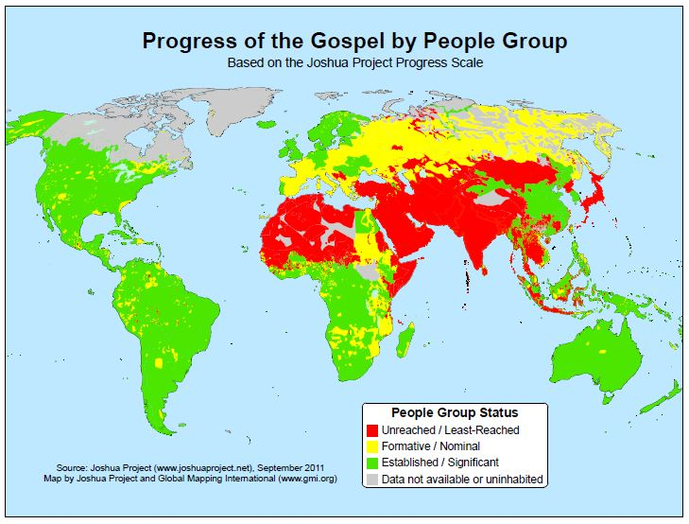
Notes:
Source: Joshua Project

Slide 34
From 35,000 to 15,000 Feet

Slide 35
Least Evangelical US States, 2010
State | Evangelical Percentage
Utah | 2.3
Rhode Island | 2.5
Massachusetts | 3.4
New Hampshire | 3.6
Vermont | 3.6
New Jersey | 4.3
Connecticut | 4.4
Maine | 4.5
New York | 4.5
Delaware | 7.2

Slide 36
Returning to the Apostolic

Slide 37
From Apostolic to Pastoral

Slide 38
E2 E3

Slide 39
Both/And

Slide 40
Growth of the Majority World Church
“It is like a grain of mustard seed, which, when sown on the ground, is the smallest of all the seeds on earth, yet when it is sown it grows up and becomes larger than all the garden plants and puts out large branches, so that the birds of the air can make nests in its shade”
(Mark 4:31-32, ESV).

Slide 41
An Enquiry into the Majority World Church

Slide 42
Select Countries with Evangelical Percentages
Country | Evangelical Percentages
Kenya | 49%
Uganda | 37%
Central African Republic | 32%
El Salvador | 32%
Zimbabwe | 31%
Nigeria | 31%
Nicaragua | 30%
Burundi | 27%

Slide 43
Notes:
Image credit: Microsoft Office

Slide 44
Select Missionary-Sending Countries
Country | Missionaries
India | 82,950
China, PRC | 20,000
Nigeria | 6,644
Philippines | 4,500
Indonesia | 3,000
Ghana | 2,000
Ukraine | 1,599

Slide 45
Pluralism and the Plurality of Faiths “I am the Way…No one comes to the Father except through me” (John 14:6, ESV).

Slide 46
How the Pressure Is Felt--Internally

Slide 47
How the Pressure is Felt--Externally

Slide 48
Contextualization Matters

Slide 49
International Migration “And He made from one man every nation of mankind to live on all the face of the earth, having determined allotted periods and the boundaries of their dwelling place” (Acts 17:26, ESV).

Slide 50
3%
232 Million

Slide 51
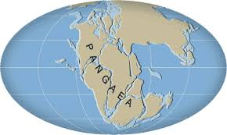
Notes:
Image credit: Microsoft Office

Slide 52
The Divine Maestro

Slide 53
God Is Working in North America

Slide 54
The Potential of the Strangers Next Door

Slide 55
Poverty “Remember the poor” (Galatians 2:10, ESV).

Slide 56
Notes:
Paul Borthwick, Western Christians in Global Mission
Image credit: Microsoft Office

Slide 57
Growth of the Cities

Slide 58
“If current projections are anything to go by, virtually the whole of the world’s demographic growth over the next 30 years will be concentrated in urban areas.”
UN Human Settlements Program

Slide 59
Children and Youth “But Jesus said, ‘Let the children come to me and do not hinder them, for to such belongs the kingdom of heaven’” (Matthew 19:14, ESV).

Slide 60
Let Them Come to Me

Slide 61
Health Care “But a Samaritan…when He saw him, He had compassion” (Luke 10:33, ESV).

Slide 62
Notes:
Image credit: Microsoft Office

Slide 63
Sanitation and Clean Water

Slide 64
Children

Slide 65
Maternal Health

Slide 66
HIV/AIDS

Slide 67
Oral Learners “Faith comes from hearing” (Romans 10:17, ESV).

Slide 68
Categories of Learning

Slide 69
Faith Comes by Understanding

Slide 70
Notes:
Image credit: Microsoft Office

Slide 71
Pornification of Societies “Flee from sexual immorality” (I Corinthians 6:18, ESV).

Slide 72
The Global Reach

Slide 73
Internal and External Pressure

Slide 74
Conclusion

Slide 75
Understand the Pressure Points

Slide 76
Know Your Box in View of the Pressure Points

Slide 77
Recognize Internal Pressures

Slide 78
Make Time to Think

Slide 79
Delight in Grace

Slide 80
Practice Strategic Integration

Slide 81
Develop Majority World Partnerships

Slide 82
Labor Among the Diasporas

Slide 83
Leverage Technology

Slide 84
Business as Mission

Slide 85
Keep It Simple
Reproducibility
Complexity

Slide 86
Share Today’s Stories Later Today

Slide 87
Prepare for Backlash

Slide 88
Develop a Missionary Strategy

Slide 89
Lead from the Word, Guided by the Spirit

Slide 90
Globalization and the Pressure Points of Our Age J.D. Payne

