Slide 1
Strangers Next Door
Empowered Conference
Colonial Heights, Virginia
April 14, 2015
J. D. Payne

Slide 2
jpayne@brookhills.org
@jd_payne
jdpayne.org

Slide 3
Yemen

Slide 4
3%
232 Million

Slide 5
Acts 17:26-27

Slide 6
Samuel and Young Cho

Slide 8
Countries with the Highest Numbers of International Migrants, 2013
Country | Estimated number of international migrants, 2013
United States | 45,800,000
Russian Federation | 11,000,000
Germany | 9,800,000
Saudi Arabia | 9,100,000
United Arab Emirates | 7,800,000
United Kingdom | 7,800,000
France | 7,400,000
Canada | 7,300,000
Australia | 6,500,000
Spain | 6,500,000

Slide 9
Global People Groups: 11,000
Unreached People Groups: 6,800

Slide 10
“Unreached”?

Slide 11
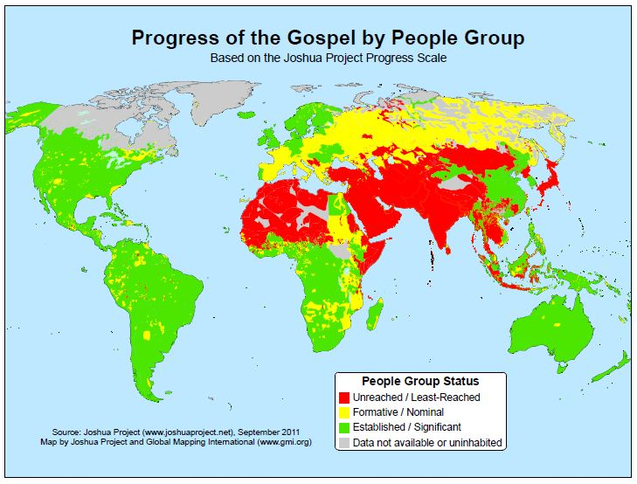
Notes:
Source: Joshua Project

Slide 12
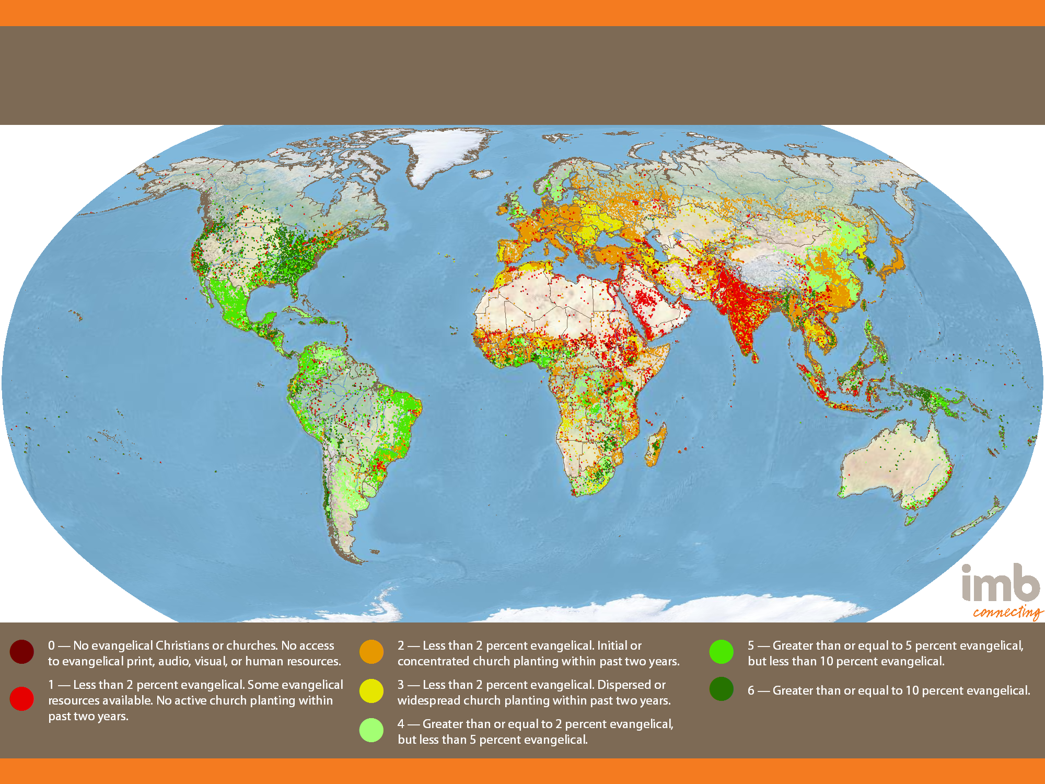
Global Status of Evangelical Christianity
2013 Edition
Notes:
11,332 people groups with a combined population of 6,972,900,714 are detailed in the IMB database as of January 1, 2013. Each people group is represented by one point for every 50,000 people. All data is taken from 2013-01 GSEC Listing of people groups.

Slide 13
Countries with the Largest Numbers of UPGs

Slide 14
Rank | Country | UPGs
1 | India | 941
2 | China | 368
3 | United States | 361
4 | Brazil | 187
5 | Canada | 180
6 | Indonesia | 177
7 | Mexico | 161
Notes:
Source: Global Research

Slide 15
Notes:
Source: Joshua Project

Slide 16
Global Status of Evangelical Christianity
2013 Edition
Notes:
11,332 people groups with a combined population of 6,972,900,714 are detailed in the IMB database as of January 1, 2013. Each people group is represented by one point for every 50,000 people. All data is taken from 2013-01 GSEC Listing of people groups.

Slide 17
35,000 Feet to
15,000 Feet

Slide 18
Top Places of Origin, International Students in the United States
Rank | Country | 2013/14 | Percentage of Total
 | World Total | 886,052 | 100
1 | China | 274,439 | 31.0
2 | India | 102,673 | 11.6
3 | South Korea | 68,047 | 7.7
4 | Saudi Arabia | 53,919 | 6.1
5 | Canada | 28,304 | 3.2
6 | Taiwan | 21,266 | 2.4
7 | Japan | 19,334 | 2.2
8 | Vietnam | 16,579 | 1.9
9 | Mexico | 14,779 | 1.7
10 | Brazil | 13,286 | 1.5

Slide 19
Starbucks Drinking Saudis

Slide 20
2014 Refugee Arrivals to the U. S. by Country of Nationality
Iraq | 19,651
Burma | 14,577
Somalia | 9,011
Bhutan | 8,316
Congo, Democratic Republic | 4,502
Cuba | 4,063
Iran | 2,833
Eritrea | 1,445
Sudan | 1,307
Afghanistan | 758
Total All Countries | 69,986

Slide 21
Mejra

Slide 22
Guidelines for Reaching the Strangers Next Door
Notes:
Chapter 1 Pg 6-8

Slide 23
Pray, Pray, Pray
Be intentional
Learn as you go
Notes:
Chapter 1 Pg 6-8

Slide 24
Expect to make mistakes
Keep things simple and highly reproducible
Avoid paternalism
Notes:
Chapter 1 Pg 6-8

Slide 25
Work the Bridges of God
Prioritize by receptivity
Notes:
Chapter 1 Pg 6-8

Slide 26
Understand cultural and generational differences
Contextualize methods
Practice evangelism that results in new churches
Notes:
Chapter 1 Pg 6-8

Slide 27
Strangers Next Door
Empowered Conference
Colonial Heights, Virginia
April 14, 2015
J. D. Payne

