Slide 1

Biblical Church Planting: Reflections and Realities in the 21st Century
J. D. Payne
Reverb Arkansas
September 17, 2015

Slide 2
J. D. Payne jpayne@brookhills.org
@jd_payne www.jdpayne.org

Slide 3
Church Planting
Evangelism that Results in
New Churches

Slide 4
Acts 13-14
Rom 15:20-21
Titus 1:5

Slide 5
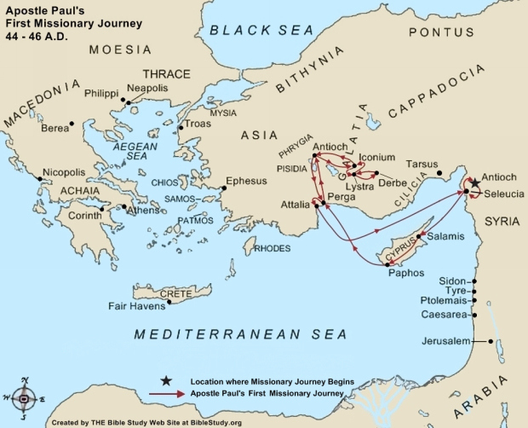

Slide 6
1 Thes 1:2-10

Slide 7
And you became
imitators of us and of the Lord.
SEED
SOWERS
SOIL
SPIRIT
Your faith…has gone forth everywhere
You became an example

Slide 8
Gospel Shared
Disciples Made
Church Identified
Pastors Appointed
Pathway to Planting

Slide 9
Team

Slide 10
Present Challenges

Slide 11
Ecclesiological Challenge

Slide 12
Challenge of Pastoral Missiology

Slide 13
Apostolic
Pastoral

Slide 14
Challenge of Complexity

Slide 15
“have turned the world upside down”

Slide 16
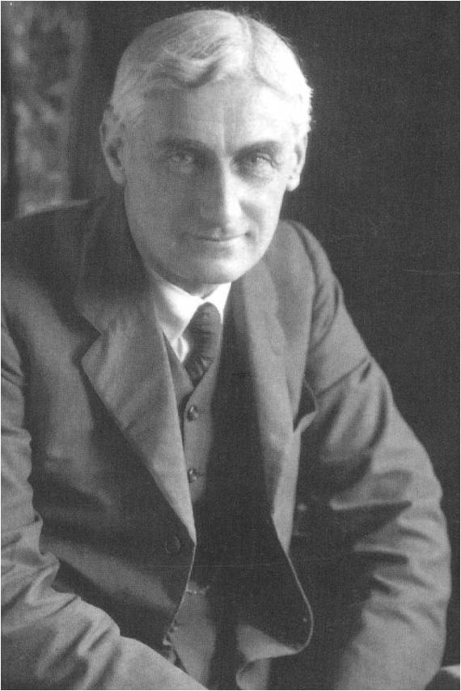
“The spontaneous expansion of the Church reduced to its elements is a very simple thing. It asks for no elaborate organization, no large finances, no great numbers of paid missionaries.”
-- Roland Allen, Spontaneous Expansion

Slide 17
“One man who is able to plant a church so modeled that very few ever could approximate his success is not thinking world evangelization. He is near-sighted. There may be room for unique models which are not reproducible, but if the world is to be reached, it will be by multiplication and not by addition.”
-- Charles Brock, Indigenous Church Planting, 126.

Slide 18
Reproducibility
Complexity

Slide 19
Challenge of Numbers

Slide 20
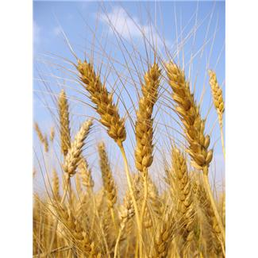
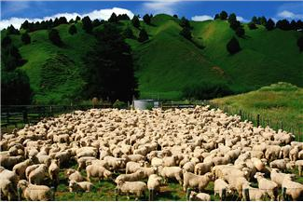
Where do churches come from???

Slide 21
Challenge of E0 and E1 Church Planting

Slide 22
Realities

Slide 23
      Over 11,000 people groups in the world.
      Over 6,000 people groups still not reached with the gospel.
      Over 3,000 unreached people groups that remain unengaged

Slide 24
      74% of the United States has no relationship with Christ
      80% of Canada has no relationship with Christ

Slide 25
      An est. 360 Unreached People Groups Live in the United States
      An est. 180 Unreached People Groups Live in Canada

Slide 26
Countries with the Largest Numbers of UPGs

Slide 27
Rank | Country | UPGs
1 | India | 941
2 | China | 368
3 | United States | 361
4 | Brazil | 187
5 | Canada | 180
6 | Indonesia | 177
7 | Mexico | 161
Notes:
Source: Global Research

Slide 28
Response: Stand on the Bridge

Slide 29
Make the Expectation the Exception
(and the Exception the Expectation)

Slide 30
Embrace a Pauline Approach

Slide 31
“Either we must drag down St. Paul from his pedestal as the great missionary, or else we must acknowledge that there is in his work that quality of universality.”
-- Roland Allen, Missionary Methods

Slide 32
Gospel Shared
Disciples Made
Small Group Gathered
Church Identified
Pastors Appointed
Pathway to Planting

Slide 33
Stop Expecting Pastors to be Missionaries
(and vice versa)

Slide 34
Prioritize According to
Unreached Peoples
Least Reached Places

Slide 35
Keep It Simple

Slide 36
Widen the Church Planting Table

Slide 37
Plant the Church that IS, not the Church to Be

Slide 38
Change Your Metrics

Slide 39
Biblical Church Planting: Reflections and Realities in the 21st Century
J. D. Payne
Reverb Arkansas
September 17, 2015

