Slide 1

Reaching the Nations
Embracing an Apostolic Imagination for Church Multiplication
J. D. Payne
October 27-28, 2017
Wake Forest, North Carolina

Slide 2
J. D. Payne jpayne@brookhills.org
@jd_payne jdpayne.org

Slide 3
3.3%
244 Million

Slide 4
PeopleGroups.Info

Slide 5
Country | UPGs
India | 1514
China | 337
United States | 282
Brazil | 181
Indonesia | 172
Canada | 167
Notes:
Source: Global Research, US and Canadian number from Bryan Galloway (PeopleGroups.info Initiative Lead, IMB Global Research) in email to J. D. Payne October 24, 2017. Numbers may be off 1-5 people groups.

Slide 6
Country | UUPGs
United States | 207
Canada | 141
Notes:
Source: Global Research, US and Canadian number from Bryan Galloway (PeopleGroups.info Initiative Lead, IMB Global Research) in email to J. D. Payne October 24, 2017. Numbers may be off 1-5 people groups.

Slide 7
Church Planting
Evangelism that Results in
New Churches

Slide 8
Rom 15:20-21
Acts 13-14

Slide 9
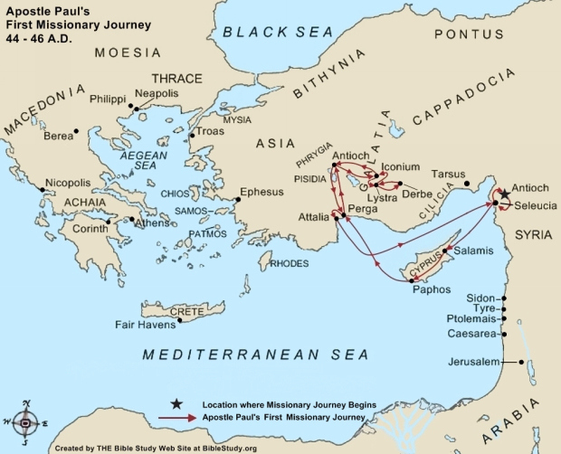

Slide 10
Gospel Shared
Disciples Made
Church Identified
Elders Appointed
Pathway to Planting

Slide 11
1 Thes 1:2-10

Slide 12
And you became
imitators of us and of the Lord.
SEED
SOWERS
SOIL
SPIRIT
Your faith…has gone forth everywhere
You became an example

Slide 13
Evangelism
Discipleship
Pastoral Development

Slide 14
Challenges

Slide 15
Ecclesiological Challenge

Slide 16
“It’s imperative that before we start a church we know what we’re starting.” – Aubrey Malphurs

Slide 17

If our foundation is wrong, then our missiology and methods are on tenuous ground.
Missionary
Methods
Missiology
Theology

Slide 18
What are we planting?

Slide 19
Kingdom
Confession
Kingdom
Ethic
Matt 18:15-20
Matt 22:37-40
Matt 28:18-20
Matt 16:13-19

Slide 20
Family (Matt 12:48-49)
Body (1 Cor 12:20)
Priests (1 Pet 2:9)
Fellowship (1 Jn 1:7)
Community (Acts 2:44; 4:34)
Temple (1 Cor 3:16)
Household (Eph 2:19-21)
Bride (Eph 5:22-23; Rev 21:9)
Branches (Jn 15:5)
Sheep (Jn 10:1-18)
Light (Matt 5:14)

Slide 21
Kingdom Communities (i.e., local churches)
Live According to the Kingdom Ethic in Relation to God, other Kingdom Citizens, and the nations.
Kingdom Citizens

Slide 22
What are we planting?

Slide 23
More Community, Less Acquaintances

Slide 24
More Participation, Less Passivity

Slide 25
More Organic, Less Institutional

Slide 26
More Simple, Less Structure

Slide 27
More ministers, Less Ministers

Slide 28
A Church has a Common. . .
Call (Rom 8:28)
Confession (Matt 16:16)
Commitment (Matt 22:37; John 14:15)
Community (Acts 4:32-47; Gal 6:2, 10)
Commission (Mat 22:39; 28:18-20)

Slide 29
What are we planting?

Slide 30
A regenerate, baptized, body of Kingdom citizens who self-identify (i.e., covenant) as a local expression of the universal Body of Christ to live out the Kingdom Ethic together.

Slide 31
“Remembering that the church is a people should help us recognize what’s important and what’s not important.” --Mark Dever
Notes:
I was once asked on a Monday at 2:00 PM, “Where is your church?” Without thinking I responded, most are in Louisville but some are scattered in Southern Indiana. To which the person responded, “No, I was not asking about the church as a people, but as the place the people meet.” My response was, “You did not ask me that question.”

Slide 32
RELATIONSHIPS

Slide 33
Challenge of Complexity

Slide 34
Complexity
Time

Slide 35
“have turned the world upside down”

Slide 36
Reproducibility
Complexity

Slide 37
“One man who is able to plant a church so modeled that very few ever could approximate his success is not thinking world evangelization. He is near-sighted. There may be room for unique models which are not reproducible, but if the world is to be reached, it will be by multiplication and not by addition.”
-- Charles Brock, Indigenous Church Planting, 126.

Slide 38
Challenge of Pastoral Missiology

Slide 39
Apostolic
Pastoral

Slide 40
Challenge of Numbers

Slide 41
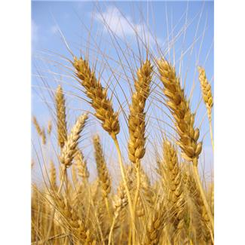
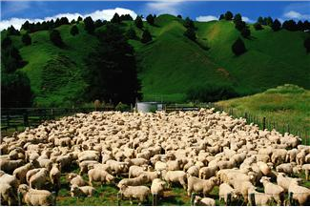
Where do churches come from???

Slide 42
Our Response

Slide 43
Make the Exception the Expectation

Slide 44
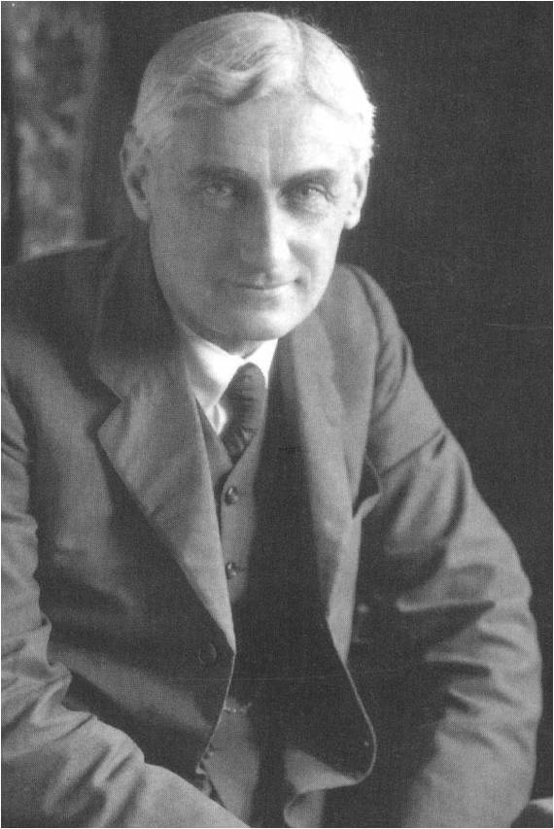
“Either we must drag down St. Paul from his pedestal as the great missionary, or else we must acknowledge that there is in his work that quality of universality.”
-- Roland Allen, Missionary Methods
Notes:
We want Paul’s theology and his results, but we do not want to follow his apostolic pattern.

Slide 45
Keep It Simple

Slide 46
When ordinary believers begin doing ordinary ministry in ordinary ways, God often does extraordinary things in our communities.

Slide 47
Plant the Church that IS, not the Church to Come

Slide 48
Reaching the Nations
Embracing an Apostolic Imagination for Church Multiplication
J. D. Payne
October 27-28, 2017
Wake Forest, North Carolina

