Slide 1
Reaching the Nations
Migration, Mission and Our Response
Brentwood, Tennessee
August 26-27, 2016
J. D. Payne

Slide 2
jpayne@brookhills.org
@jd_payne
jdpayne.org

Slide 3
Migration and Mission

Slide 4
Yemen

Slide 5
3.3%
244 Million

Slide 6
Acts 17:26-27

Slide 7
Samuel and Young Cho

Slide 9
International Migrants

Slide 10
United States | 47,000,000
Germany | 12,000,000
Russian Federation | 12,000,000
Saudi Arabia | 10,000,000
United Kingdom | 9,000,000
United Arab Emirates | 8,000,000
Canada | 8,000,000
France | 8,000,000
Australia | 7,000,000
Spain | 6,000,000
Notes:
Countries with the highest number of international migrants, 2015 (UN data).

Slide 11
Global People Groups: 11,500
Unreached People Groups: 6,800

Slide 12
“Unreached”?

Slide 13
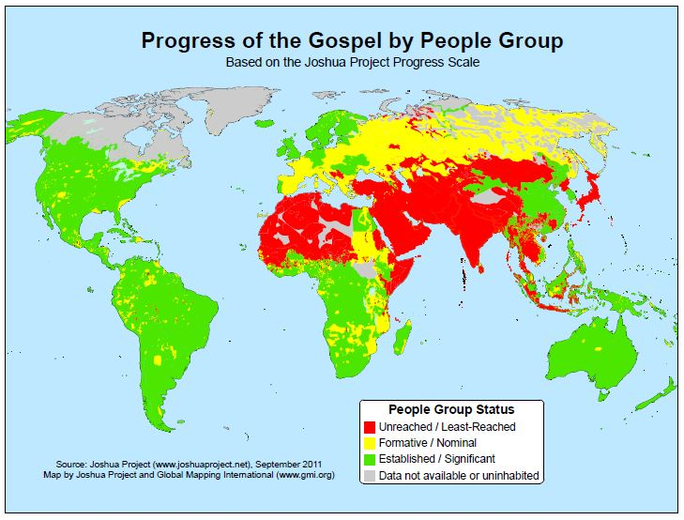
Notes:
Source: Joshua Project

Slide 14
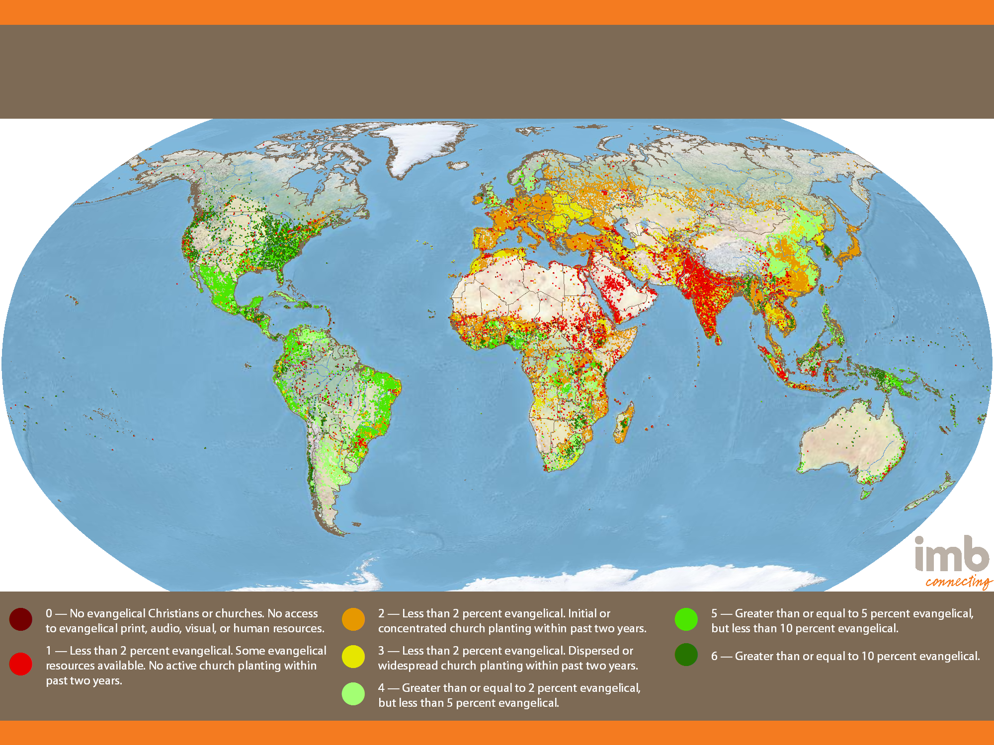
Global Status of Evangelical Christianity
2013 Edition
Notes:
11,332 people groups with a combined population of 6,972,900,714 are detailed in the IMB database as of January 1, 2013. Each people group is represented by one point for every 50,000 people. All data is taken from 2013-01 GSEC Listing of people groups.

Slide 15
35,000 Feet to
15,000 Feet

Slide 16
PeopleGroups.Info

Slide 17
Country | UPGs
India | 1,264
China | 340
United States | 287
Canada | ~287
Brazil | 181
Notes:
Source: Peoplegroups.org Global Research, US and Canadian numbers from Bryan Galloway (PeopleGroups.info Initiative Lead, IMB Global Research) in email to J. D. Payne August 15, 2016. US and Canadian estimates based on present research. Galloway wrote, “We presently know of 287 (51% of all PGs) UPGs in the USA with at least (39% of all PGs) 220 of these UPGs being Unengaged, no one with an intentional church planting strategy in place. I would estimate at least the same number in Canada.”

Slide 18
International Students:
United States

Slide 19
China | 304,040
India | 132,888
South Korea | 63,710
Saudi Arabia | 59,945
Canada | 27,240
Brazil | 23,675
Taiwan | 20,993
Japan | 19,064
Vietnam | 18,722
Mexico | 17,052
Notes:
Open Doors, 2015 Fast Facts, Top places of origin of international students to the US in 2014-15 academic years (collegiate level). 974,926 students were studying in the United States during this time.

Slide 20
International Students:
Canada

Slide 21
China | 110,918
India | 38,891
South Korea | 19,358
France | 19,035
Saudi Arabia | 13,677
United States | 12,450
Brazil | 8,920
Nigeria | 8,620
Japan | 6,900
Mexico | 5,138
Notes:
Canadian Bureau for International Education, International Students in Canada, 2014 data. There were 336,497 international students in Canada in 2014, studying at all levels.

Slide 22
Starbucks Drinking Saudis

Slide 23
U. S. Refugees

Slide 24
Burma | 18,386
Iraq | 12,676
Somalia | 8,858
Congo, Democratic Republic | 7,876
Bhutan | 5,775
Iran | 3,109
Syria | 1,682
Eritrea | 1,596
Sudan | 1,578
Cuba | 1,527
Notes:
Top countries of origin for refugee arrivals to US in 2015. Total number: 69,933. Taken from October 28, 2015 “Refugees and Asylees in the United States” MigrationPolicy.org

Slide 25
Our Response
Notes:
Chapter 1 Pg 6-8

Slide 26
Reaching the Nations
Migration, Mission and Our Response
Brentwood, Tennessee
August 26-27, 2016
J. D. Payne

