Slide 1
Developing and Leading Apostolic Church Planting Teams
Houston Church Planting Network
February 21, 2018

Slide 2
J. D. Payne jpayne@brookhills.org
@jd_payne www.jdpayne.org

Slide 3




Slide 4
Realities

Slide 5
      Over 11,000 people groups in the world.
      Almost 7,000 people groups still not reached with the gospel.
      Over 3,000 unreached people groups that remain unengaged

Slide 6
      74% of the United States has no relationship with Christ
      90% of Canada has no relationship with Christ

Slide 7
Country | UPGs
India | 1514
China | 337
United States | 282
Brazil | 181
Indonesia | 172
Canada | 167
Notes:
Source: Global Research, US and Canadian number from Bryan Galloway (PeopleGroups.info Initiative Lead, IMB Global Research) in email to J. D. Payne October 24, 2017. Numbers may be off 1-5 people groups.

Slide 8
Country | UUPGs
United States | 207
Canada | 141
Notes:
Source: Global Research, US and Canadian number from Bryan Galloway (PeopleGroups.info Initiative Lead, IMB Global Research) in email to J. D. Payne October 24, 2017. Numbers may be off 1-5 people groups.

Slide 9
Rom 15:20-21
Acts 13-14
Titus 1:5

Slide 10
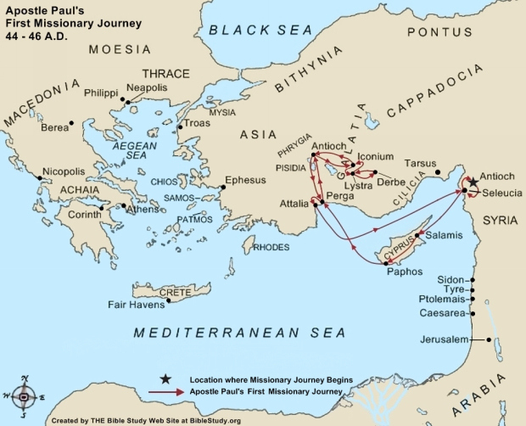

Slide 11
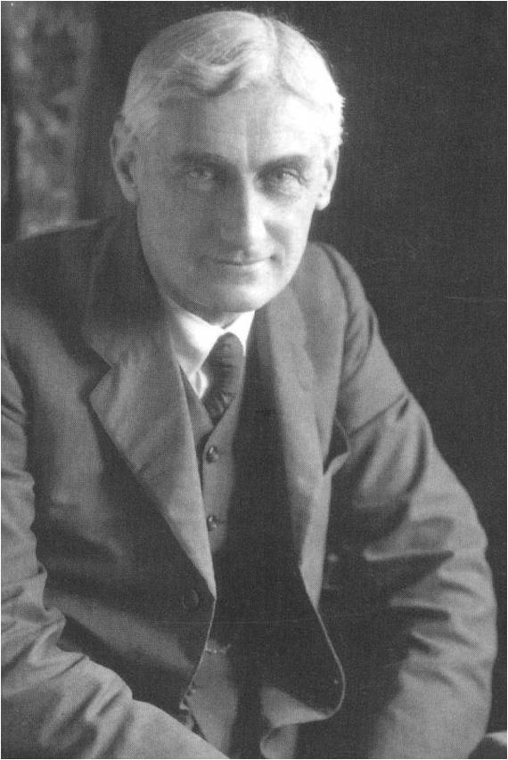
“Either we must drag down St. Paul from his pedestal as the great missionary, or else we must acknowledge that there is in his work that quality of universality.”
-- Roland Allen, Missionary Methods
Notes:
We want Paul’s theology and his results, but we do not want to follow his apostolic pattern.

Slide 12

Gospel Shared
Disciples Made
Church Identified
Pastors Appointed
Pathway to Planting

Slide 13
Gospel Shared
Disciples Made
Small Group Gathered
Church Identified
Pastors Appointed
Pathway to Planting

Slide 14
1 Thes 1:2-10

Slide 15
Team

Slide 16
Evangelism
Discipleship
Pastoral Development

Slide 17
Definition of Team

Slide 18
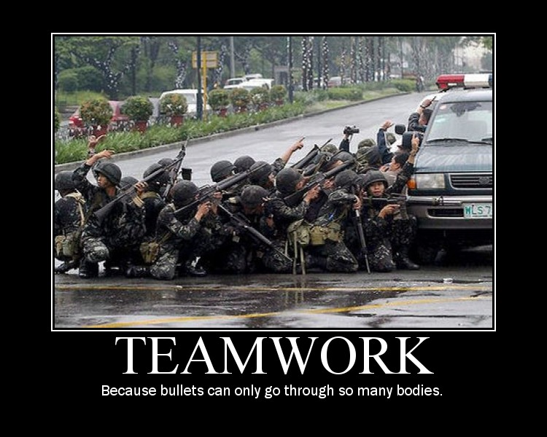

Slide 19

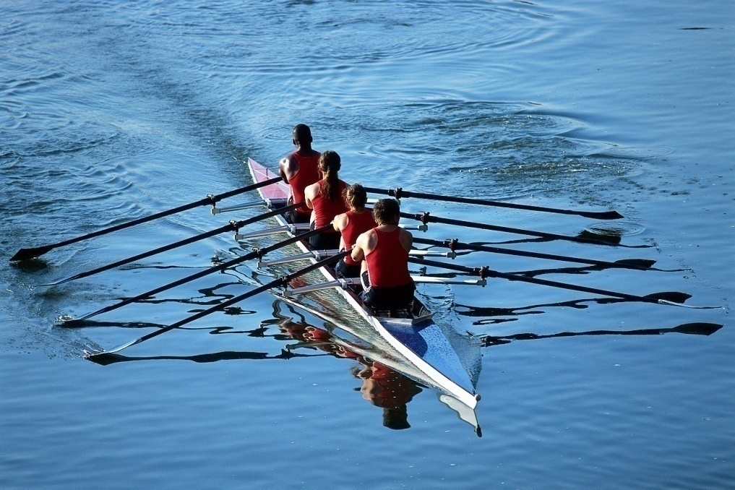
How do you “see” team?

Slide 20
Common Problems for Teams

Slide 21
Communication Breakdown

Slide 22
Poor Chemistry

Slide 23
Refrain from the AIR-LOVE Test

Slide 24
Authority Issues

Slide 25
Character Issues

Slide 26
Vision and Values

Slide 27
On Selecting Team Members

Slide 28
Pray and Fast

Slide 29
Look for People Who Share. . .

Slide 30
Common Calling

Slide 31
Common Theological Position

Slide 32
Commitment to Apostolic Church Planting

Slide 33
Healthy Chemistry

Slide 34
The Barnabas Factors

Slide 35
Walks with the Lord
Maintains an Outstanding Character
Serves in the Local Church
Remains Faithful to the Call
Shares the Gospel Regularly**
Raises Up Leaders**
Encourages with Speech and Actions
Responds Well to Conflict

Slide 36
Agree to a Covenant of Team Understandings

Slide 37
Developing and Leading Apostolic Church Planting Teams
Houston Church Planting Network
February 21, 2018

