Slide 1
From 35,000 to 15,000 Feet: Evangelicals in the United States and Canada: A State/Province, Metro, and County Glimpse
Prepared by the Church Planting Center, The Southern Baptist Theological Seminary,
Dr. J. D. Payne, Director

Slide 2
Presentation Prepared by J. D. Payne and Renee Emerson, Church Planting Center, The Southern Baptist Theological Seminary
In order to understand this presentation better, you are urged to download and read the free corresponding report by clicking HERE
For more information, contact: J. D. Payne at jpayne@sbts.edu or the Church Planting Center at churchplanting@sbts.edu

Slide 3
important limitations
Definition of Evangelical used in the research report of Religious Congregations and Membership in the United States: 2000
Because of this broad definition used, from a missiological perspective, I (Payne) firmly believe the number of Kingdom Citizens living missional lives in these locations of the U. S. and Canada are, in reality, much lower than they appear in this presentation.

Slide 4
what is not here
The 15,000 feet perspective is still a big picture perspective; so you will not find:
Pockets of lostness
Substantial numbers of Unreached People Groups who have migrated to the U. S. or Canada
Receptivity levels to the gospel
(For important information related to these three matters, see the corresponding report linked to Slide #2.)

Slide 5
why these statistics
Most missiologists have labeled unreached peoples of the world numbering approximately 2% or less evangelical, with 5% or less Christian adherents
Desire to show how the statistics look in the U.S. and Canada
Some missiologists have encouraged setting goals of evangelical church to population ratios of 1:1500 in urban contexts and 1:500 in rural contexts.

Slide 6
Moving from 35,000 to 15,000 feet
35,000 feet perspective—maps revealing the total estimated percentage of evangelicals in a country
15,000 feet perspective—maps in this presentation showing the total estimated percent of evangelicals in a state/province, metro, and country
This change in perspective provides us with a more accurate and surprising picture of reality

Slide 8
data sources
The U. S. data for this presentation was taken from The Association of Religion Data Archives (2000 Religious Congregations and Membership Study)
Data on the U. S. is nine years old at the time of this study by the Church Planting Center
The Canadian data for this presentation was provided by Loren Hunter, Outreach Canada
2006 Data on Canada was three years old at the time of this study by the Church Planting Center

Slide 9
the purpose
To note the need for better missiological research in North America
To note that important data is available to evangelicals if they are willing to search for it
To emphasize that wise missionary strategy is guided by good missiological research
To point out some of the least evangelical areas of the United States and Canada
To urge strategists across denominations and churches to consider the importance of prioritizing most needy areas (and most receptive)

Slide 10
contents of presentation
The percentage of evangelicals per U. S. state
The evangelical church to population ratio of each U. S. state
A sampling of some U. S. counties with a 10% or less evangelical population AND the evangelical church to population ratio in each of those counties
A list of U. S. Metro areas with less than a 10% evangelical population
A specific list of U. S Metro areas with less than a 3% evangelical population
The number of evangelical churches and the evangelical church to population ratios in selected Canadian cities (2006)

Slide 11
strategic recommendations
Missionary strategies for the U. S. and Canada must reflect a wise stewardship of the opportunities the Lord has provided
While evangelical need is not the only factor that should be taken into consideration for wise strategic planning (receptivity levels must be included as well-see corresponding report), need is a major factor that should be considered

Slide 12
strategic recommendations
Evangelicals must begin to do more and better missiological research throughout the U. S. and Canada and share their findings for the sake of the Kingdom
Evangelicals must begin prioritizing areas of the greatest need for gospel sowing and church multiplication
Within the areas of the greatest need the most strategic area/people to begin missional labors is among the most receptive to the gospel. Who is presently asking the Philippian Jailer Question in your area? If you don’t know—find out!

Slide 13
strategic recommendations
Evangelicals should consider using an evangelical church to population ratio of 1:1500 (urban) and 1:500 (rural)

Slide 14
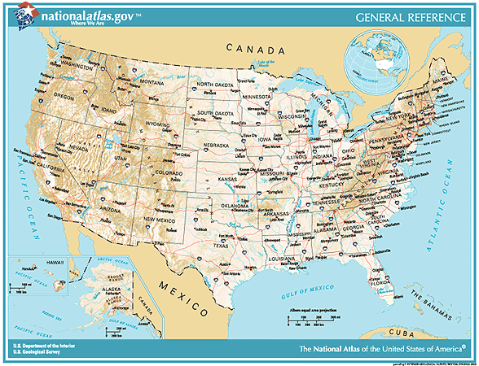
Evangelicals per State

Slide 15
Alabama: 41% evangelical, 717 people per church
Statistic Source: The Association of Religion Data Archives
Presentation by: The Church Planting Center, The Southern Baptist Theological Seminary, 2009

Slide 16
Alaska: 13% evangelical, 1,511 people per church
Statistic Source: The Association of Religion Data Archives
Presentation by: The Church Planting Center, The Southern Baptist Theological Seminary, 2009

Slide 17
Arizona: 10% evangelical, 2,959 people per church
Statistic Source: The Association of Religion Data Archives
Presentation by: The Church Planting Center, The Southern Baptist Theological Seminary, 2009

Slide 18
Arkansas: 43% evangelical, 586 people per church
Statistic Source: The Association of Religion Data Archives
Presentation by: The Church Planting Center, The Southern Baptist Theological Seminary, 2009

Slide 19
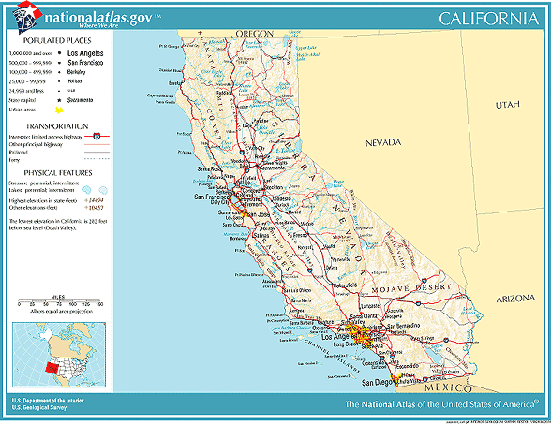
California: 7% evangelical; 3,760 people per church
Statistic Source: The Association of Religion Data Archives
Presentation by: The Church Planting Center, The Southern Baptist Theological Seminary, 2009

Slide 20
Colorado: 11% evangelical, 2,573 people per church
Statistic Source: The Association of Religion Data Archives
Presentation by: The Church Planting Center, The Southern Baptist Theological Seminary, 2009

Slide 21
Connecticut: 2% evangelical, 7,403 people per church
Statistic Source: The Association of Religion Data Archives
Presentation by: The Church Planting Center, The Southern Baptist Theological Seminary, 2009

Slide 22
Delaware: 5% evangelical, 3,628 people per church
Statistic Source: The Association of Religion Data Archives
Presentation by: The Church Planting Center, The Southern Baptist Theological Seminary, 2009

Slide 23
Florida: 14% evangelical, 2,401 people per church
Statistic Source: The Association of Religion Data Archives
Presentation by: The Church Planting Center, The Southern Baptist Theological Seminary, 2009

Slide 24
Georgia: 28% evangelical, 1,272 people per church
Statistic Source: The Association of Religion Data Archives
Presentation by: The Church Planting Center, The Southern Baptist Theological Seminary, 2009

Slide 25
Hawaii: 8% evangelical, 2,898 people per church
Statistic Source: The Association of Religion Data Archives
Presentation by: The Church Planting Center, The Southern Baptist Theological Seminary, 2009

Slide 26
Idaho: 9% evangelical, 2,193 people per church
Statistic Source: The Association of Religion Data Archives
Presentation by: The Church Planting Center, The Southern Baptist Theological Seminary, 2009

Slide 27
Illinois: 10% evangelical, 2,597 people per church
Statistic Source: The Association of Religion Data Archives
Presentation by: The Church Planting Center, The Southern Baptist Theological Seminary, 2009

Slide 28
Indiana: 16% evangelical, 1,481 people per church
Statistic Source: The Association of Religion Data Archives
Presentation by: The Church Planting Center, The Southern Baptist Theological Seminary, 2009

Slide 29
Iowa: 12% evangelical, 1,859 people per church
Statistic Source: The Association of Religion Data Archives
Presentation by: The Church Planting Center, The Southern Baptist Theological Seminary, 2009

Slide 30
Kansas: 16% evangelical, 1,489 people per church
Statistic Source: The Association of Religion Data Archives
Presentation by: The Church Planting Center, The Southern Baptist Theological Seminary, 2009

Slide 31
Kentucky: 34% evangelical, 788 people per church
Statistic Source: The Association of Religion Data Archives
Presentation by: The Church Planting Center, The Southern Baptist Theological Seminary, 2009

Slide 32
Louisiana: 22% evangelical, 1,755 people per church
Statistic Source: The Association of Religion Data Archives
Presentation by: The Church Planting Center, The Southern Baptist Theological Seminary, 2009

Slide 33
Maine: 3% evangelical, 3,783 people per church
Statistic Source: The Association of Religion Data Archives
Presentation by: The Church Planting Center, The Southern Baptist Theological Seminary, 2009

Slide 34
Maryland: 8% evangelical, 3,655 people per church
Statistic Source: The Association of Religion Data Archives
Presentation by: The Church Planting Center, The Southern Baptist Theological Seminary, 2009

Slide 35
Massachusetts: 2% evangelical, 8,078 people per church
Barnstable and Yarmouth
Statistic Source: The Association of Religion Data Archives
Presentation by: The Church Planting Center, The Southern Baptist Theological Seminary, 2009

Slide 36
Michigan: 11% evangelical, 2,615 people per church
Statistic Source: The Association of Religion Data Archives
Presentation by: The Church Planting Center, The Southern Baptist Theological Seminary, 2009

Slide 37
Minnesota: 11% evangelical, 2,431 people per church
Statistic Source: The Association of Religion Data Archives
Presentation by: The Church Planting Center, The Southern Baptist Theological Seminary, 2009

Slide 38
Mississippi: 40% evangelical, 754 people per church
Statistic Source: The Association of Religion Data Archives
Presentation by: The Church Planting Center, The Southern Baptist Theological Seminary, 2009

Slide 39
Missouri: 25% evangelical, 1,111 people per church
Statistic Source: The Association of Religion Data Archives
Presentation by: The Church Planting Center, The Southern Baptist Theological Seminary, 2009

Slide 40
Montana: 11% evangelical, 1,251 people per church
Statistic Source: The Association of Religion Data Archives
Presentation by: The Church Planting Center, The Southern Baptist Theological Seminary, 2009

Slide 41
Nevada: 5% evangelical, 5,124 people per church
Statistic Source: The Association of Religion Data Archives
Presentation by: The Church Planting Center, The Southern Baptist Theological Seminary, 2009

Slide 42
New Hampshire: 2% evangelical, 6,088 people per church
Statistic Source: The Association of Religion Data Archives
Presentation by: The Church Planting Center, The Southern Baptist Theological Seminary, 2009

Slide 43
New Jersey: 2% evangelical, 7,540 people per church
Statistic Source: The Association of Religion Data Archives
Presentation by: The Church Planting Center, The Southern Baptist Theological Seminary, 2009

Slide 44
New Mexico: 13% evangelical, 1,718 people per church
Statistic Source: The Association of Religion Data Archives
Presentation by: The Church Planting Center, The Southern Baptist Theological Seminary, 2009

Slide 45
New York: 3% evangelical, 6,607 people per church
Statistic Source: The Association of Religion Data Archives
Presentation by: The Church Planting Center, The Southern Baptist Theological Seminary, 2009

Slide 46
North Carolina: 27% evangelical, 1,172 people per church
Statistic Source: The Association of Religion Data Archives
Presentation by: The Church Planting Center, The Southern Baptist Theological Seminary, 2009

Slide 47
North Dakota: 11% evangelical, 1,504 people per church
Statistic Source: The Association of Religion Data Archives
Presentation by: The Church Planting Center, The Southern Baptist Theological Seminary, 2009

Slide 48
Nebraska: 15% evangelical, 1,693 people per church
Statistic Source: The Association of Religion Data Archives
Presentation by: The Church Planting Center, The Southern Baptist Theological Seminary, 2009

Slide 49
Ohio: 10% evangelical, 2,254 people per church
Statistic Source: The Association of Religion Data Archives
Presentation by: The Church Planting Center, The Southern Baptist Theological Seminary, 2009

Slide 50
Oklahoma: 42% evangelical, 787 people per church
Statistic Source: The Association of Religion Data Archives
Presentation by: The Church Planting Center, The Southern Baptist Theological Seminary, 2009

Slide 51
Oregon: 11% evangelical, 1,909 people per church
Statistic Source: The Association of Religion Data Archives
Presentation by: The Church Planting Center, The Southern Baptist Theological Seminary, 2009

Slide 52
Pennsylvania: 6% evangelical, 3,014 people per church
Statistic Source: The Association of Religion Data Archives
Presentation by: The Church Planting Center, The Southern Baptist Theological Seminary, 2009

Slide 53
Rhode Island: 2% evangelical, 8,454 people per church
Statistic Source: The Association of Religion Data Archives
Presentation by: The Church Planting Center, The Southern Baptist Theological Seminary, 2009

Slide 54
South Carolina: 29% evangelical, 1,138 people per church
Statistic Source: The Association of Religion Data Archives
Presentation by: The Church Planting Center, The Southern Baptist Theological Seminary, 2009

Slide 55
South Dakota: 14% evangelical, 1,189 people per church
Statistic Source: The Association of Religion Data Archives
Presentation by: The Church Planting Center, The Southern Baptist Theological Seminary, 2009

Slide 56
Tennessee: 37% evangelical, 795 people per church
Statistic Source: The Association of Religion Data Archives
Presentation by: The Church Planting Center, The Southern Baptist Theological Seminary, 2009

Slide 57
Texas: 24% evangelical, 1,712 people per church
Statistic Source: The Association of Religion Data Archives
Presentation by: The Church Planting Center, The Southern Baptist Theological Seminary, 2009

Slide 58
Utah: 2% evangelical, 8,589 people per church
Statistic Source: The Association of Religion Data Archives
Presentation by: The Church Planting Center, The Southern Baptist Theological Seminary, 2009

Slide 59
Vermont: 2% evangelical, 4,349 people per church
Statistic Source: The Association of Religion Data Archives
Presentation by: The Church Planting Center, The Southern Baptist Theological Seminary, 2009

Slide 60
Virginia: 17% evangelical, 1,754 people per church
Statistic Source: The Association of Religion Data Archives
Presentation by: The Church Planting Center, The Southern Baptist Theological Seminary, 2009

Slide 61
Washington: 10% evangelical, 2,550 people per church
Statistic Source: The Association of Religion Data Archives
Presentation by: The Church Planting Center, The Southern Baptist Theological Seminary, 2009

Slide 62
West Virginia:11% evangelical, 1,051 people per church
Statistic Source: The Association of Religion Data Archives
Presentation by: The Church Planting Center, The Southern Baptist Theological Seminary, 2009

Slide 63
Wisconsin: 13% evangelical, 1,550 people per church
Statistic Source: The Association of Religion Data Archives
Presentation by: The Church Planting Center, The Southern Baptist Theological Seminary, 2009

Slide 64
Wyoming: 11% evangelical, 1,310 people per church
Statistic Source: The Association of Religion Data Archives
Presentation by: The Church Planting Center, The Southern Baptist Theological Seminary, 2009

Slide 65
Evangelicals in Selected Counties

Slide 66
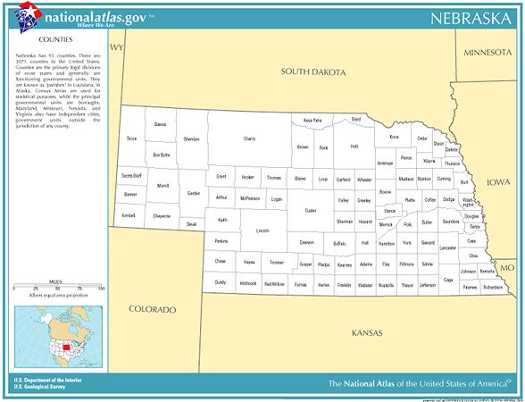
Nebraska
Logan
0 % evangelical
0 evangelicals
Total population:774
0 evangelical churches
Arthur
0 % evangelical
0 evangelicals
Total population: 444
0 evangelical churches
Statistic Source: The Association of Religion Data Archives
Presentation by: The Church Planting Center, The Southern Baptist Theological Seminary, 2009

Slide 67
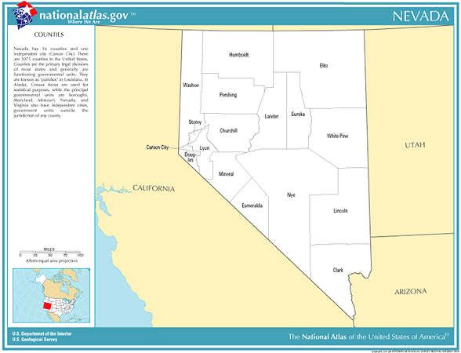
Nevada
Washoe
4.6 % evangelical
15,504 evangelicals
Total population: 339,486
72 evangelical churches
4,715 people per church
Storey
0 % evangelical
0 evangelicals
Total population:3,399
0 evangelical churches
Clark
5.2 % evangelical
70,938 evangelicals
Total population:1,375,765
172 evangelical churches
7,999 people per church
Statistic Source: The Association of Religion Data Archives
Presentation by: The Church Planting Center, The Southern Baptist Theological Seminary, 2009

Slide 68
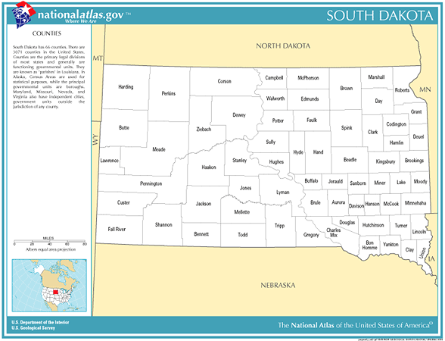
South Dakota
Buffalo
0 % evangelical
0 evangelicals
Total population:2,032
0 evangelical churches
Statistic Source: The Association of Religion Data Archives
Presentation by: The Church Planting Center, The Southern Baptist Theological Seminary, 2009

Slide 69
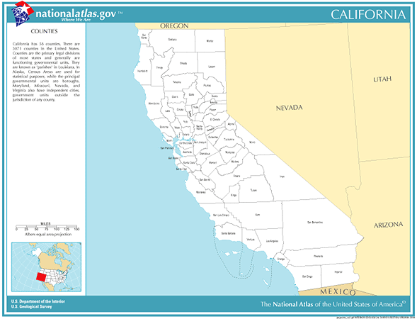
California
Marin
2.2 % evangelical
5,518 evangelicals
Total population: 247,289
36 evangelical churches
6,869 people per church
Sonoma
5.4% evangelical
24,632 evangelicals
Total population: 458,614
119 evangelical churches
3,854 people per church
Alpine
0 % evangelical
0 evangelicals
Total population: 1,208
0 evangelical churches
San Francisco
3.4 % evangelical
26,248 evangelicals
Total population: 776,733
134 evangelical churches
5,797 people per church
San Mateo
2.7 % evangelical
19,291 evangelicals
Total population: 707,161
131 evangelical churches
5,398 people per church
Alameda
4.9 % evangelical
71,279 evangelicals
Total population: 1,443,741
332 evangelical churches
4349 people per church
Santa Clara
5.4 % evangelical
90,851 evangelicals
Total population: 1,682,585
324 evangelical churches
5,193 people per church
Monterey
4.7 % evangelical
18,844 evangelicals
Total population: 401,762
109 evangelical churches
3,686 people per church
Statistic Source: The Association of Religion Data Archives
Presentation by: The Church Planting Center, The Southern Baptist Theological Seminary, 2009

Slide 70
California (continued)
Yolo
4.7% evangelical
7,985 evangelicals
Total population: 168,660
47 evangelical churches
3589 people per church
Santa Cruz
5.4 % evangelical
13,927evangelicals
Total population: 255,602
65 evangelical churches
3,932 people per church
San Benito
2.9 % evangelical
1,548 evangelicals
Total population: 53,234
14 evangelical churches
3,802 people per church
Statistic Source: The Association of Religion Data Archives
Presentation by: The Church Planting Center, The Southern Baptist Theological Seminary, 2009

Slide 71
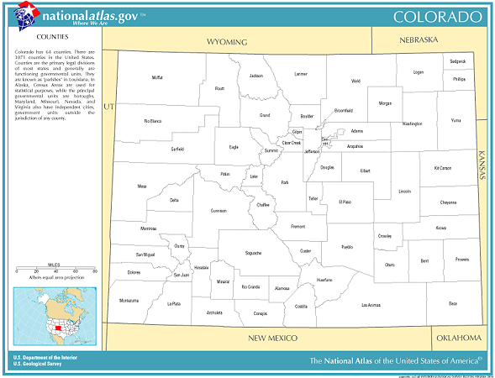
Colorado
Clear Creek
0.7 % evangelical
61 evangelicals
Total population: 9,322
1 evangelical churches
9,322 people per church
Summit
1.4 % evangelical
332 evangelicals
Total population: 23,548
8 evangelical churches
2,944 people per church
Park
2.3 % evangelical
335 evangelicals
Total population: 14,523
8 evangelical churches
1,815 people per church
Statistic Source: The Association of Religion Data Archives
Presentation by: The Church Planting Center, The Southern Baptist Theological Seminary, 2009

Slide 72
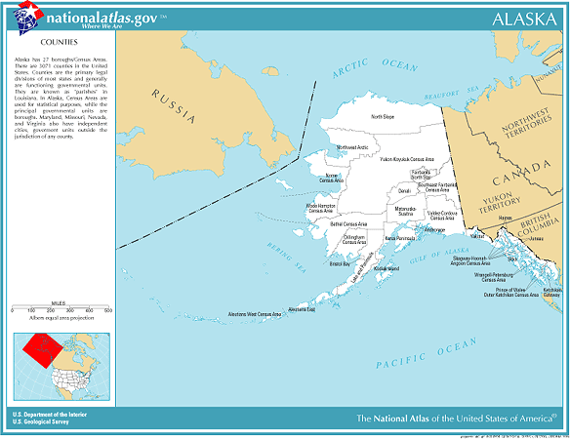
Alaska
Bethel
2.1% evangelical
331 evangelicals
Total population: 16,006
7 evangelical churches
2287 people per church
Aleutians West
0% evangelical
0 evangelicals
Total population: 5,465
0 evangelical churches
Statistic Source: The Association of Religion Data Archives
Presentation by: The Church Planting Center, The Southern Baptist Theological Seminary, 2009

Slide 73
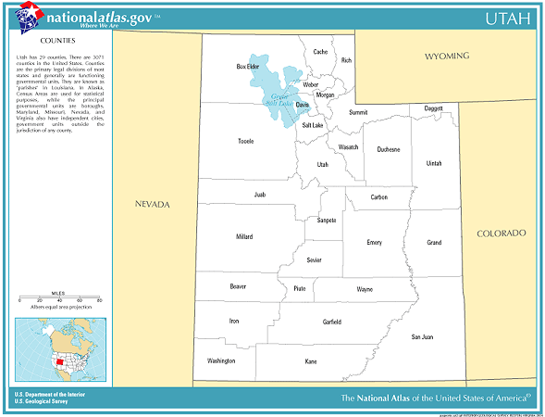
Utah
Cache
1% evangelical
870 evangelicals
Total population: 91,391
8 evangelical churches
11,424 people per church
Box Elder
1.2% evangelical
524 evangelicals
Total population: 42,745
6 evangelical churches
7,124 people per church
Weber
3.2% evangelical
6,348 evangelicals
Total population: 196,533
31 evangelical churches
6,340 people per church
Salt Lake
2.1 % evangelical
18,477 evangelicals
Total population: 898,387
81 evangelical churches
11,091 people per church
Davis
2.4% evangelical
5,703 evangelicals
Total population: 238,994
24 evangelical churches
9,958 people per church
Piute
0% evangelical
0 evangelicals
Total population: 1,435
0 evangelical churches
Washington
1.3% evangelical
1,203 evangelicals
Total population: 90,354
11 evangelical churches
8,214 people per church
Utah
0.6% evangelical
2,356 evangelicals
Total population: 368,536
20 evangelical churches
18,427 people per church
Statistic Source: The Association of Religion Data Archives
Presentation by: The Church Planting Center, The Southern Baptist Theological Seminary, 2009

Slide 74
Utah (continued)
Wasatch
0.2% evangelical
37 evangelicals
Total population: 15,215
0 evangelical churches
15,215 people per church
Tooele
1.3% evangelical
531 evangelicals
Total population: 40,735
6 evangelical churches
6,789 people per church
San Juan
2.1% evangelical
305 evangelicals
Total population: 14,413
7 evangelical churches
2,059 people per church
Beaver
0.8 % evangelical
50 evangelicals
Total population: 6,005
3 evangelical churches
2002 people per church
Iron
1.5% evangelical
493 evangelicals
Total population: 33,779
7 evangelical churches
4,826 people per church
Statistic Source: The Association of Religion Data Archives
Presentation by: The Church Planting Center, The Southern Baptist Theological Seminary, 2009

Slide 75
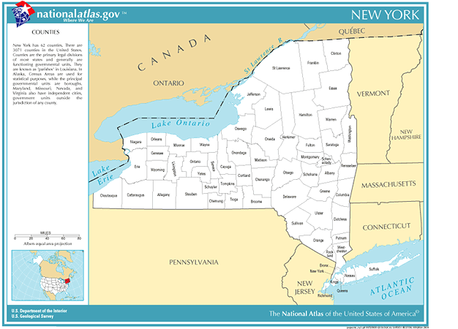
New York
Herkimer
1.7% evangelical
1,096 evangelicals
Total population: 64,427
15 evangelical churches
4,295 people per church
Renssellear
1% evangelical
1,557 evangelicals
Total population: 152,538
21 evangelical churches
7,264 people per church
Ulster
1.6% evangelical
2,801 evangelicals
Total population: 177,749
29 evangelical churches
6,129 people per church
Erie
4.8% evangelical
45,692 evangelicals
Total population: 950,265
132 evangelical churches
7,199 people per church
Suffolk
2.3% evangelical
32,240 evangelicals
Total population: 1,419,369
153 evangelical churches
9,277 people per church
Rockland
2% evangelical
5,759 evangelicals
Total population: 286,753
45 evangelical churches
6,372 people per church
New York
2.1% evangelical
32,144 evangelicals
Total population: 1,537,195
146 evangelical churches
10,529 people per church
Richmond
2.1% evangelical
9,206 evangelicals
Total population: 443,728
38 evangelical churches
11,677 people per church
Nassau
1.6% evangelical
21,344 evangelicals
Total population: 1,334,544
118 evangelical churches
11,310 people per church
Statistic Source: The Association of Religion Data Archives
Presentation by: The Church Planting Center, The Southern Baptist Theological Seminary, 2009

Slide 76
New York (continued)
Saratoga
2.9% evangelical
5,777 evangelicals
Total population: 200,635
37 evangelical churches
5,423 people per church
Monroe
4.4% evangelical
32,002 evangelicals
Total population: 735,343
122 evangelical churches
6,027 people per church
Onondaga
3.8% evangelical
17,216 evangelicals
Total population: 458,336
76 evangelical churches
6,031 people per church
Westchester
2% evangelical
18,313 evangelicals
Total population: 923,459
109 evangelical churches
8,472 people per church
Albany
2.7% evangelical
8,096 evangelicals
Total population: 294,565
45 evangelical churches
6,546 people per church
Columbia
1.3% evangelical
851 evangelicals
Total population: 63,094
9 evangelical churches
7,010 people per church
Queens
1.9% evangelical
41,437 evangelicals
Total population: 2,229,379
261 evangelical churches
8,542 people per church
Dutchess
3.5% evangelical
9,918 evangelicals
Total population: 280,150
37 evangelical churches
7,572 people per church
Orange
3.3% evangelical
11,187 evangelicals
Total population: 341,367
55 evangelical churches
6,207 people per church
Kings
3.5% evangelical
86,054 evangelicals
Total population: 2,465,326
295 evangelical churches
8,357 people per church
Statistic Source: The Association of Religion Data Archives
Presentation by: The Church Planting Center, The Southern Baptist Theological Seminary, 2009

Slide 77
New York (continued)
St. Lawrence
3.7% evangelical
4145 evangelicals
Total population: 111931
44 evangelical churches
2544 people per church
Cayuga
3% evangelical
2489 evangelicals
Total population: 81963
17 evangelical churches
4821 people per church
Jefferson
2.9% evangelical
3261evangelicals
Total population: 111738
30 evangelical churches
3725 people per church
Madison
2.3% evangelical
1600 evangelicals
Total population: 69441
13 evangelical churches
5342 people per church
Wayne
2.7% evangelical
2502 evangelicals
Total population: 93765
27 evangelical churches
3473 people per church
Livingston
2.6 % evangelical
1699 evangelicals
Total population: 64328
19 evangelical churches
3386 people per church
Washington
2.1% evangelical
1257evangelicals
Total population: 61042
12 evangelical churches
5087 people per church
Wyoming
2.8% evangelical
1211 evangelicals
Total population: 43424
14 evangelical churches
3102 people per church
Montgomery
2.8% evangelical
1389 evangelicals
Total population: 49708
13 evangelical churches
3824 people per church
Broome
4.1% evangelical
8314 evangelicals
Total population: 200536
54 evangelical churches
3714 people per church
Otsego
1.9% evangelical
1192 evangelicals
Total population: 61676
14 evangelical churches
4405 people per church
Sullivan
1.3% evangelical
947 evangelicals
Total population: 73966
14 evangelical churches
5283 people per church
Statistic Source: The Association of Religion Data Archives
Presentation by: The Church Planting Center, The Southern Baptist Theological Seminary, 2009

Slide 78
New York (continued)
Clinton
2.9% evangelical
2346 evangelicals
Total population: 79894
18 evangelical churches
4429 people per church
Essex
1.8% evangelical
682 evangelicals
Total population: 38851
9 evangelical churches
4317 people per church
Fulton
3.9% evangelical
2156 evangelicals
Total population: 55073
15 evangelical churches
3672 people per church
Oneida
3.9% evangelical
9216 evangelicals
Total population: 235469
47 evangelical churches
5010 people per church
Warren
4.2% evangelical
2633evangelicals
Total population: 63303
17 evangelical churches
3724 people per church
Ontario
3.9% evangelical
3859 evangelicals
Total population: 100224
22 evangelical churches
4556 people per church
Schenectady
4.2% evangelical
6099 evangelicals
Total population: 146555
26 evangelical churches
5637 people per church
Tompkins
3.6% evangelical
3460 evangelicals
Total population: 96501
22 evangelical churches
4386 people per church
Greene
2.2% evangelical
1049 evangelicals
Total population: 48195
7 evangelical churches
6885 people per church
Chenango
2.6% evangelical
1312 evangelicals
Total population: 51401
16 evangelical churches
3213 people per church
Putnam
2% evangelical
1890 evangelicals
Total population: 95745
10 evangelical churches
9575 people per church
Statistic Source: The Association of Religion Data Archives
Presentation by: The Church Planting Center, The Southern Baptist Theological Seminary, 2009

Slide 79
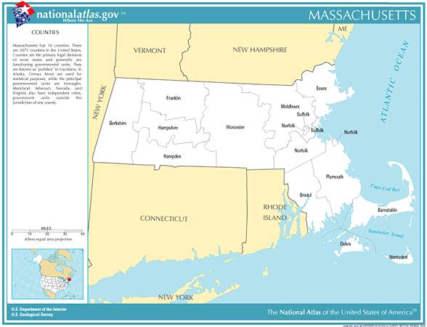
Massachusetts
Middlesex
1.9% evangelical
28188 evangelicals
Total population: 1465396
154 evangelical churches
9516 people per church
Essex
2% evangelical
14713 evangelicals
Total population: 723419
88 evangelical churches
8221 people per church
Worcester
3.3% evangelical
24538 evangelicals
Total population: 24538
136 evangelical churches
5522 people per church
Franklin
2.3% evangelical
1648 evangelicals
Total population: 71535
14 evangelical churches
5110 people per church
Suffolk
4.4% evangelical
30250 evangelicals
Total population: 689807
98 evangelical churches
7039 people per church
Berkshire
1.5% evangelical
1963 evangelicals
Total population: 134953
14 evangelical churches
9640 people per church
Plymouth
2.3% evangelical
10889 evangelicals
Total population: 472822
62 evangelical churches
7626 people per church
Hampshire
1% evangelical
1518 evangelicals
Total population: 152251
11 evangelical churches
13841 people per church
Hampden
2.2% evangelical
9985 evangelicals
Total population: 456228
51 evangelical churches
8946 people per church
Norfolk
1.4% evangelical
9401 evangelicals
Total population: 650308
52 evangelical churches
12506 people per church
Bristol
2.6% evangelical
13783 evangelicals
Total population: 534678
77 evangelical churches
6944 people per church
Barnstable
1.5% evangelical
3291 evangelicals
Total population: 222230
25 evangelical churches
8889 people per church
Statistic Source: The Association of Religion Data Archives
Presentation by: The Church Planting Center, The Southern Baptist Theological Seminary, 2009

Slide 80
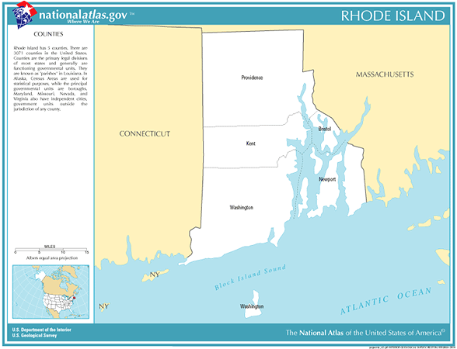
Rhode Island
Newport
1% evangelical
857 evangelicals
Total population: 85433
7 evangelical churches
12205 people per church
Providence
1.8% evangelical
11269 evangelicals
Total population: 621602
91 evangelical churches
6831 people per church
Kent
1.4% evangelical
2325 evangelicals
Total population: 167090
12 evangelical churches
13924 people per church
Washington
1.5% evangelical
1873 evangelicals
Total population: 123546
12 evangelical churches
10296 people per church
Statistic Source: The Association of Religion Data Archives
Presentation by: The Church Planting Center, The Southern Baptist Theological Seminary, 2009

Slide 81
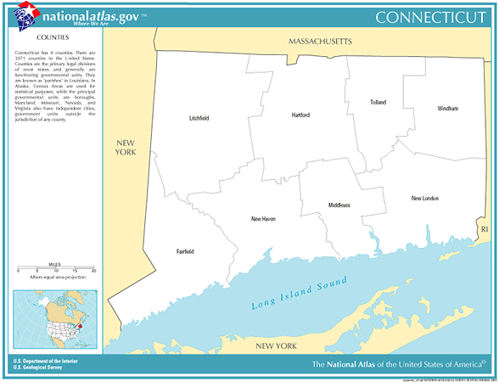
Connecticut
Hartford
2.9% evangelical
24659 evangelicals
Total population: 857183
116 evangelical churches
7390 people per church
Tolland
2.8% evangelical
3795 evangelicals
Total population: 136364
20 evangelical churches
6818 people per church
Windham
2.2% evangelical
2348 evangelicals
Total population: 109091
19 evangelical churches
5742 people per church
Litchfield
2% evangelical
1873 evangelicals
Total population: 182193
21 evangelical churches
8676 people per church
New Haven
1.9% evangelical
16021 evangelicals
Total population: 824008
110 evangelical churches
7491 people per church
Fairfield
2.6% evangelical
22650 evangelicals
Total population: 882567
119 evangelical churches
7417 people per church
Middlesex
1.5% evangelical
2283 evangelicals
Total population: 155071
16 evangelical churches
9692 people per church
New London
2.5% evangelical
6482 evangelicals
Total population: 259088
40 evangelical churches
6477 people per church
Statistic Source: The Association of Religion Data Archives
Presentation by: The Church Planting Center, The Southern Baptist Theological Seminary, 2009

Slide 82
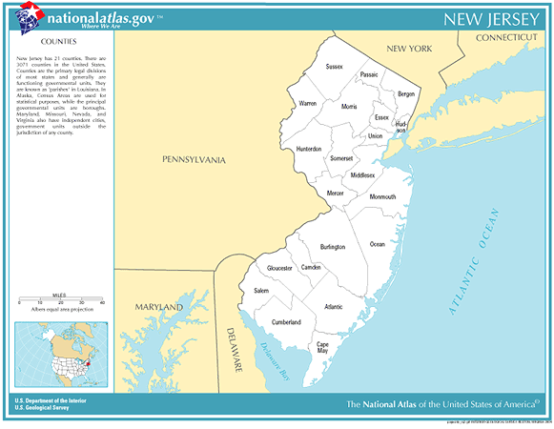
New Jersey
Essex
2.1% evangelical
16810 evangelicals
Total population: 793633
107 evangelical churches
7417 people per church
Bergen
2.2% evangelical
19368 evangelicals
Total population: 884118
108 evangelical churches
8186 people per church
Morris
2.4% evangelical
11075 evangelicals
Total population: 470212
61evangelical churches
7708 people per church
Hudson
2% evangelical
12330 evangelicals
Total population: 608975
82 evangelical churches
7427 people per church
Union
1.9% evangelical
9939 evangelicals
Total population: 522541
71 evangelical churches
7360 people per church
Middlesex
1.6% evangelical
12014 evangelicals
Total population: 750162
67 evangelical churches
11196 people per church
Mercer
2.7% evangelical
9366 evangelicals
Total population: 350761
55 evangelical churches
6377 people per church
Camden
2.3% evangelical
11680 evangelicals
Total population: 508932
68 evangelical churches
7484 people per church
Atlantic
2.1% evangelical
5427 evangelicals
Total population: 252552
44 evangelical churches
5740 people per church
Ocean
1.8% evangelical
9014 evangelicals
Total population: 510916
11 evangelical churches
354 people per church
Monmouth
1.6% evangelical
10149 evangelicals
Total population: 615301
55 evangelical churches
11187 people per church
Statistic Source: The Association of Religion Data Archives
Presentation by: The Church Planting Center, The Southern Baptist Theological Seminary, 2009

Slide 83
New Jersey (continued)
Sussex
2.4% evangelical
3390 evangelicals
Total population: 144166
22 evangelical churches
6553 people per church
Passiac
3.2% evangelical
15781 evangelicals
Total population: 489049
72 evangelical churches
6792 people per church
Warren
4% evangelical
4066 evangelicals
Total population: 102437
29 evangelical churches
3532 people per church
Hunterdon
3.3% evangelical
4081 evangelicals
Total population: 121989
22 evangelical churches
5545 people per church
Somerset
2.6% evangelical
7614 evangelicals
Total population: 297490
28 evangelical churches
10625 people per church
Burlington
3.7% evangelical
15607 evangelicals
Total population: 423394
58 evangelical churches
7300 people per church
Cumberland
5.9% evangelical
8681 evangelicals
Total population: 146438
44 evangelical churches
3328 people per church
Gloucester
5.4% evangelical
13710 evangelicals
Total population: 254673
45 evangelical churches
5659 people per church
Salem
3.6% evangelical
2319 evangelicals
Total population: 64285
22 evangelical churches
2922 people per church
Cape May
1.6% evangelical
1680 evangelicals
Total population: 102326
17 evangelical churches
6019 people per church
Statistic Source: The Association of Religion Data Archives
Presentation by: The Church Planting Center, The Southern Baptist Theological Seminary, 2009

Slide 84
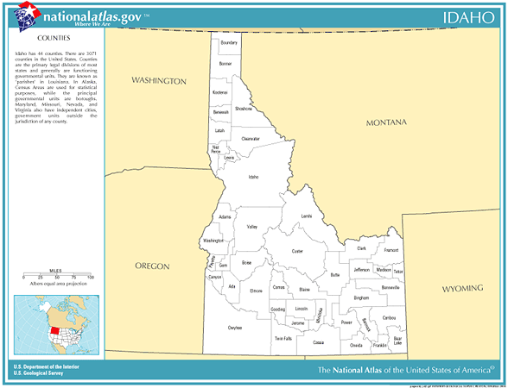
Idaho
Jefferson
0.8% evangelical
153 evangelicals
Total population: 19155
2 evangelical churches
9578 people per church
Bingham
2.1% evangelical
878 evangelicals
Total population: 41735
9 evangelical churches
4637 people per church
Madison
0.1% evangelical
38 evangelicals
Total population: 27467
2 evangelical churches
13734 people per church
Blaine
1.3% evangelical
251 evangelicals
Total population: 18991
4 evangelical churches
4748 people per church
Statistic Source: The Association of Religion Data Archives
Presentation by: The Church Planting Center, The Southern Baptist Theological Seminary, 2009

Slide 85
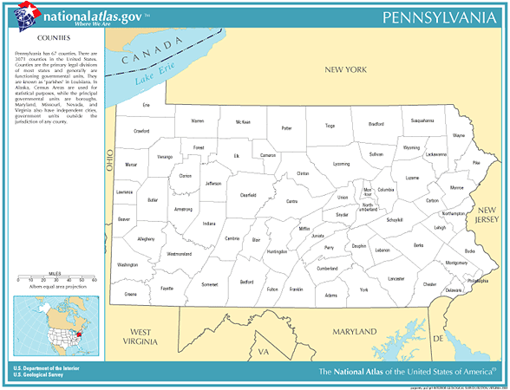
Pennsylvania
Lackawanna
2.6% evangelical
5496 evangelicals
Total population: 213295
35 evangelical churches
6094 people per church
Lehigh
3.2% evangelical
9853 evangelicals
Total population: 312090
54 evangelical churches
5779 people per church
Bucks
3.2% evangelical
19213 evangelicals
Total population: 597635
91 evangelical churches
6567 people per church
Schuylkill
3.1% evangelical
4689 evangelicals
Total population: 150336
47 evangelical churches
3199 people per church
Montgomery
4% evangelical
29774 evangelicals
Total population: 750097
145 evangelical churches
5173 people per church
Beaver
5.6% evangelical
10105 evangelicals
Total population: 10105
60 evangelical churches
3024 people per church
Chester
3.1% evangelical
13397 evangelicals
Total population: 433501
96 evangelical churches
4516 people per church
Allegheny
4.2% evangelical
53737 evangelicals
Total population:1281666
220 evangelical churches
5826 people per church
Delaware
2.1% evangelical
11659 evangelicals
Total population: 550864
69 evangelical churches
7984 people per church
Philadelphia
4.1% evangelical
61574 evangelicals
Total population: 1517550
266 evangelical churches
5705 people per church
Statistic Source: The Association of Religion Data Archives
Presentation by: The Church Planting Center, The Southern Baptist Theological Seminary, 2009

Slide 86
Pennsylvania (continued)
Pike
0.9% evangelical
406 evangelicals
Total population: 46302
5 evangelical churches
9260 people per church
Monroe
2.9% evangelical
4091 evangelicals
Total population: 138687
20 evangelical churches
6934 people per church
Luzerne
2.9% evangelical
9125 evangelicals
Total population: 319250
66 evangelical churches
4837 people per church
Carbon
1% evangelical
586 evangelicals
Total population: 58802
6 evangelical churches
9800 people per church
Washington
4.3% evangelical
8732 evangelicals
Total population: 202897
59 evangelical churches
3439 people per church
Berks
4% evangelical
14779 evangelicals
Total population: 373638
93 evangelical churches
4018 people per church
Westmoreland
5.7% evangelical
21136 evangelicals
Total population: 369993
111 evangelical churches
3333 people per church
Northampton
2.8% evangelical
7585 evangelicals
Total population: 267066
119 evangelical churches
2244 people per church
Statistic Source: The Association of Religion Data Archives
Presentation by: The Church Planting Center, The Southern Baptist Theological Seminary, 2009

Slide 87
Pennsylvania (continued)
Wayne
1.7% evangelical
808 evangelicals
Total population: 47722
7 evangelical churches
6817 people per church
Cambria
5.5% evangelical
8420 evangelicals
Total population: 152598
55 evangelical churches
2775 people per church
Statistic Source: The Association of Religion Data Archives
Presentation by: The Church Planting Center, The Southern Baptist Theological Seminary, 2009

Slide 88
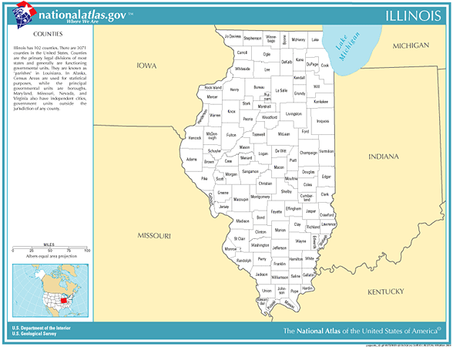
Illinois
Cook
5% evangelical
270818 evangelicals
Total population: 5376741
924 evangelical churches
5819 people per church
Statistic Source: The Association of Religion Data Archives
Presentation by: The Church Planting Center, The Southern Baptist Theological Seminary, 2009

Slide 89
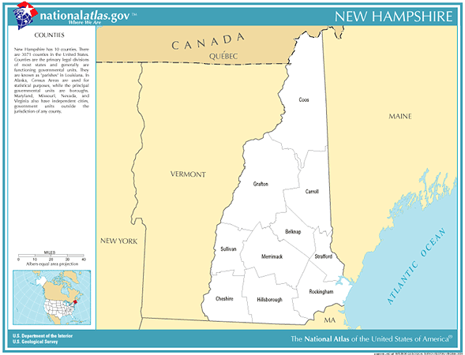
New Hampshire
Merrimack
2.2% evangelical
2969 evangelicals
Total population: 136225
20 evangelical churches
6811 people per church
Grafton
1.4% evangelical
1142 evangelicals
Total population: 81743
17 evangelical churches
4808 people per church
Carroll
1.3% evangelical
582 evangelicals
Total population: 43666
8 evangelical churches
5458 people per church
Sullivan
1.4% evangelical
559 evangelicals
Total population: 40458
9 evangelical churches
4498 people per church
Belknap
2.5% evangelical
1397 evangelicals
Total population: 56325
13 evangelical churches
4333 people per church
Hillsborough
3.1% evangelical
11932 evangelicals
Total population: 380841
54 evangelical churches
7053 people per church
Strafford
2.8% evangelical
3089 evangelicals
Total population: 112233
22 evangelical churches
5102 people per church
Cheshire
3.2% evangelical
2378 evangelicals
Total population: 73825
16 evangelical churches
4614 people per church
Rockingham
1.9% evangelical
5172 evangelicals
Total population: 277359
35 evangelical churches
7925 people per church
Statistic Source: The Association of Religion Data Archives
Presentation by: The Church Planting Center, The Southern Baptist Theological Seminary, 2009

Slide 90
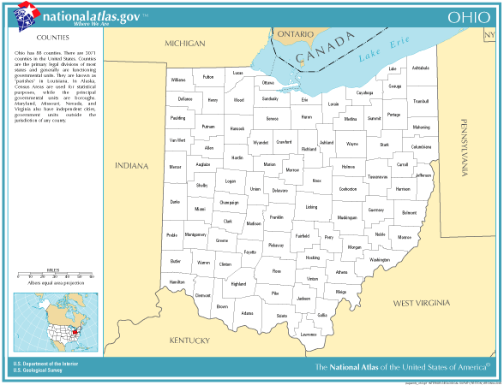
Ohio
Ottawa
3.9% evangelical
1602 evangelicals
Total population: 40985
15 evangelical churches
2732 people per church
Cuyahoga
5.5% evangelical
77164 evangelicals
Total population: 1393978
239 evangelical churches
5833 people per church
Delaware
3.8% evangelical
4210 evangelicals
Total population: 109989
33 evangelical churches
3333 people per church
Portage
5.9% evangelical
8912 evangelicals
Total population: 152061
48 evangelical churches
3168 people per church
Perry
4.1% evangelical
1414 evangelicals
Total population: 34078
20 evangelical churches
1704 people per church
Statistic Source: The Association of Religion Data Archives
Presentation by: The Church Planting Center, The Southern Baptist Theological Seminary, 2009

Slide 91
Ohio (continued)
Seneca
5.3% evangelical
3126 evangelicals
Total population: 58683
24 evangelical churches
2445 people per church
Statistic Source: The Association of Religion Data Archives
Presentation by: The Church Planting Center, The Southern Baptist Theological Seminary, 2009

Slide 92
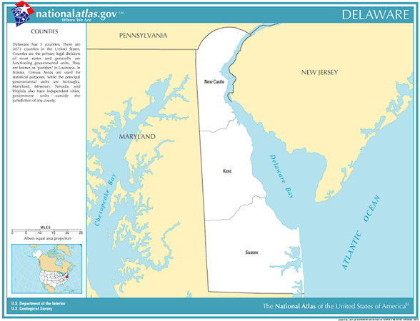
Delaware
New Castle
4.1% evangelical
20283 evangelicals
Total population: 500265
90 evangelical churches
5559 people per church
Statistic Source: The Association of Religion Data Archives
Presentation by: The Church Planting Center, The Southern Baptist Theological Seminary, 2009

Slide 93
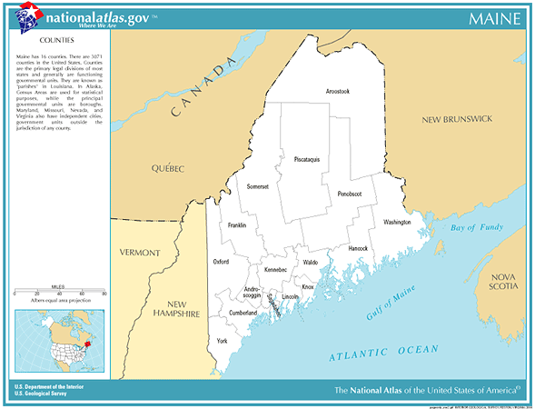
Maine
Penobscot
3.8% evangelical
5523 evangelicals
Total population: 144919
41 evangelical churches
3535 people per church
Kennebec
3% evangelical
3495 evangelicals
Total population: 117114
27 evangelical churches
4338 people per church
Hancock
2.2% evangelical
1123 evangelicals
Total population: 51791
15 evangelical churches
3453 people per church
Cumberland
3.8% evangelical
10156 evangelicals
Total population: 265612
58 evangelical churches
4580 people per church
Waldo
2.4% evangelical
859 evangelicals
Total population: 36280
9 evangelical churches
4031 people per church
York
1.6% evangelical
3025 evangelicals
Total population: 186742
27 evangelical churches
6916 people per church
Knox
2.4% evangelical
936 evangelicals
Total population: 39618
11 evangelical churches
3602 people per church
Statistic Source: The Association of Religion Data Archives
Presentation by: The Church Planting Center, The Southern Baptist Theological Seminary, 2009

Slide 94
Maine (continued)
Washington
3.4% evangelical
1156 evangelicals
Total population: 33941
19 evangelical churches
1786 people per church
Somerset
4.4% evangelical
2264 evangelicals
Total population: 50888
83 evangelical churches
2213 people per church
Franklin
2.6% evangelical
763 evangelicals
Total population: 29467
12 evangelical churches
2456 people per church
Oxford
2.6% evangelical
1438 evangelicals
Total population: 54755
17 evangelical churches
3221 people per church
Lincoln
1.9% evangelical
651 evangelicals
Total population: 33616
7 evangelical churches
4802 people per church
Sagadahoc
2.6% evangelical
900 evangelicals
Total population: 35214
14 evangelical churches
2515 people per church
Statistic Source: The Association of Religion Data Archives
Presentation by: The Church Planting Center, The Southern Baptist Theological Seminary, 2009

Slide 95
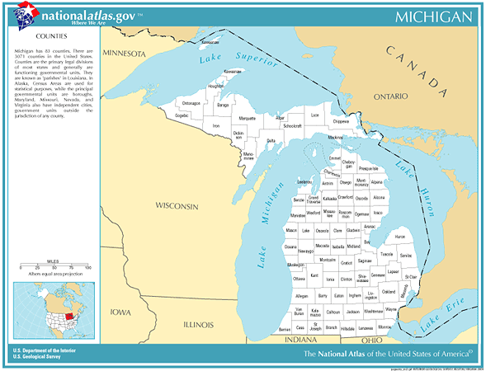
Michigan
Cass
5.5% evangelical
2794 evangelicals
Total population: 51104
23 evangelical churches
2222 people per church
Statistic Source: The Association of Religion Data Archives
Presentation by: The Church Planting Center, The Southern Baptist Theological Seminary, 2009

Slide 96
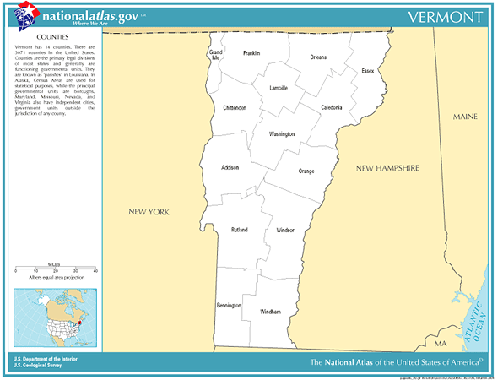
Vermont
Caledonia
1.3% evangelical
383 evangelicals
Total population: 29702
8 evangelical churches
3713 people per church
Franklin
1.1% evangelical
519 evangelicals
Total population: 45417
6 evangelical churches
7570 people per church
Washington
2.3% evangelical
1342 evangelicals
Total population: 58039
18 evangelical churches
3224 people per church
Chittenden
3.6% evangelical
5276 evangelicals
Total population: 146571
24 evangelical churches
6107 people per church
Orange
2.6% evangelical
735 evangelicals
Total population: 28226
9 evangelical churches
3136 people per church
Addison
2.4% evangelical
846 evangelicals
Total population: 35974
8 evangelical churches
4497 people per church
Windsor
2.1% evangelical
1187 evangelicals
Total population: 57418
14 evangelical churches
4101 people per church
Rutland
1.8% evangelical
1125 evangelicals
Total population: 63400
13 evangelical churches
4877 people per church
Bennington
2.5% evangelical
925 evangelicals
Total population: 36994
9 evangelical churches
4110 people per church
Windham
1.7% evangelical
744 evangelicals
Total population: 44216
12 evangelical churches
3685 people per church
Statistic Source: The Association of Religion Data Archives
Presentation by: The Church Planting Center, The Southern Baptist Theological Seminary, 2009

Slide 97
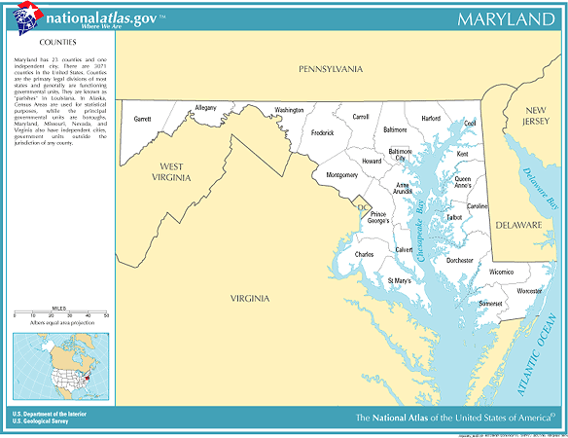
Maryland
Howard
5.8% evangelical
14359 evangelicals
Total population 247842
52 evangelical churches
4766 people per church
Baltimore
3.9% evangelical
25330 evangelicals
Total population: 651154
108 evangelical churches
6029 people per church
Statistic Source: The Association of Religion Data Archives
Presentation by: The Church Planting Center, The Southern Baptist Theological Seminary, 2009

Slide 98
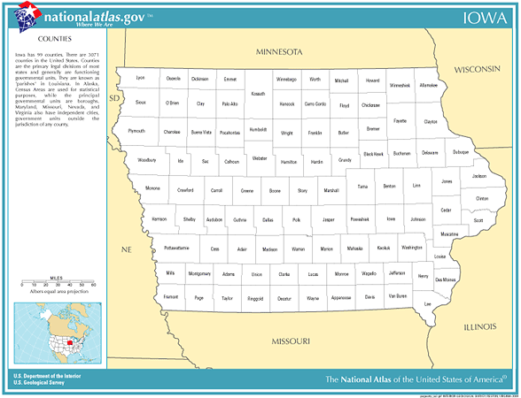
Iowa
Winneshiek
1.7% evangelical
372 evangelicals
Total population: 21310
4 evangelical churches
5328people per church
Dubuque
3.1% evangelical
2780 evangelicals
Total population: 89143
13 evangelical churches
6857 people per church
Jackson
1.6% evangelical
128 evangelicals
Total population: 20296
3 evangelical churches
6765 people per church
Johnson
5.4% evangelical
6014 evangelicals
Total population: 111006
29 evangelical churches
3828 people per church
Statistic Source: The Association of Religion Data Archives
Presentation by: The Church Planting Center, The Southern Baptist Theological Seminary, 2009

Slide 99
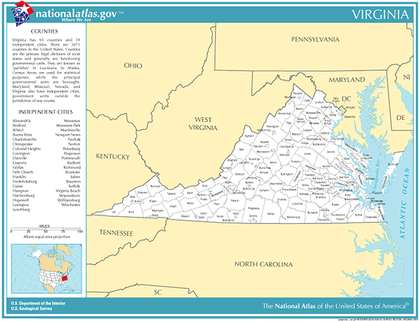
Virginia
Arlington
3.4% evangelical
6478 evangelicals
Total population: 189453
40 evangelical churches
4736 people per church
Prince William
3.8% evangelical
19194 evangelicals
Total population: 280813
58 evangelical churches
4842 people per church
Fairfax
5.9% evangelical
56969 evangelicals
Total population: 969749
173 evangelical churches
5605 people per church
Statistic Source: The Association of Religion Data Archives
Presentation by: The Church Planting Center, The Southern Baptist Theological Seminary, 2009

Slide 100
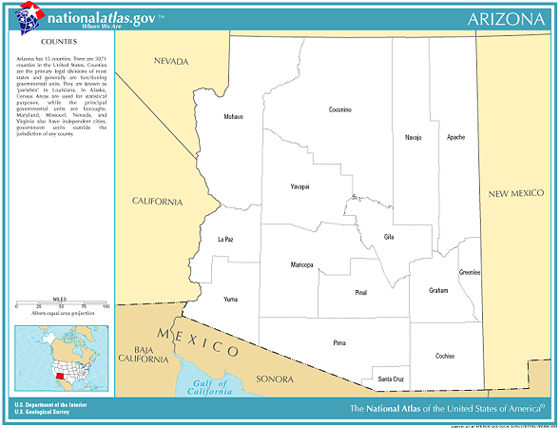
Arizona
Apache
5.2% evangelical
3584 evangelicals
Total population: 69423
55 evangelical churches
1262 people per church
Statistic Source: The Association of Religion Data Archives
Presentation by: The Church Planting Center, The Southern Baptist Theological Seminary, 2009

Slide 101
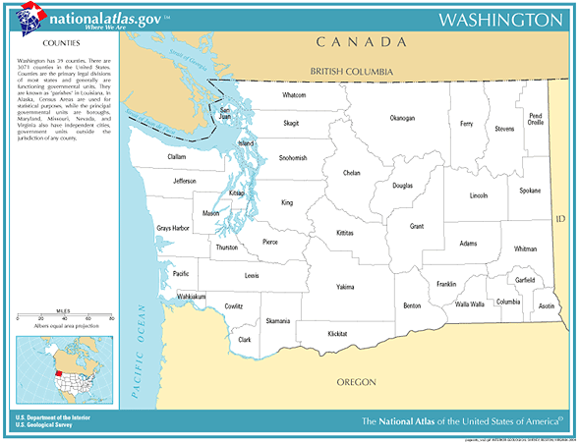
Washington
San Juan
1% evangelical
146 evangelicals
Total population: 14077
5 evangelical churches
2815 people per church
Statistic Source: The Association of Religion Data Archives
Presentation by: The Church Planting Center, The Southern Baptist Theological Seminary, 2009

Slide 102
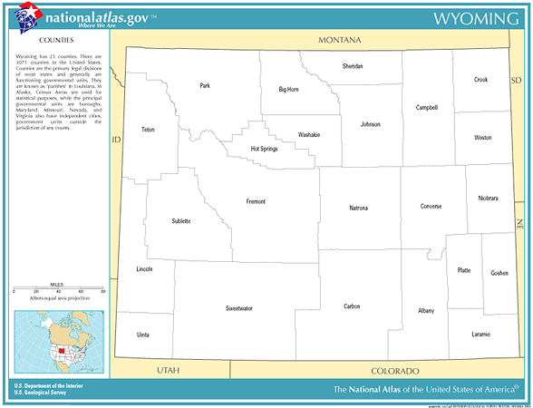
Wyoming
Teton
1.3% evangelical
229 evangelicals
Total population: 18251
6 evangelical churches
3042 people per church
Statistic Source: The Association of Religion Data Archives
Presentation by: The Church Planting Center, The Southern Baptist Theological Seminary, 2009

Slide 103
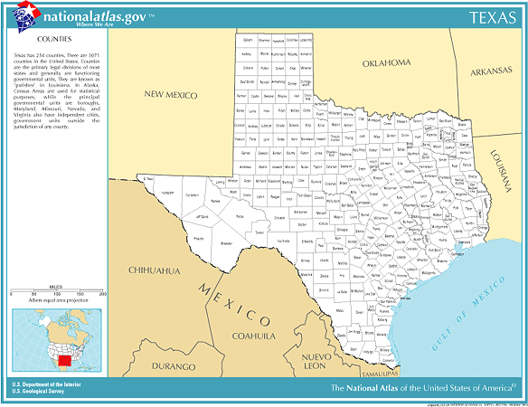
Texas
Webb
3.9% evangelical
7456 evangelicals
Total population: 193117
42 evangelical churches
4598 people per church
Statistic Source: The Association of Religion Data Archives
Presentation by: The Church Planting Center, The Southern Baptist Theological Seminary, 2009

Slide 104
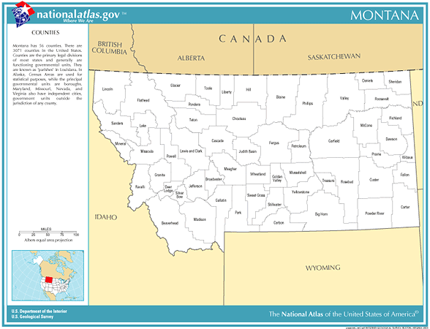
Montana
Carter
0.5% evangelical
7 evangelicals
Total population: 1360
1 evangelical churches
1360 people per church
Statistic Source: The Association of Religion Data Archives
Presentation by: The Church Planting Center, The Southern Baptist Theological Seminary, 2009

Slide 105
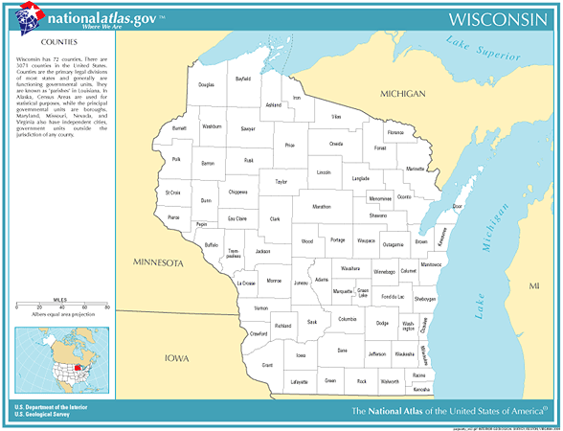
Wisconsin
Dane
5.2% evangelical
22292 evangelicals
Total population: 426526
83 evangelical churches
5139 people per church
Grant
5.4% evangelical
2678evangelicals
Total population: 49597
23 evangelical churches
2156 people per church
Statistic Source: The Association of Religion Data Archives
Presentation by: The Church Planting Center, The Southern Baptist Theological Seminary, 2009

Slide 106
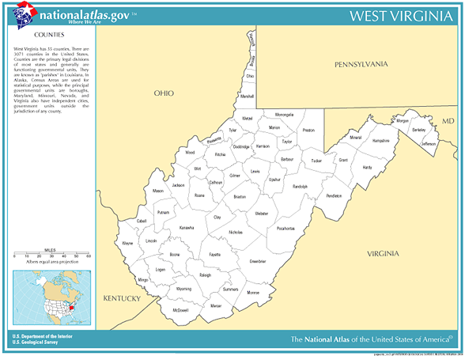
West Virginia
Monongalia
4.8% evangelical
3956 evangelicals
Total population: 81866
32 evangelical churches
2558 people per church
Statistic Source: The Association of Religion Data Archives
Presentation by: The Church Planting Center, The Southern Baptist Theological Seminary, 2009

Slide 107
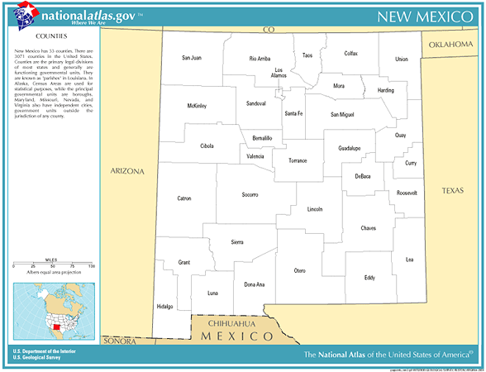
New Mexico
Sandoval
5.2% evangelical
4672 evangelicals
Total population: 89908
31 evangelical churches
2900 people per church
Santa Fe
4% evangelical
5207 evangelicals
Total population: 129292
31 evangelical churches
4171 people per church
Statistic Source: The Association of Religion Data Archives
Presentation by: The Church Planting Center, The Southern Baptist Theological Seminary, 2009

Slide 108
United States Metro Areas 10% or less evangelical

Slide 109
Arizona
Flagstaff, AZ
9.3% evangelical 75 evangelical churches total population:122,366
people per church: 1,632
Yuma, AZ
8.1% evangelical 62 evangelical churches total population: 160,026
people per church: 2,581
Phoenix-Mesa, AZ
9.9% evangelical 847 evangelical churches total population:3,251,876
people per church: 3,839
Tucson, AZ
8.3% evangelical 217 evangelical churches total population:843,746
people per church: 3,888
Statistic Source: The Association of Religion Data Archives
Presentation by: The Church Planting Center, The Southern Baptist Theological Seminary, 2009

Slide 110
California
Chico-Paradise, CA
9.8% evangelical 97 evangelical churches total population: 203,171
people per church: 2,095
Stockton-Lodi, CA
8% evangelical 201 evangelical churches total population: 563,598
people per church: 2,804
Sacramento-Yolo, CA
9.7% evangelical 509 evangelical churches total population: 1,796,857
people per church: 3,530
Merced, CA
8.2% evangelical 83 evangelical churches total population: 210,554
people per church: 2,537
Salinas, CA
4.7% evangelical 109 evangelical churches total population: 401,762
people per church: 3,686
San Francisco-Oakland-San Jose, CA
5.3% evangelical 1,488 evangelical churches total population: 7,039,362
people per church: 4,731
Los Angeles-Riverside-Orange County, CA
7.1% evangelical 2,561 evangelical churches total population: 16,373,645
people per church: 6,393
San Luis Obispo-Atascadero-Paso Robles, CA
9.1% evangelical 107 evangelical churches total population: 246,681
people per church: 2,399
Santa Barbara-Santa Maria-Lompoc, CA
6.7% evangelical 120 evangelical churches total population: 399,347
people per church: 3,328
San Diego, CA
5.9% evangelical 613 evangelical churches total population: 2,813,833
people per church: 4,590
Statistic Source: The Association of Religion Data Archives
Presentation by: The Church Planting Center, The Southern Baptist Theological Seminary, 2009

Slide 111
Colorado
Denver-Boulder-Greeley, CO
9.7% evangelical 673 evangelical churches total population:2,581,506
people per church: 3,836
Pueblo, CO
8.8% evangelical 65 evangelical churches total population:141,472
people per church: 2,176
Statistic Source: The Association of Religion Data Archives
Presentation by: The Church Planting Center, The Southern Baptist Theological Seminary, 2009

Slide 112
Connecticut
Hartford, CT
2.7% evangelical 152 evangelical churches total population: 1,148,618
people per church: 7,557
New London-Norwich, CT
2.5% evangelical 40 evangelical churches total population: 259,088
people per church: 6,477
Statistic Source: The Association of Religion Data Archives
Presentation by: The Church Planting Center, The Southern Baptist Theological Seminary, 2009

Slide 113
Delaware
Philadelphia-Wilmington-Atlantic City, PA-NJ-DE-MD
3.6% evangelical 1,085 evangelical churches total population 6,188,463
people per church: 5,704
Dover, DE
6.9% evangelical 59 evangelical churches total population126,697
people per church: 2,147
Statistic Source: The Association of Religion Data Archives
Presentation by: The Church Planting Center, The Southern Baptist Theological Seminary, 2009

Slide 114
Florida
Fort Pierce-Port St. Lucie, FL
7.6% evangelical 118 evangelical churches total population 319,426
people per church: 2,708
Punta Gorda, FL
7.4% evangelical 45 evangelical churches total population 141,627
people per church: 3,147
West Palm Beach-Boca Raton, FL
9.2% evangelical 277 evangelical churches total population 1,131,184
people per church 4,084
Naples, FL
8.3% evangelical 68 evangelical churches total population 251,377
people per church: 3,697
Maimi-Fort Lauderdale, FL
7.4% evangelical 841 evangelical churches total population 3,876,380
people per church 4,609
Statistic Source: The Association of Religion Data Archives
Presentation by: The Church Planting Center, The Southern Baptist Theological Seminary, 2009

Slide 115
Hawaii
Honolulu, HI
7.9% evangelical 259 evangelical churches total population 876,156
people per church: 3,383
Statistic Source: The Association of Religion Data Archives
Presentation by: The Church Planting Center, The Southern Baptist Theological Seminary, 2009

Slide 116
Idaho
Pocatello, ID
5.8% evangelical 18 evangelical churches total population: 75,565
people per church: 4,198
Statistic Source: The Association of Religion Data Archives
Presentation by: The Church Planting Center, The Southern Baptist Theological Seminary, 2009

Slide 117
Illinois
Chicago-Gary-Kenosha, IL-IN-WI
6.5% evangelical 1,916 evangelical churches total population: 9,157,540
people per church: 4,780
Statistic Source: The Association of Religion Data Archives
Presentation by: The Church Planting Center, The Southern Baptist Theological Seminary, 2009

Slide 118
Iowa
Dubuque, IA
3.1% evangelical 13 evangelical churches total population: 89,143
people per church: 6,857
Iowa City, IA
5.4% evangelical 29 evangelical churches total population: 111,006
people per church: 3,828
Statistic Source: The Association of Religion Data Archives
Presentation by: The Church Planting Center, The Southern Baptist Theological Seminary, 2009

Slide 119
Indiana
South Bend, IN
9.3% evangelical 108 evangelical churches total population: 265,559
people per church: 2,459
Muncie, IN
9.8% evangelical 75 evangelical churches total population: 118,769
people per church: 1,584
Statistic Source: The Association of Religion Data Archives
Presentation by: The Church Planting Center, The Southern Baptist Theological Seminary, 2009

Slide 120
Kansas
Lawrence, KS
8.3% evangelical 40 evangelical churches total population 99,962
people per church: 2,499
Statistic Source: The Association of Religion Data Archives
Presentation by: The Church Planting Center, The Southern Baptist Theological Seminary, 2009

Slide 121
Louisiana
Lafayette, LA
8.5% evangelical 90 evangelical churches total population: 385,647
people per church: 4,285
Houma, LA
9.7% evangelical 52 evangelical churches total population:194,477
people per church: 3,740
Statistic Source: The Association of Religion Data Archives
Presentation by: The Church Planting Center, The Southern Baptist Theological Seminary, 2009

Slide 122
Maine
Bangor, ME
3.8% evangelical 42 evangelical churches total population: 144,919
people per church: 3,450
Lewiston-Auburn, ME
5% evangelical 25 evangelical churches total population: 103,793
people per church: 4,152
Portland, ME
3.8% evangelical 58 evangelical churches total population: 265,612
people per church: 4,424
Statistic Source: The Association of Religion Data Archives
Presentation by: The Church Planting Center, The Southern Baptist Theological Seminary, 2009

Slide 123
Maryland
Washington-Baltimore, DC-MD
7.9% evangelical 1,196 evangelical churches total population 7,608,070.
people per church: 6,361
Statistic Source: The Association of Religion Data Archives
Presentation by: The Church Planting Center, The Southern Baptist Theological Seminary, 2009

Slide 124
Massachusetts
Boston-Worcester-Lawrence-Lowell-Brockton, MA
2.5% evangelical 778 evangelical churches total population: 6,057,826
people per church:7,786
Pittsfield, MA
1.5% evangelical 14 evangelical churches total population: 134,953
people per church: 9,640
Springfield, MA
1.9% evangelical 62 evangelical churches total population: 608,479
people per church: 9,814
Barnstable-Yarmouth, MA
1.5% evangelical 25 evangelical churches total population: 222,230
people per church: 8,889
Statistic Source: The Association of Religion Data Archives
Presentation by: The Church Planting Center, The Southern Baptist Theological Seminary, 2009

Slide 125
Michigan
Detroit-Ann Arbor-Flint, MI
8% evangelical 1,316 evangelical churches total population: 5,456,428
people per church: 4,146
Lansing-East Lansing, MI
10% evangelical 162 evangelical churches total population: 447,728
people per church: 2,764
Statistic Source: The Association of Religion Data Archives
Presentation by: The Church Planting Center, The Southern Baptist Theological Seminary, 2009

Slide 126
Minnisota
Duluth-Superior, MN-WI
8.7% evangelical 116 evangelical churches total population 243,815
people per church: 2,102
St. Cloud, MN
8.1% evangelical 51 evangelical churches total population 167,392
people per church: 3,282
Minneapolis-St. Paul, MN
9.2% evangelical 711 evangelical churches total population 2,968,806
people per church: 4,176
Statistic Source: The Association of Religion Data Archives
Presentation by: The Church Planting Center, The Southern Baptist Theological Seminary, 2009

Slide 127
Montana
Missoula, MT
8% evangelical 41 evangelical churches total population: 95,802
people per church: 2,337
Great Falls, MT
9.6% evangelical 38 evangelical churches total population: 80,357
people per church: 2,115
Statistic Source: The Association of Religion Data Archives
Presentation by: The Church Planting Center, The Southern Baptist Theological Seminary, 2009

Slide 128
Nevada
Las Vegas, NV
5.4% evangelical 257 evangelical churches total population: 1,563,282
people per church: 6,083
Reno, NV
4.6% evangelical 72 evangelical churches total population: 339,486
people per church: 4,718
Statistic Source: The Association of Religion Data Archives
Presentation by: The Church Planting Center, The Southern Baptist Theological Seminary, 2009

Slide 129
New Mexico
Santa Fe, NM
5.8% evangelical 41 evangelical churches total population: 147,635
people per church: 3,601
Albuquerque, NM
9.8% evangelical 222 evangelical churches total population: 712,738
people per church: 3,211
Statistic Source: The Association of Religion Data Archives
Presentation by: The Church Planting Center, The Southern Baptist Theological Seminary, 2009

Slide 130
New York
Syracuse, NY
3.7% evangelical 146 evangelical churches total population732,117
people per church: 5,015
Rochester, NY
4.1% evangelical 216 evangelical churches total population 1,098,201
people per church: 5,084
Utica-Rome, NY
3.4% evangelical 60 evangelical churches total population299,896
people per church: 4,998
Buffalo-Niagara Falls, NY
5.4% evangelical 188 evangelical churches total population:
1,170,111
people per church: 6,224
Glens Falls, NY
3.1% evangelical 29 evangelical churches total population 124,345
people per church: 4,288
Jamestown, NY
7.9% evangelical 73 evangelical churches total population
139,750
people per church: 1,914
Albany-Schenectady-Troy, NY
2.7% evangelical 150 evangelical churches total population: 6,557,826
people per church: 7,786
Elmira, NY
5.6% evangelical 27 evangelical churches total population:91,070
people per church: 3,373
Binghamton, NY
4.4% evangelical 75 evangelical churches total population 252,320
people per church: 3,364
New York – Northern New Jersey – Long Island, NY-NJ-CT-PA
2.3% evangelical 2478 evangelical churches total population: 21,104,292
people per church: 8,517
Statistic Source: The Association of Religion Data Archives
Presentation by: The Church Planting Center, The Southern Baptist Theological Seminary, 2009

Slide 131
North Dakota
Grand Forks, ND
7.7% evangelical 53 evangelical churches total population:97,478
people per church: 1,839
Fargo-Moorehead, ND-MN
6.6% evangelical 47 evangelical churches total population: 174,367
people per church: 3,710
Statistic Source: The Association of Religion Data Archives
Presentation by: The Church Planting Center, The Southern Baptist Theological Seminary, 2009

Slide 132
Ohio
Cleveland-Akron, OH
7.4% evangelical 827 evangelical churches total population 2,945,831
people per church: 3,562
Toledo, OH
8% evangelical 193 evangelical churches total population 618,203
people per church: 3,203
Columbus, OH
8.7% evangelical 478 evangelical churches total population 1,540,157
people per church: 3,222
Youngstown-Warren, OH
8.7% evangelical 280 evangelical churches total population 594,746
people per church: 2,124
Statistic Source: The Association of Religion Data Archives
Presentation by: The Church Planting Center, The Southern Baptist Theological Seminary, 2009

Slide 133
Oregon
Corvallis, OR
7.9% evangelical 38 evangelical churches total population 78,153
people per church: 2,057
Medford-Ashland, OR
8% evangelical 95 evangelical churches total population 181,269
people per church: 1,908
Statistic Source: The Association of Religion Data Archives
Presentation by: The Church Planting Center, The Southern Baptist Theological Seminary, 2009

Slide 134
Pennsylvania
State College, PA
6.8% evangelical 58 evangelical churches total population: 135,758
people per church: 2,341
Williamsport, PA
7.1% evangelical 43 evangelical churches total population: 120,044
people per church: 2,792
Scranton--Wilkes-Barre—Hazelton, PA
3.1% evangelical 177 evangelical churches total population: 624,776
people per church: 3,530
Erie, PA
6.9% evangelical 88 evangelical churches total population: 280,843
people per church: 3,191
Sharon, PA
7.5% evangelical 66 evangelical churches total population: 120,293
people per church: 1,823
Allentown-Bethlehem-Easton, PA
2.8% evangelical 97 evangelical churches total population: 637,985
people per church: 6,577
Pittsburgh, PA
5% evangelical 593 evangelical churches total population: 2,358,695
people per church: 3,978
Johnstown, PA
9% evangelical 137 evangelical churches total population: 232,621
people per church: 1,698
Harrisburg-Lebanon-Carlisle, PA
9.4% evangelical 312 evangelical churches total population: 629,401
people per church: 2,017
York, PA
7.5% evangelical 134evangelical churches total population: 381,751
people per church: 2,489
Reading, PA
4% evangelical 92 evangelical churches total population: 373,638
people per church: 4,061
Statistic Source: The Association of Religion Data Archives
Presentation by: The Church Planting Center, The Southern Baptist Theological Seminary, 2009

Slide 135
Rhode Island
Providence-Warwick-Pawtucket, RI
1.7% evangelical 117 evangelical churches total population: 962,886
people per church: 8,230
Statistic Source: The Association of Religion Data Archives
Presentation by: The Church Planting Center, The Southern Baptist Theological Seminary, 2009

Slide 136
Texas
McAllen-Edenburg-Mission, TX
7.4% evangelical 199 evangelical churches total population 569,463
people per church: 2,862
El Paso, TX
7.5% evangelical 183 evangelical churches total population 679,622
people per church: 3,714
Laredo, TX
3.9% evangelical 42 evangelical churches total population 193,117
people per church: 4,598
Brownsville-Harlingen-San Benito, TX
9.2% evangelical 141 evangelical churches total population 335,227
people per church: 2,377
Statistic Source: The Association of Religion Data Archives
Presentation by: The Church Planting Center, The Southern Baptist Theological Seminary, 2009

Slide 137
Utah
Salt Lake City-Ogden, Utah
2.3% evangelical 136 evangelical churches total population: 1,333,914
people per church: 9,808
Provo-Orem, Utah
0.6% evangelical 20 evangelical churches total population: 368,536
people per church: 18,427
Statistic Source: The Association of Religion Data Archives
Presentation by: The Church Planting Center, The Southern Baptist Theological Seminary, 2009

Slide 138
Vermont
Burlington, VT
2.9% evangelical 30 evangelical churches total population: 198,889
people per church: 6,630
Statistic Source: The Association of Religion Data Archives
Presentation by: The Church Planting Center, The Southern Baptist Theological Seminary, 2009

Slide 139
Washington
Seattle-Tacoma-Bremerton, WA
9.1% evangelical 1138 evangelical churches total population: 3,554,760
people per church: 3,124
Statistic Source: The Association of Religion Data Archives
Presentation by: The Church Planting Center, The Southern Baptist Theological Seminary, 2009

Slide 140
West Virginia
Wheeling, WV
7.7% evangelical 89 evangelical churches total population:153,172
people per church: 1,721
Charleston, WV
9.8% evangelical 199 evangelical churches total population:251,662
people per church:1,265
Statistic Source: The Association of Religion Data Archives
Presentation by: The Church Planting Center, The Southern Baptist Theological Seminary, 2009

Slide 141
Wisconsin
Green Bay, WI
9.2% evangelical 52 evangelical churches total population 226,778
people per church: 4,361
Madison, WI
5.2% evangelical 83 evangelical churches total population 426,526
people per church: 5,139
Statistic Source: The Association of Religion Data Archives
Presentation by: The Church Planting Center, The Southern Baptist Theological Seminary, 2009

Slide 142
United States Metro Areas less than 3% evangelical

Slide 143
Utah
Salt Lake City-Ogden, Utah
2.3% evangelical 136 evangelical churches total population: 1,333,914
people per church: 9,808
Provo-Orem, Utah
0.6% evangelical 20 evangelical churches total population: 368,536
people per church: 18,427
Statistic Source: The Association of Religion Data Archives
Presentation by: The Church Planting Center, The Southern Baptist Theological Seminary, 2009

Slide 144
Massachusetts
Boston-Worcester-Lawrence-Lowell-Brockton, MA
2.5% evangelical 778 evangelical churches total population: 6,057,826
people per church:7,786
Pittsfield, MA
1.5% evangelical 14 evangelical churches total population: 134,953
people per church: 9,640
Barnstable-Yarmouth, MA
1.5% evangelical 25 evangelical churches total population: 222,230
people per church: 8,889
Springfield, MA
1.9% evangelical 62 evangelical churches total population: 608,479
people per church: 9,814
Source: The Association of Religion Data Archives

Slide 145
Rhode Island
Providence-Warwick-Pawtucket, RI
1.7% evangelical 117 evangelical churches total population: 962,886
people per church: 8,230
Source: The Association of Religion Data Archives

Slide 146
Connecticut
Hartford, CT
2.7% evangelical 152 evangelical churches total population: 1,148,618
people per church: 7,557
New London-Norwich, CT
2.5% evangelical 40 evangelical churches total population: 259,088
people per church: 6,477
Source: The Association of Religion Data Archives

Slide 147
New York
Albany-Schenectady-Troy, NY
2.7% evangelical 150 evangelical churches total population: 6,557,826
people per church: 7,786
New York – Northern New Jersey – Long Island, NY-NJ-CT-PA
2.3% evangelical 2478 evangelical churches total population: 21,104,292
people per church: 8,517
Source: The Association of Religion Data Archives

Slide 148
Pennsylvania
Allentown-Bethlehem-Easton, PA
2.8% evangelical 97 evangelical churches total population: 637,985
people per church: 6,577
Statistic Source: The Association of Religion Data Archives
Presentation by: The Church Planting Center, The Southern Baptist Theological Seminary, 2009

Slide 149
Vermont
Burlington, VT
2.9% evangelical 30 evangelical churches total population: 198,889
people per church: 6,630
Statistic Source: The Association of Religion Data Archives
Presentation by: The Church Planting Center, The Southern Baptist Theological Seminary, 2009

Slide 150
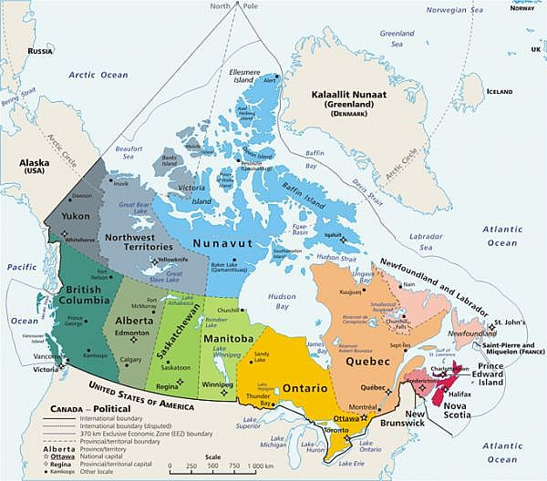
Evangelicals in selected Canadian metropolitan areas
Source: Lorne Hunter, Outreach Canada
Map: Natural Resources Canada
Presentation by: The Church Planting Center, The Southern Baptist Theological Seminary, 2009

Slide 151
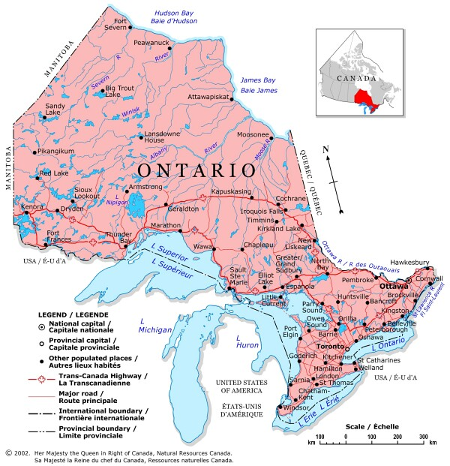
Ontario
Thunder Bay
Total Population: 125,359
evangelical churches: 39
People per Church: 3,214
Greater Sudbury
Total Population: 161,983
evangelical churches: 34
People per Church: 4,764
Ottawa-Gatineau
Total Population: 1,158,314
evangelical churches: 189
People per Church: 6,129
Kingston
Total Population: 154,971
evangelical churches: 43
People per Church: 3,604
Hamilton
Total Population: 716, 230
evangelical churches: 196
People per Church: 3,654
Oshawa
Total Population: 344,374
evangelical churches: 64
People per Church: 5,381
London
Total Population: 465,720
evangelical churches: 139
People per Church: 3,351
Toronto
Total Population: 5,406,324
evangelical churches: 1,034
People per Church: 5,229
Windsor
Total Population: 332,066
evangelical churches: 88
People per Church: 3,773
St. Catherine’s-Niagara
Total Population: 396,754
evangelical churches: 166
People per Church: 2,390
Kitchener
Total Population: 463,644
evangelical churches: 166
People per Church: 1,793
Source: Lorne Hunter, Outreach Canada
Map: Natural Resources Canada
Presentation by: The Church Planting Center, The Southern Baptist Theological Seminary, 2009

Slide 152
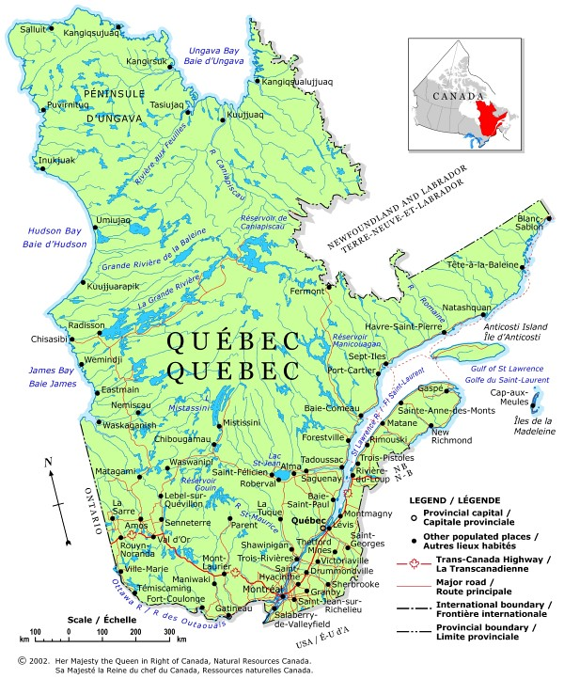
Quebec
Saguenay
Total Population: 152,132
evangelical churches: 7
People per Church: 21,733
Quebec
Total Population: 723,263
evangelical churches: 31
People per Church: 23,331
Trois-Rivieres
Total Population: 142,614
evangelical churches: 15
People per Church: 9,508
Montreal
Total Population: 3,666,280
evangelical churches: 422
People per Church: 8,688
Sherbrooke
Total Population: 164,685
evangelical churches: 19
People per Church: 8,668
Source: Lorne Hunter, Outreach Canada
Map: Natural Resources Canada
Presentation by: The Church Planting Center, The Southern Baptist Theological Seminary, 2009

Slide 153
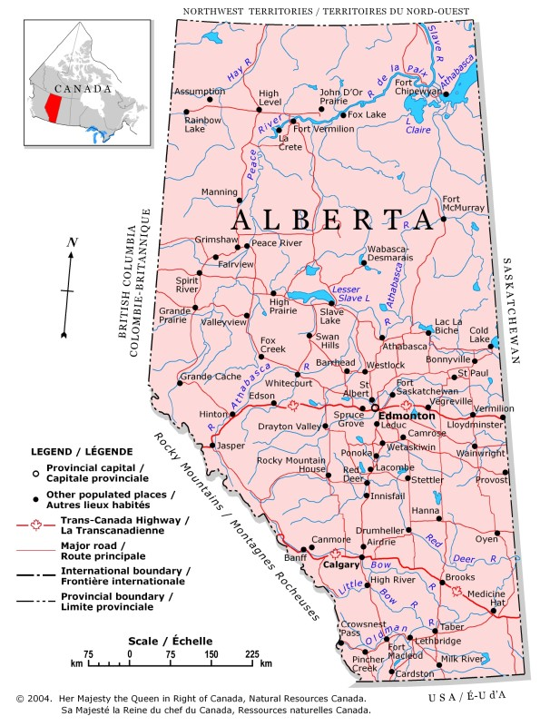
Alberta
Edmonton
Total Population: 1,050,046
evangelical churches: 307
People per Church: 3,420
Calgary
Total Population: 1,107,242
evangelical churches: 290
People per Church: 3,818
Source: Lorne Hunter, Outreach Canada
Map: Natural Resources Canada
Presentation by: The Church Planting Center, The Southern Baptist Theological Seminary, 2009

Slide 154
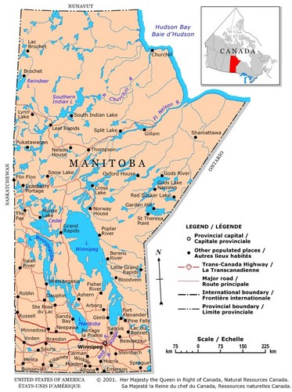
Manitoba
Winnipeg
Total Population: 706,749
evangelical churches: 223
People per Church: 3,169
Source: Lorne Hunter, Outreach Canada
Map: Natural Resources Canada
Presentation by: The Church Planting Center, The Southern Baptist Theological Seminary, 2009

Slide 155
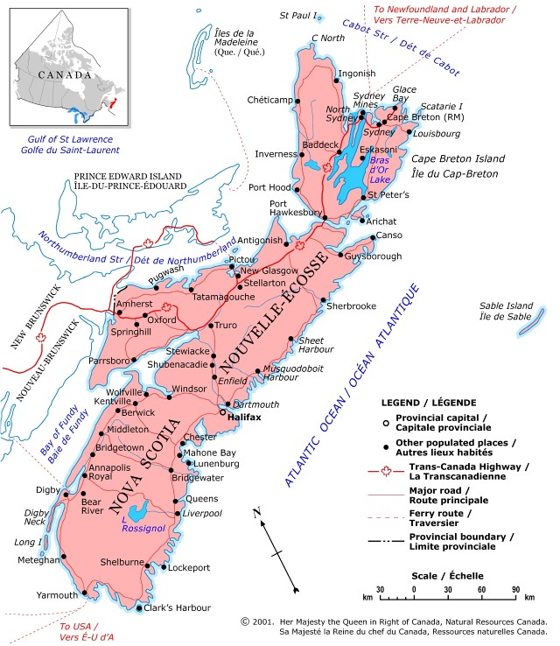
Nova Scotia
Halifax
Total Population: 382,203
evangelical churches: 108
People per Church: 3,539
Source: Lorne Hunter, Outreach Canada
Map: Natural Resources Canada
Presentation by: The Church Planting Center, The Southern Baptist Theological Seminary, 2009

Slide 156
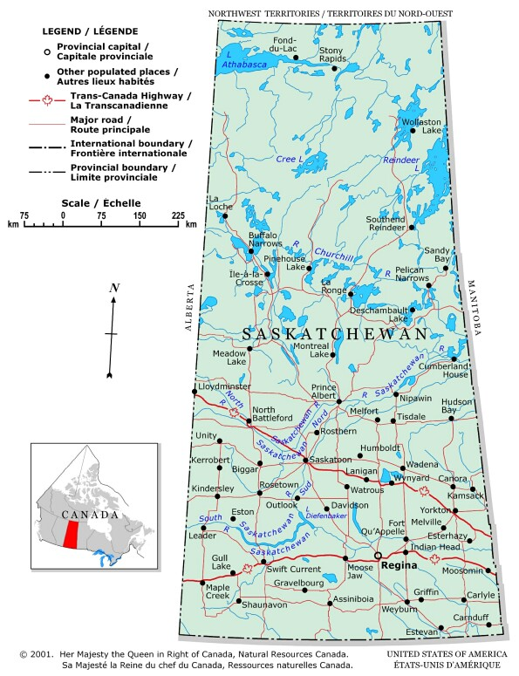
Saskatchewan
Saskatoon
Total Population: 235,464
evangelical churches: 101
People per Church: 2,331
Regina
Total Population: 198,316
evangelical churches: 63
People per Church: 3,148
Source: Lorne Hunter, Outreach Canada
Map: Natural Resources Canada
Presentation by: The Church Planting Center, The Southern Baptist Theological Seminary, 2009

Slide 157
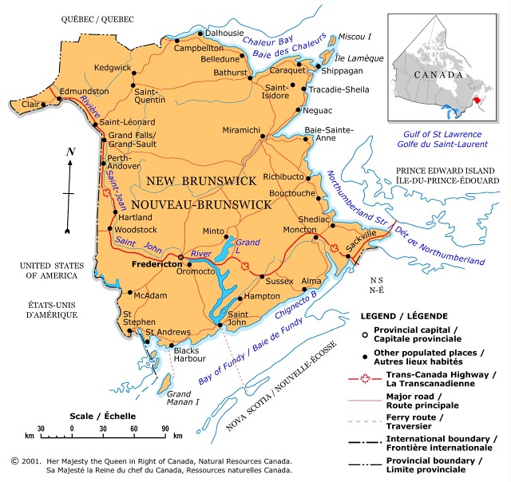
New Brunswick
Saint John
Total Population: 125,944
evangelical churches: 60
People per Church: 2,099
Source: Lorne Hunter, Outreach Canada
Map: Natural Resources Canada
Presentation by: The Church Planting Center, The Southern Baptist Theological Seminary, 2009

Slide 158
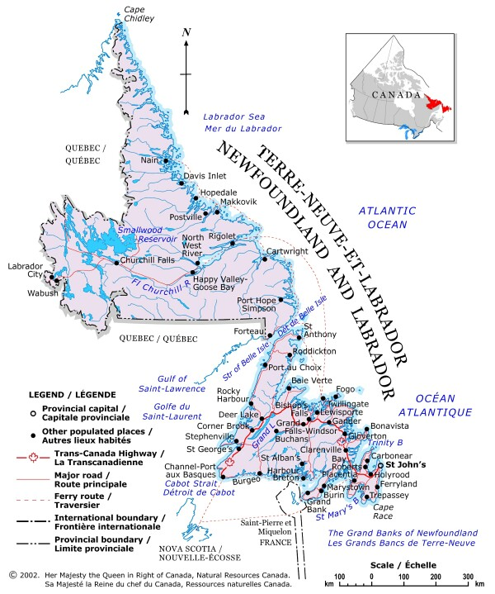
Newfoundland
St. John’s
Total Population: 181, 394
evangelical churches: 27
People per Church: 6,718
Source: Lorne Hunter, Outreach Canada
Map: Natural Resources Canada
Presentation by: The Church Planting Center, The Southern Baptist Theological Seminary, 2009

Slide 159
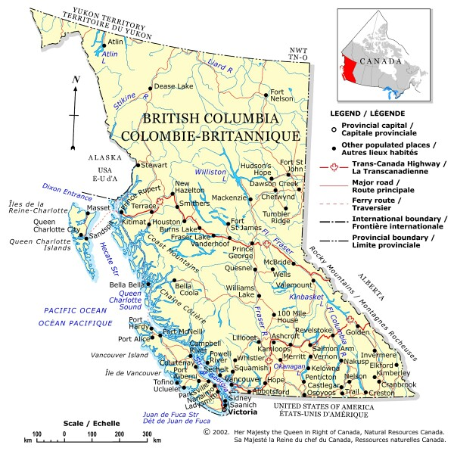
British Columbia
Vancouver
Total Population: 2,236,068
evangelical churches: 684
People per Church: 3,269
Victoria
Total Population: 334,332
evangelical churches: 91
People per Church: 3,674
Abbotsford
Total Population: 161, 911
evangelical churches: 105
People per Church: 1,542
Source: Lorne Hunter, Outreach Canada
Map: Natural Resources Canada
Presentation by: The Church Planting Center, The Southern Baptist Theological Seminary, 2009

