Slide 1
Reaching the Strangers Next Door
Providence Baptist Church
J. D. Payne
Notes:
Providence Baptist Church, Huntsville, AL October 28-29, 2022
Theology Conference
J. D. Payne

Slide 2
Session 1: Migration in the Bible
Session 2: What in the World is God Doing?
Session 3: Stories from the Field
Session 4: Our Response

Slide 3
Session 1: Migration in the Bible
Session 2: What in the World is God Doing?
Session 3: Stories from the Field
Session 4: Our Response

Slide 4
Reaching the Strangers Next Door:
Migration in the Bible
Providence Baptist Church
J. D. Payne
Notes:
Providence Baptist Church, Huntsville, AL October 28-29, 2022
Theology Conference
J. D. Payne

Slide 5



Slide 6




Slide 7



Slide 8
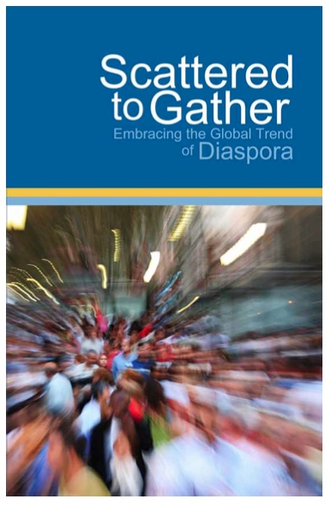


Slide 9


Slide 10
WORDS TO KNOW

Slide 11
Migration
Migrant
Immigration
Emigration
Refugee
Asylum Seeker

Slide 12
3.6%
281 Million
Notes:
IOM 2020 international migration estimate.
Estimate has increased over the past five decades

Slide 13
Acts 17:26-27

Slide 14
DIVINE MAESTRO

Slide 15
Migration
BEFORE THE FALL (Gen 1:18)
FROM THE GARDEN (Gen 3:22-24)
OF CAIN (Gen 4:12, 16)
AFTER THE FLOOD (Gen 9:1; 10:5, 6, 11, 15-19, 30, 32)
AFTER BABEL (Gen 11:1-2, 6-9)

Slide 16
ABRAHAM, ISAAC, JACOB (Gen 11:31; 15:13-16)
JOSEPH: THROUGH SLAVE TRADE (Gen 37; 45:7-8; 50:20)

Slide 17
EXODUS TO PROMISED LAND (Exodus, Numbers, Joshua)
RUTH (Ruth 1:1-2, 6-8)

Slide 18
ISRAEL TO ASSYRIA (722 BC)
(Isa 10:21-27)
ISRAEL TO BABYLON (587 BC)
(Jer 29:10-11, 14)
BABYLON TO ISRAEL (538 BC)
(2 Chr 36:22-23)

Slide 19
BIRTH OF JESUS (Luke 2:1-7; Matt 2:15, 23; cf. Hos 11:1)
JERUSALEM PERSECUTION (Acts 8:1-3; 11:19-21)

Slide 20
PAUL’S MISSIONARY JOURNEYS TO SYNAGOGUES (Acts 13:5, 14; 14:1, 17:1)
ATHEN’S SERMON (Acts 17:26-27)

Slide 21
BELIEVERS OF THE DISPERSION (Heb 11:13-16; Jas 1:1; 1 Pet 1:1; 2:11)
JOHN’S EXILE (Rev 1:9)

Slide 22
DIVINE MAESTRO

Slide 24
Session 1: Migration in the Bible
Session 2: What in the World is God Doing?
Session 3: Stories from the Field
Session 4: Our Response

Slide 25
Reaching the Strangers Next Door:
What in the World is God Doing?
Providence Baptist Church
J. D. Payne
Notes:
Providence Baptist Church, Huntsville, AL October 28-29, 2022
Theology Conference
J. D. Payne

Slide 26
1500-1850 European Colonialism and African Slave Trade Era
1850-1945 Industrial Era
1945-Present Post-Industrial Global Migrations Era

Slide 27
1500-1850 European Colonialism and African Slave Trade Era
Growth in mobility, economics, territories
“Christianize and Civilize”
400 years of Atlantic Slave Trade (11-13 million forced to the West)
1776: 10% of the 13 colonies were Irish
1800-1860: 66% British 22% German in US

Slide 28
1850-1945 Industrial Era
Massive European Waves
1750-1945: 35 million arrive in U.S.
40 million U.S. citizens can trace ancestry to 7 million Irish
1850-1914: Most from Ireland, Italy, Spain, Eastern Europe
By WWI 21% ethnic Europeans living outside of their homelands, only 4% in 1800
U.S. had mostly an open policy in 18th and 19th centuries

Slide 29
1945-Present Post Industrial Global Migrations Era
Contributors: travel, communication, fall of Communism, famine, wars, ethnic cleansing
Age of the Refugee
1950 United Nations High Commissioner for Refugees
Age of Migration

Slide 30
By the early 21st century:
  The Netherlands had approximately 200,000 people from each of the following countries: Surinam, Indonesia, and Turkey.
  In Spain, Moroccans numbered 310,000
  The U.K.’s Indian population was at 1 million; South Africans, Kenyans, and Nigerians numbered 100,000.

Slide 31
By the early 21st century:
  Italy had 200,000 people from the former Yugoslavia and 155,000 Moroccans.
  Belgium had 100,000 from Morocco, 70,000 from Turkey, and 40,000 from the Congo
  In France, migrants from Algeria, Morocco, and Tunisia numbered 2.3 million.

Slide 32
The largest nationalities granted British citizenship in 2010 were Indian (29,405), Pakistani (22,054), Filipino (9,429), Bangladeshi (7,966), and Chinese (7,581).
The proportions of babies born to mothers from outside the UK recently reached a record high of 24.7%.

Slide 33
Global Migration Trends
Between 1990-2010, the more developed countries gained 45 million international migrants, an increase of 55%.
By 2010, Europe hosted almost 70 million international migrants, 1/3 of the global total. Asia hosted 61 million. Northern America hosted 50 million.

Slide 34
Global Migration Trends
The increase of migrant stock between 2000-2010 was the highest in Northern America (24%), Europe (21%), and Oceania (20%).
Between 2000-2010, nine countries gained over a million international migrants: United States (8.0 million), Spain (4.6 million), Italy (2.3 million), Saudi Arabia (2.2 million), the United Kingdom (1.7 million), Canada (1.6 million), the Syrian Arab Republic (1.3 million), Jordan (1 million), and the United Arab Emirates (1 million).

Slide 35
Global Migration Trends
In 2010, Asia hosted 10.9 million refugees, making up 66% of the global number of refugees. Africa with 2.6 million (16% of the global population); Europe with 1.6 million refugees (10%); Northern America with 730,000 refugees, and Latin America and the Caribbean hosting 530,000 refugees.
In 2005, countries with at least 20 million inhabitants where international migrants constituted high proportions of the population included Australia (20%), Canada (19%), France (11%), Germany (12%), Saudi Arabia (26%), Spain (11% ), Ukraine (15%), and the United States (13%).

Slide 36
Global Migration Trends
Between 2000-2007, the number of international students more than doubled to over 2 million. The main destination countries were the United States, the United Kingdom, Germany, France and Australia. The greatest percent increases occurred in New Zealand, Korea, the Netherlands, Greece, Spain, Italy, and Ireland.
In 2010, migrants comprised 14.2% of the total population of North America and 12.4% of Western Europe.

Slide 37
Global Migration Trends
In 2010, migrants comprised 22% of the total population in Australia, 21.3% of Canada, 13.5% of the United States, 10.4% of the United Kingdom.
Notes:
As of 2019 US percentage is 13.7%. Highest record was 14.8% in 1890 (Migration Policy Institute).

Slide 38
Remittances
$702 Billion
Notes:
IOM 2020 estimate. It was $126 Billion in 2000. Covid only caused a slight drop

Slide 39
Top 10 Remittance Receiving (Billions)
India $83
China $60
Mexico $43
Philippines $35
Egypt $30
Pakistan $26
France $24
Bangladesh $22
Germany $18
Nigeria $17

Slide 40
Top Remittance Sending Country?
United States ($68 Billion)
Notes:
IOM 2020 estimate by World Bank.
US has been top sender for decades

Slide 41
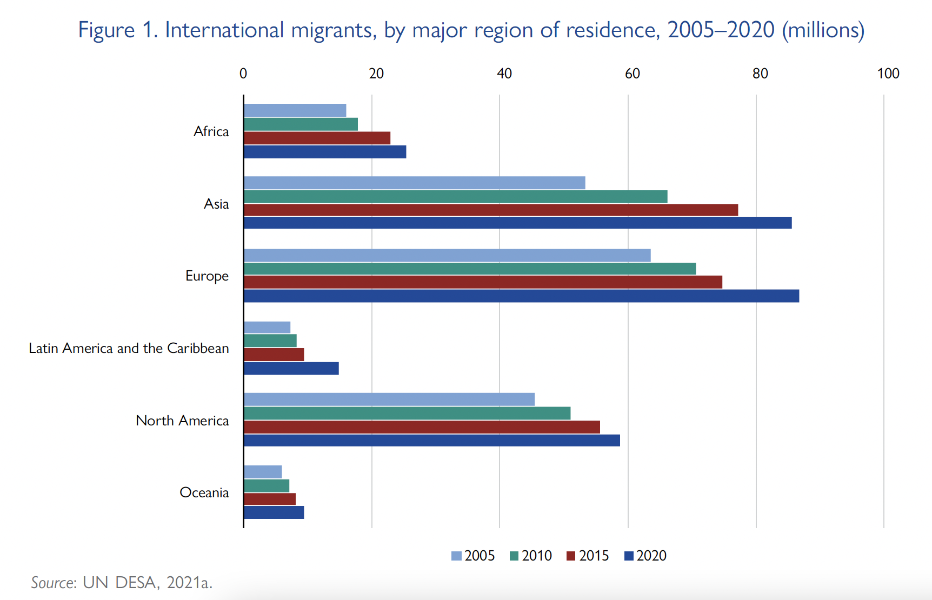

Slide 42
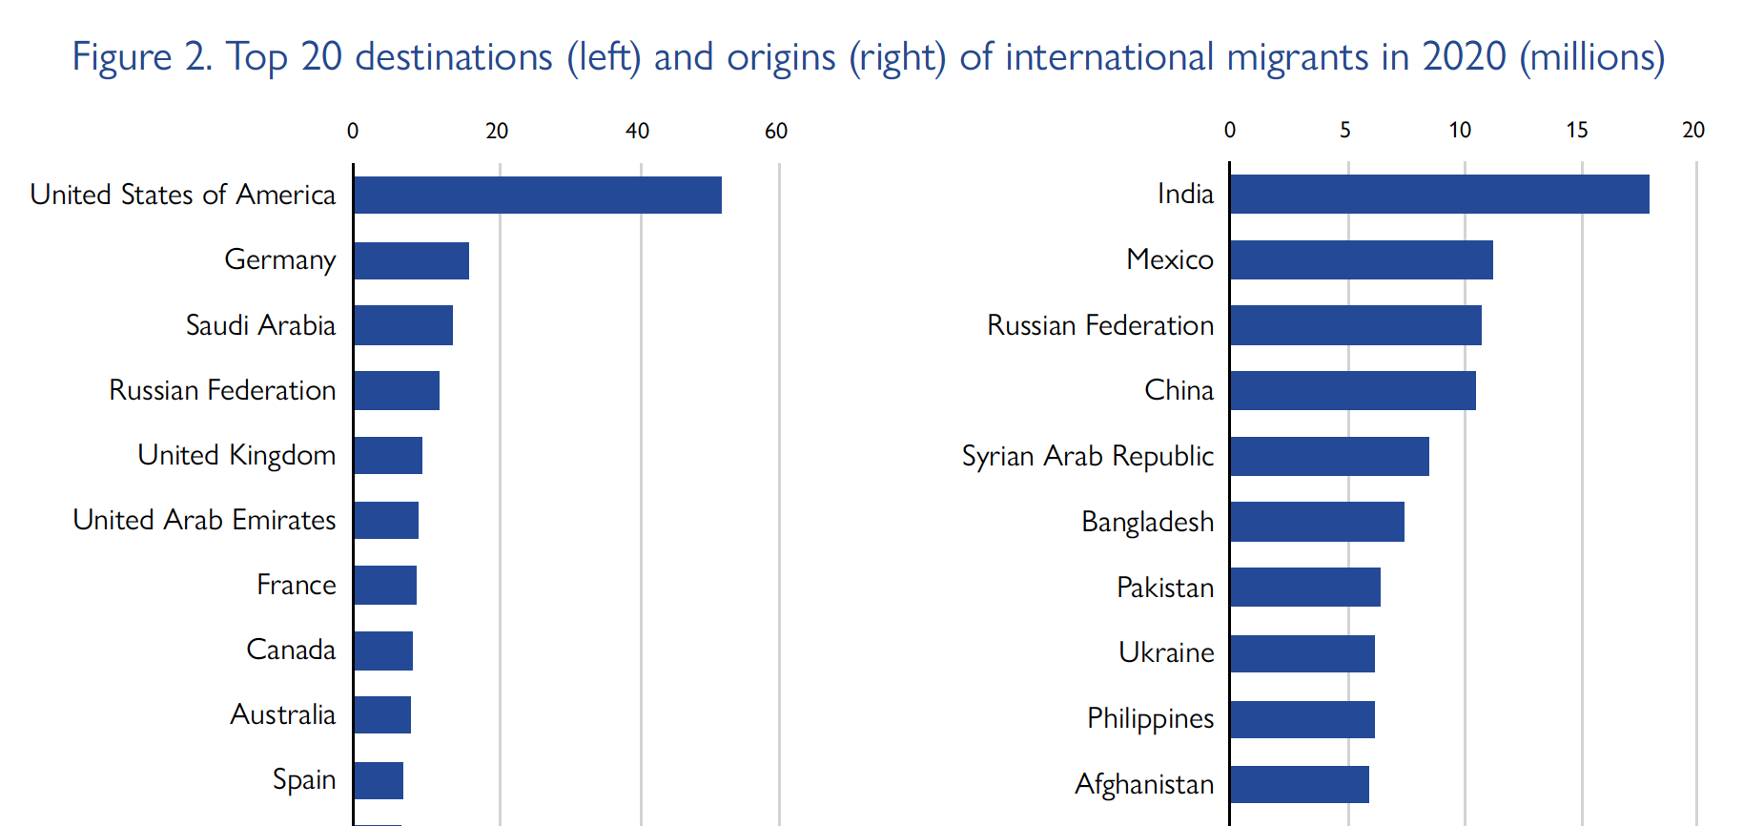
Notes:
Source UN World Migration Report 2022

Slide 43
3.6%
281 Million
Notes:
IOM 2020 international migration estimate.
Estimate has increased over the past five decades

Slide 44
REFUGEES

Slide 45
26.4 Million Refugees
55 Million IDPs
4.1 Million Asylum Seekers
Notes:
UN World Migration Report 2022
55 Million IDPs = 48M due to conflict and violence; 7M due to disasters

Slide 46
NUMBERS IN THE UNITED STATES

Slide 47
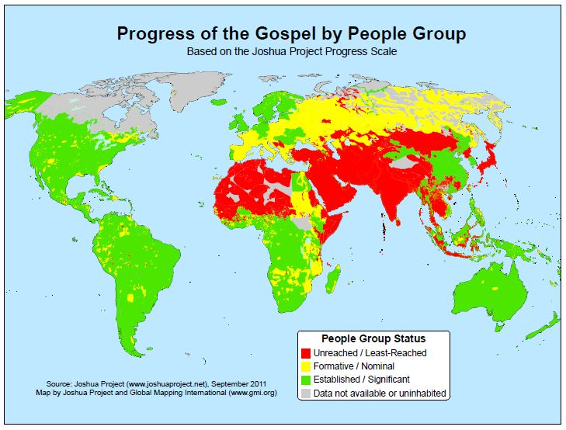
Notes:
Source: Joshua Project

Slide 48
45 million immigrants by 2019 (new record)

Slide 49
Countries with the Highest Numbers of International Migrants, 2020
Country | Foreign-Born Residents (millions)
United States | 50.6
Germany | 15.8
Saudi Arabia | 13.5
Russia | 11.6
United Kingdom | 9.4
UAE | 8.7
France | 8.5
Canada | 8
Australia | 7.7
Spain | 6.8
Notes:
World Population Review

Slide 50
Origins of Immigrants to US
Mexico (24%)
China (6%)
India (6%)
Philippines (5%)
El Salvador (3%)
Vietnam (3%)
Cuba (3%)
Notes:
Percentages of total foreign-born populations 2019. 2019 data from Migration Policy Institute

Slide 51
2019 Increase of Groups with at least 100,000
Venezuela (153%)
Afghanistan (143%)
Nepal (140%)
Myanmar (Burma) (84%)
Nigeria (79%)
Notes:
Among groups with at least 100,000 immigrants in the US in 2019. Migration Policy Institute

Slide 52
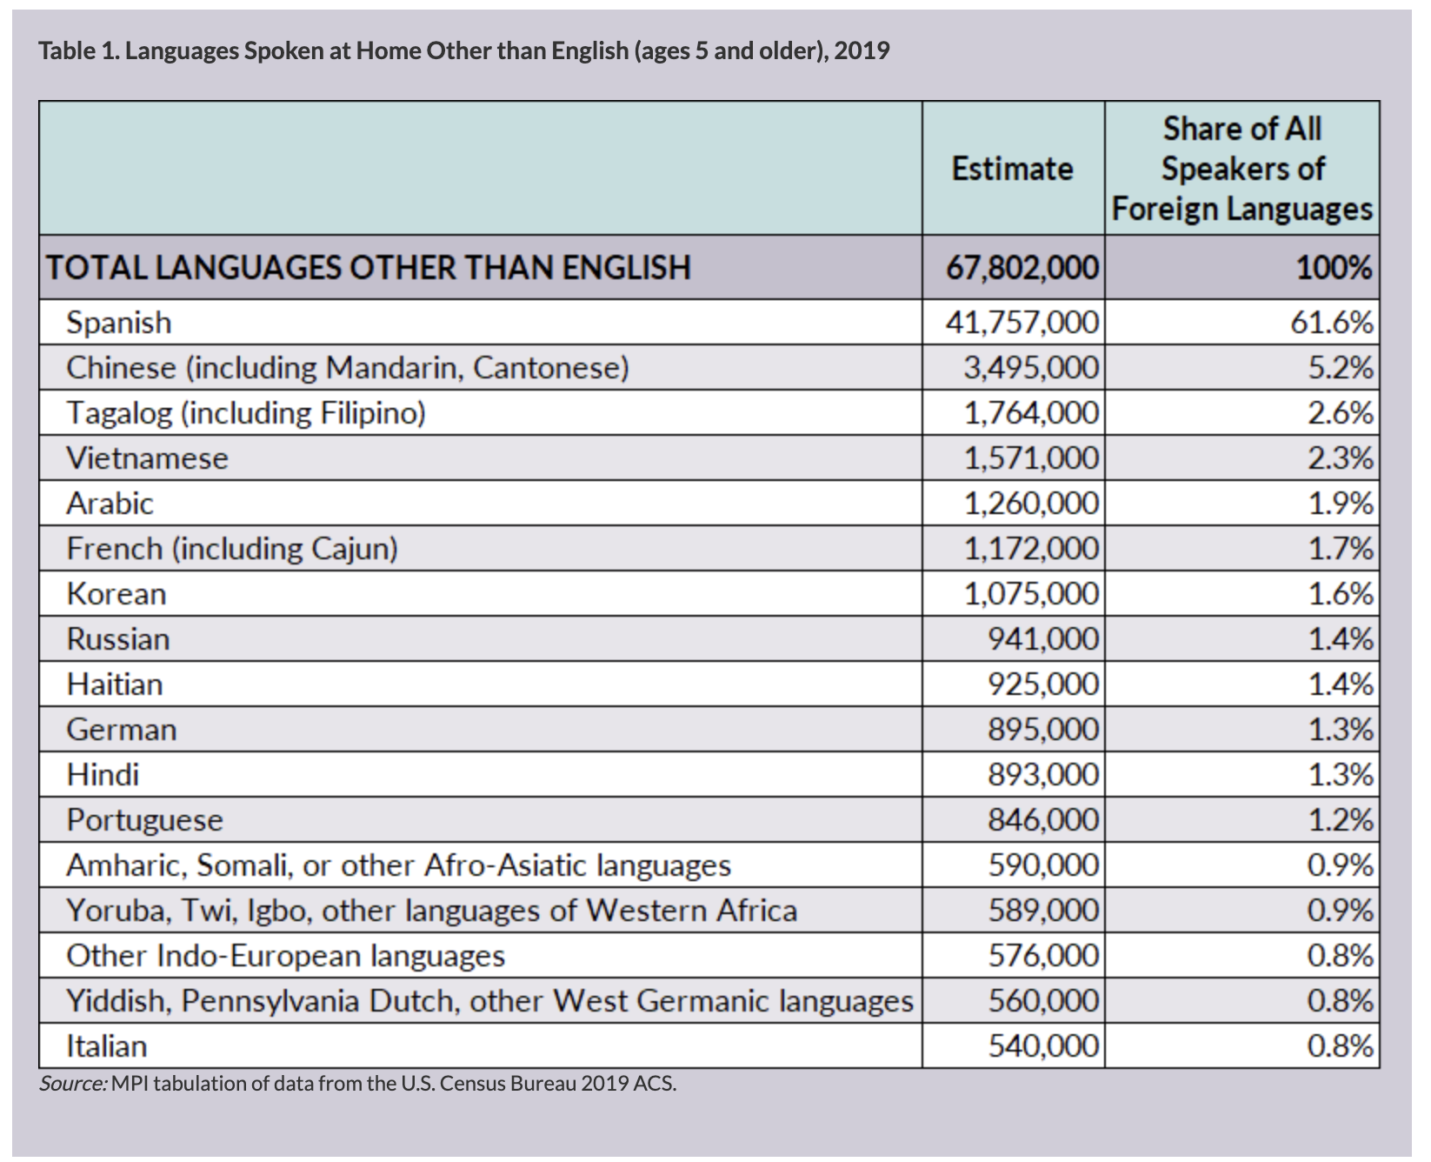
Notes:
Migration Policy Institute

Slide 53
REFUGEES IN THE US

Slide 54
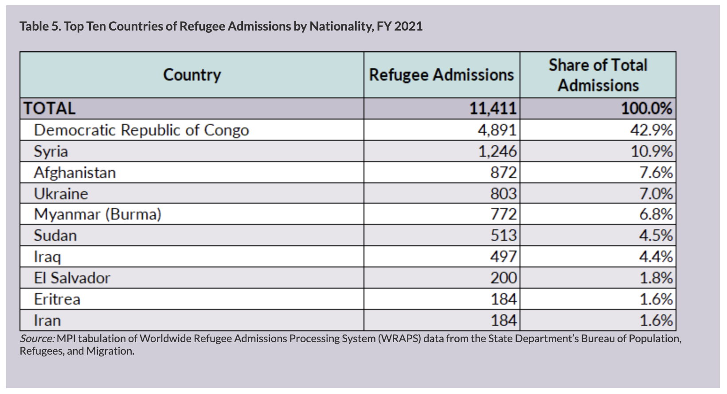
Notes:
Refugee cap in 2021 was 62,500. The 2022 cap is 125,000. Refugees from the Ukraine are starting to come to the US. Source: Migration Policy Institute.

Slide 55
REFUGEES TO US IN 2021 by Religion
74% Christian
22% Muslim
1% Buddhist
1% Atheist or No Affiliation
<1% Hindu

Slide 56
INTERNATIONAL STUDENTS

Slide 57
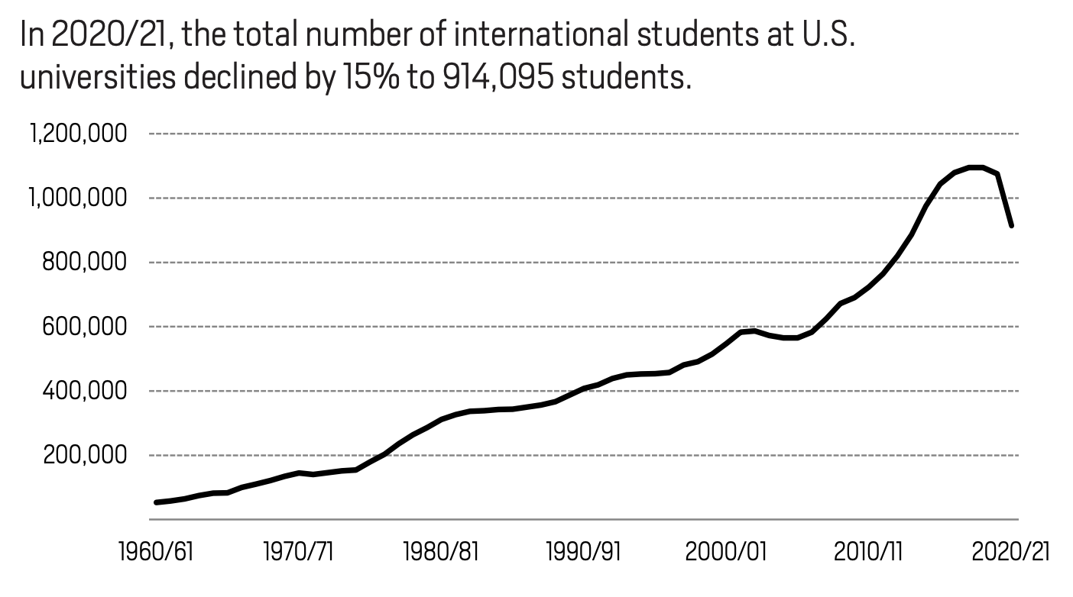
Notes:
Open Doors Fast Facts 2021

Slide 58
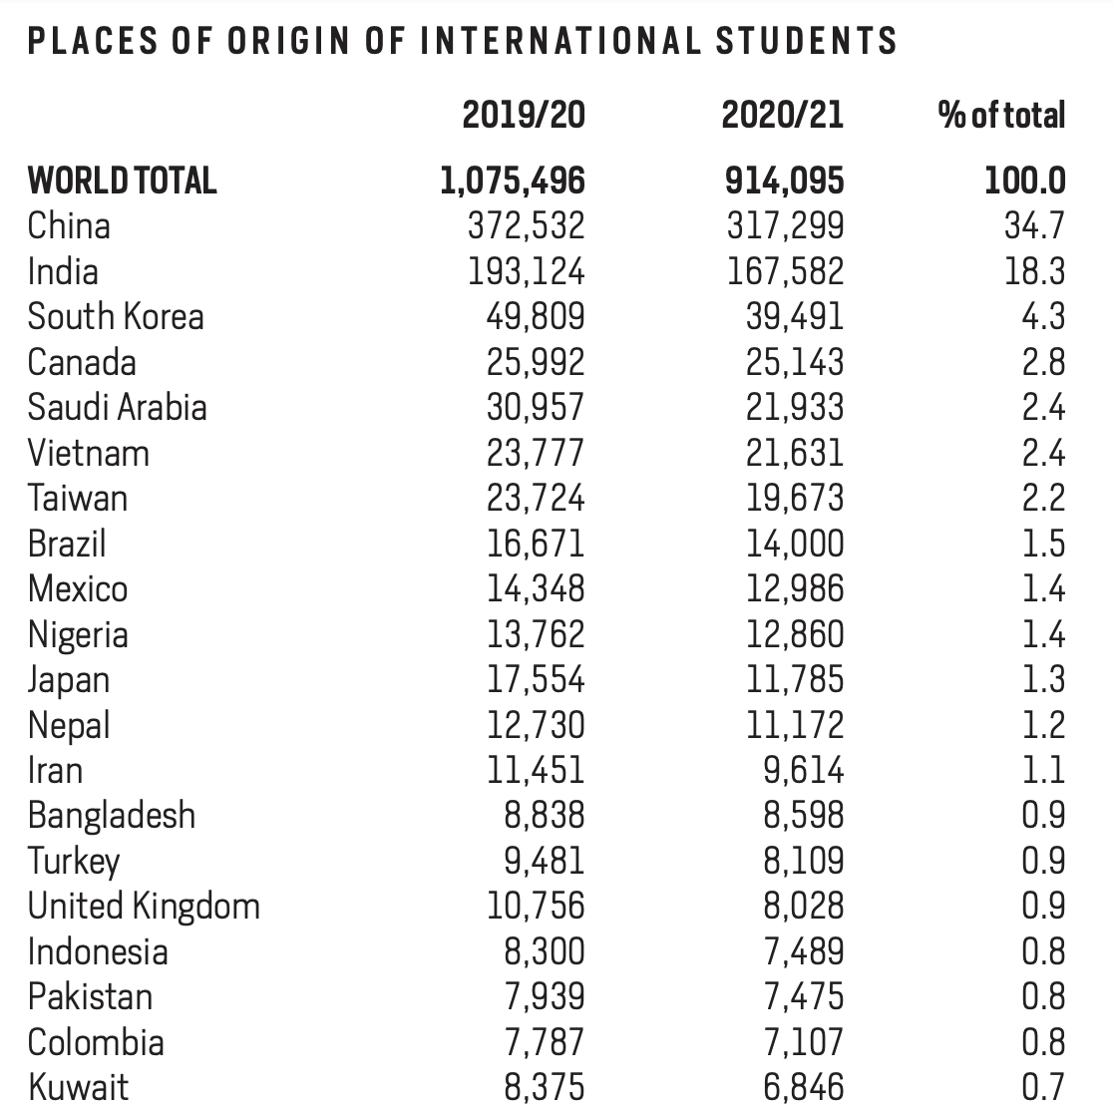
Notes:
Open Doors Fast Facts 2021

Slide 59
Notes:
Source: Joshua Project

Slide 60
The World’s Unreached in the West

Slide 61
World’s Peoples
Global People Groups: 12,016
Unreached People Groups: 7,218
Notes:
Peoplegroups.org, October 27, 2022

Slide 62
“Unreached”?

Slide 63
“Unengaged-Unreached”?

Slide 64
How Many UPGs in the West?

Slide 65
1,173
Notes:
Strangers Next Door, © 2012

Slide 66
How Many UPGs and UUPGs in the United States?

Slide 67
UPGs | 186
UUPGs | 97
Notes:
PEOPLEGROUPS.ORG, October 28, 2022

Slide 68
Countries with the Largest Numbers of UPGs

Slide 69
India 1867
China 332
United States 186
Brazil 176
Congo (Kinshasa) 162
Indonesia 158
Nepal 155
Nigeria 129
Sudan 126
Cameroon 117

Slide 70
Acts 17:26-27

Slide 71
Notes:
Source: Global Research

Slide 72
Session 1: Migration in the Bible
Session 2: What in the World is God Doing?
Session 3: Stories from the Field
Session 4: Our Response

Slide 73
Reaching the Strangers Next Door: Stories from the Field
Providence Baptist Church
J. D. Payne
Notes:
Providence Baptist Church, Huntsville, AL October 28-29, 2022
Theology Conference
J. D. Payne

Slide 74
Acts 17:26-27

Slide 75
Samuel and Young Cho

Slide 76
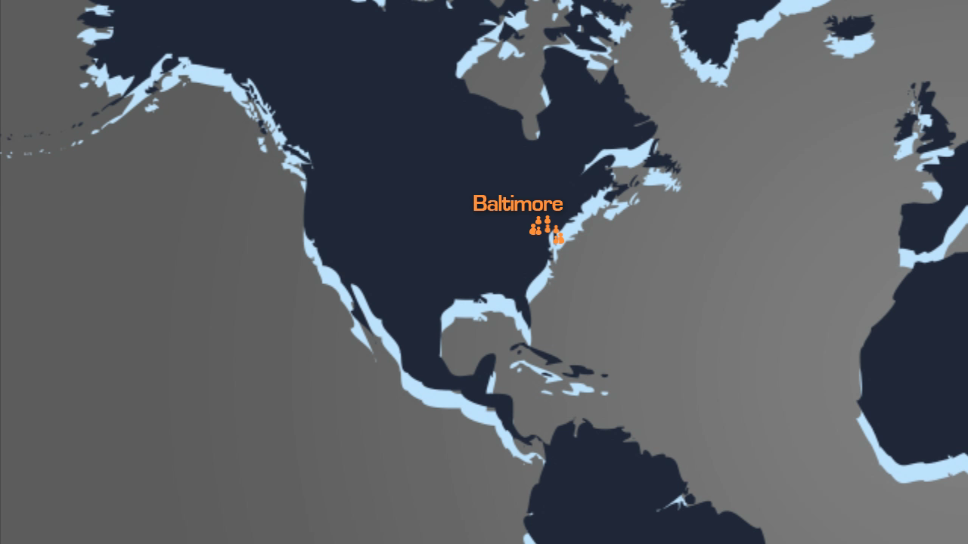

Slide 77


Slide 78
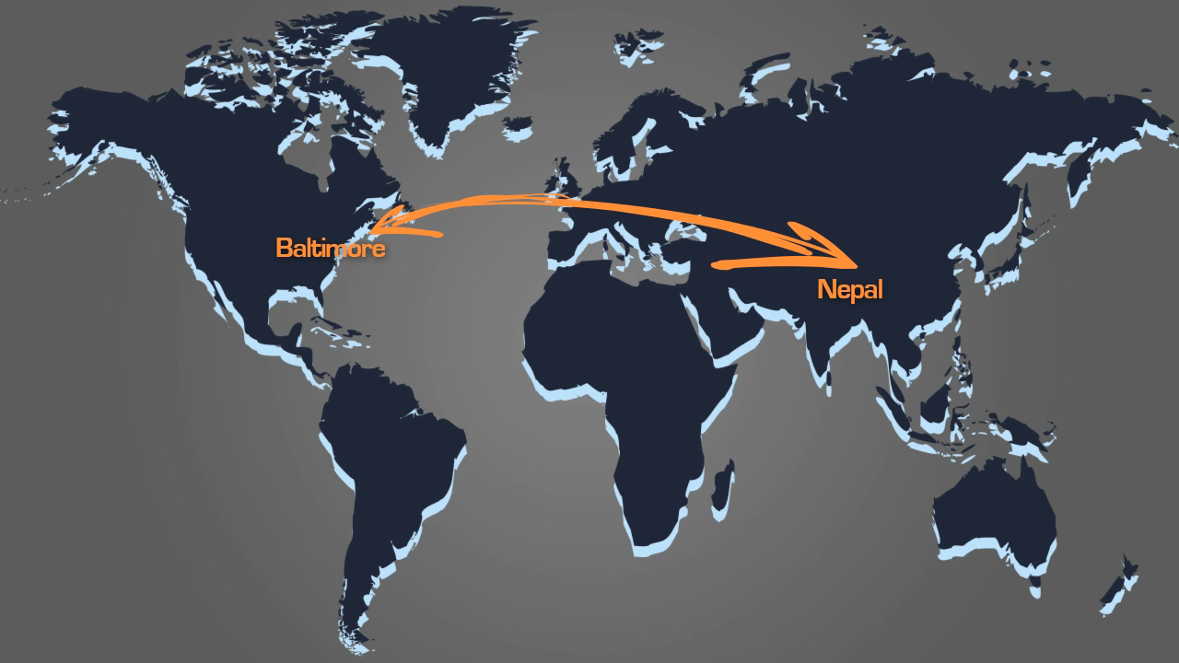

Slide 79
Samuel and Young
Server

Slide 80
Mejra

Slide 81
Rain

Slide 82
”Stay with me in Nepal”

Slide 83
”Be My Wedding Guest in India?”

Slide 84
”Come Teach English in My Nail Salon”

Slide 85
Jay

Slide 86
Are Mr. Singh and Auntie the Strangers Next Door to You?
Notes:
Strangers Next Door, page 35

Slide 87
West Africa from New York

Slide 88
David Boyd
Notes:
Strangers Next Door, page 118

Slide 89
Starbucks Drinking Saudis

Slide 90
Yemeni Mosque

Slide 91
Acts 17:26-27

Slide 93
Session 1: Migration in the Bible
Session 2: What in the World is God Doing?
Session 3: Stories from the Field
Session 4: Our Response

Slide 94
Reaching the Strangers Next Door: Our Response
Providence Baptist Church
J. D. Payne
Notes:
Providence Baptist Church, Huntsville, AL October 28-29, 2022
Theology Conference
J. D. Payne

Slide 95
Guidelines for Reaching the Strangers Next Door

Slide 96
Pray, Pray, Pray
Notes:
Chapter 1 Pg 6-8

Slide 97
peoplegroups.info
peoplegroups.org
Notes:
Chapter 1 Pg 6-8

Slide 98
Be Intentional
Notes:
Chapter 1 Pg 6-8

Slide 99
Learn As You Go
Notes:
Chapter 1 Pg 6-8

Slide 100
Be Prepared to Make Mistakes

Slide 101
Work through Social Networks
Notes:
Chapter 1 Pg 6-8

Slide 102
Start with the Most Receptive
Notes:
Chapter 1 Pg 6-8

Slide 103
Understand Cultural and Generational Differences
Notes:
Chapter 1 Pg 6-8

Slide 104
Try Different Methods
Notes:
Chapter 1 Pg 6-8

Slide 105
Practice Evangelism That Results In New Churches
Notes:
Chapter 1 Pg 6-8

Slide 106
Partner with Ministries Already Engaged
Notes:
Chapter 1 Pg 6-8

Slide 107
Partner with Returning Missionaries
Notes:
Chapter 1 Pg 6-8

Slide 108
Strategy for Reaching the Strangers Next Door

Slide 109
R.E.P.S.

Slide 110
REACH
EQUIP
PARTNER
SEND

Slide 111
Your Team
Stranger Next Door

Slide 112
Acts 17:26-27

Slide 114
Reaching the Strangers Next Door
Providence Baptist Church
J. D. Payne
Notes:
Providence Baptist Church, Huntsville, AL October 28-29, 2022
Theology Conference
J. D. Payne

